Slide 1
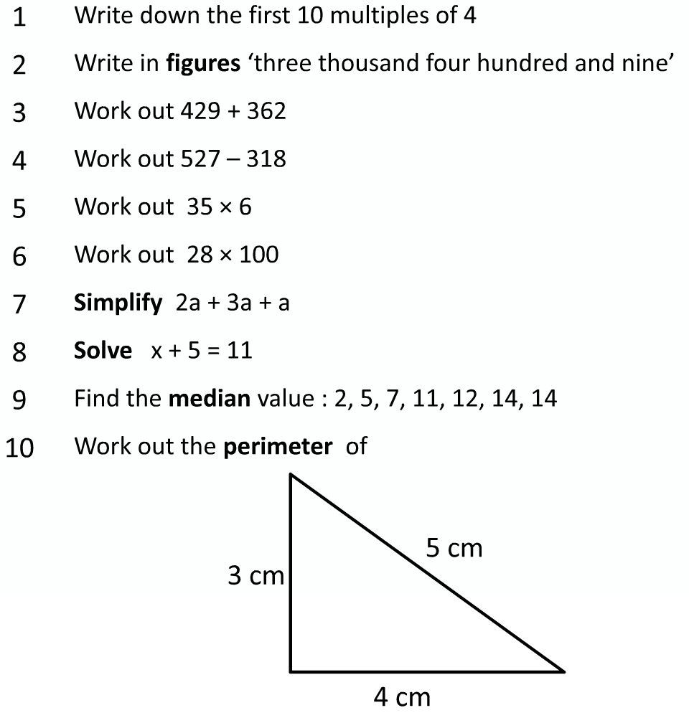
Congruency
LO: Can I identify congruent shapes?

Slide 2
Congruency
Congruent means identical in shape.
If any shape looks the same by size, then they are said to be congruent. From the shapes below, circle which ones are congruent

Slide 3
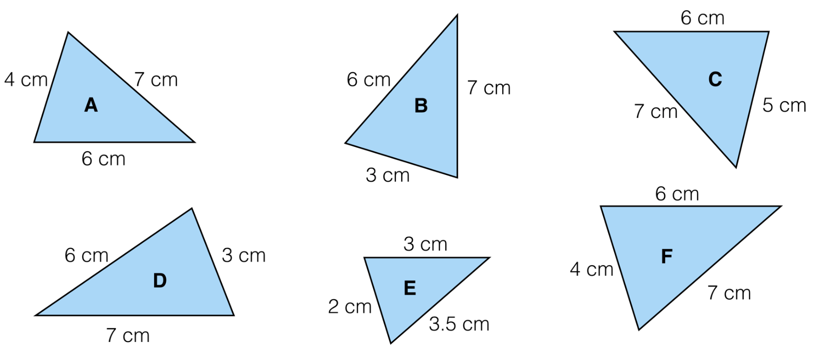
Congruency
Look at the triangles below and see which ones you think are congruent.
This is known as Side, Side, Side (SSS). If all the sides are the same, then the triangles must be identical

Slide 4
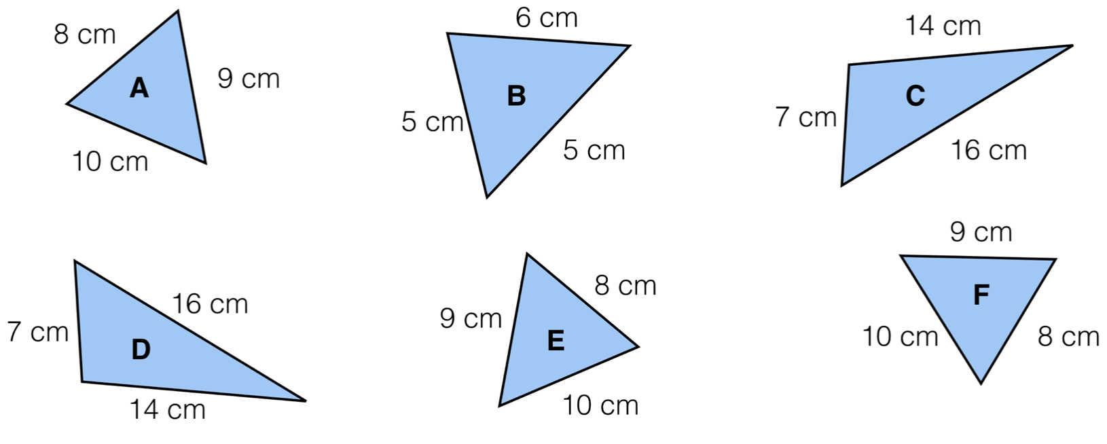
Questions

Slide 5
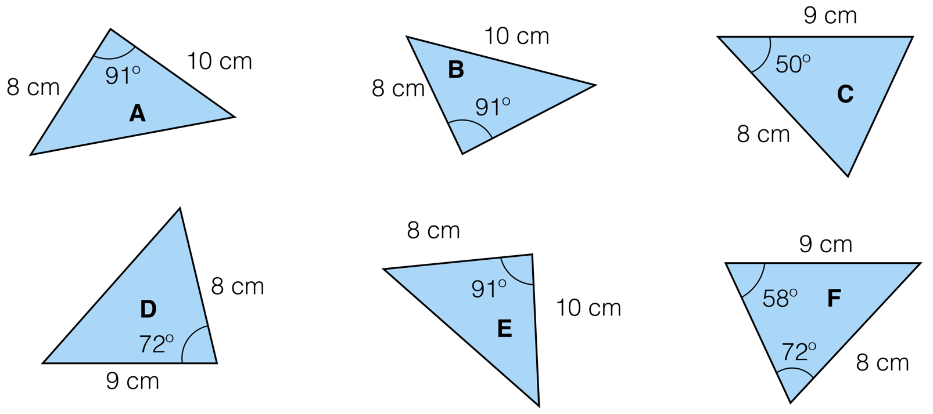
Next properties
There is more than one way to show if two triangles are congruent. We can look at some angles too.
Degrees in a triangle?

Slide 6
More examples
SAS
This is when you have two sides the same and the angle between them the same.
ASA
This is when you have two angles and the side joining them are the same

Slide 7
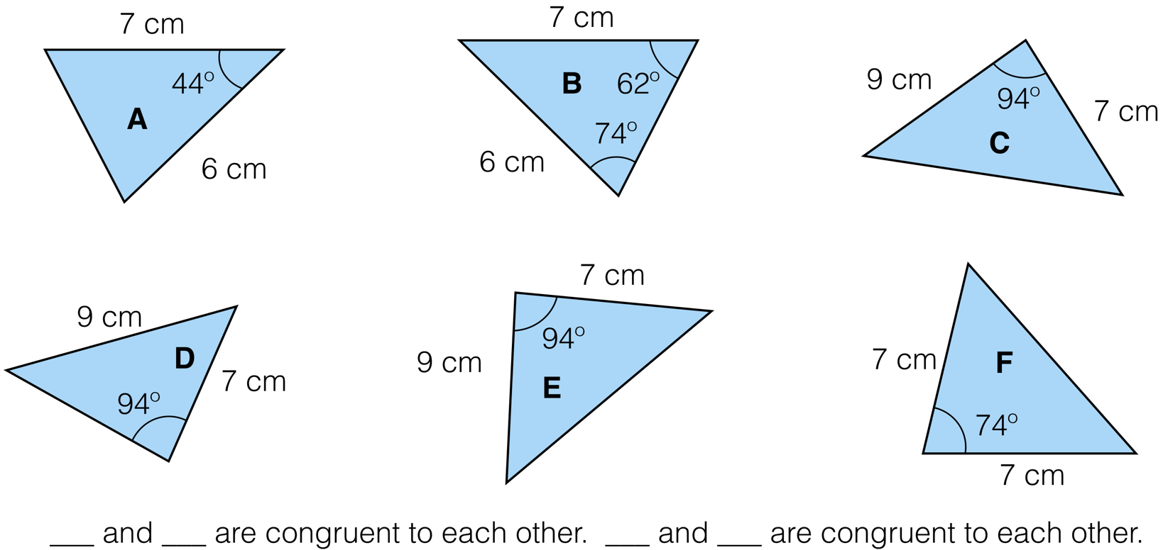
Questions

Slide 8
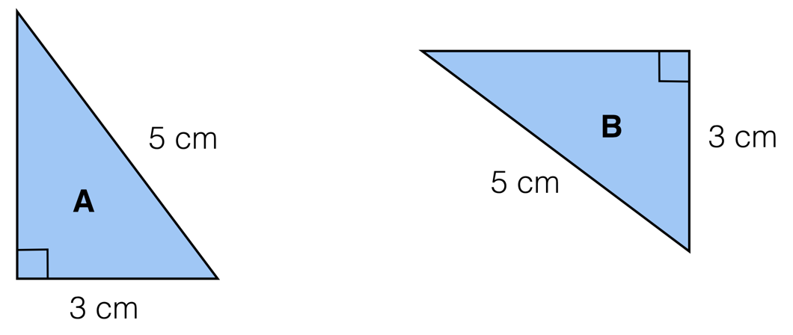
Final property
Last one is called Right angle, Hypothenuse, Side (RHS).

Slide 9
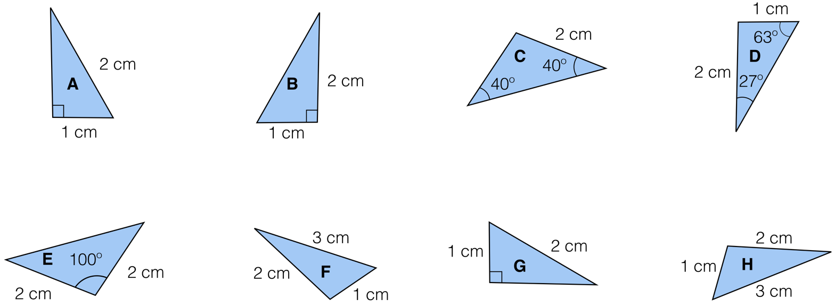
Questions

Slide 10
Notes and summary
SSS (side, side, side)
All three corresponding sides are equal in length
SAS (side, angle, side)
A pair of corresponding sides and the included angle are equal
ASA (angle, side, angle)
A pair of corresponding angles and the included side are equal
RHS (right angle, hypotenuse, side)
One right angle with a side and the longest side the same

Slide 11
Examples of exam questions

Slide 12
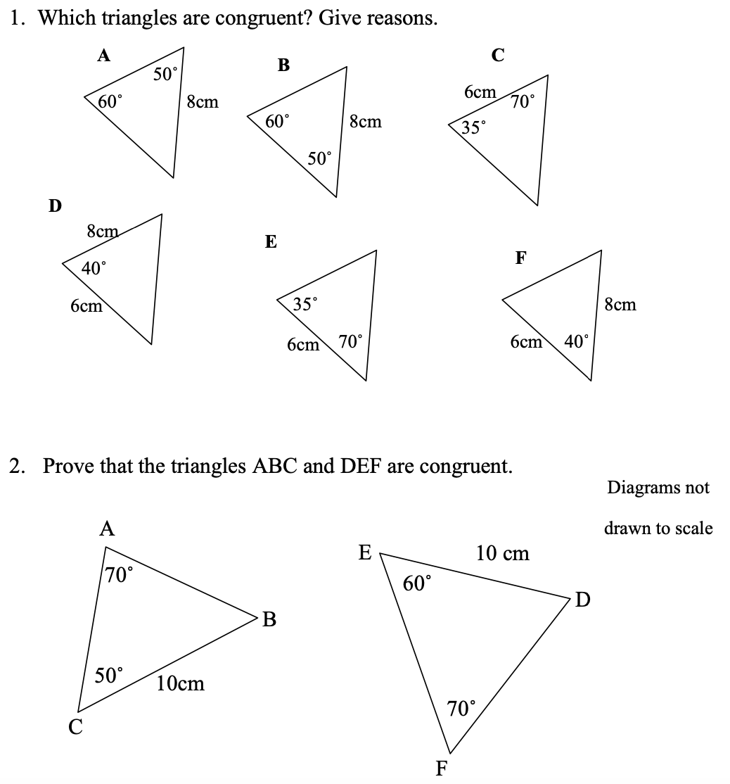
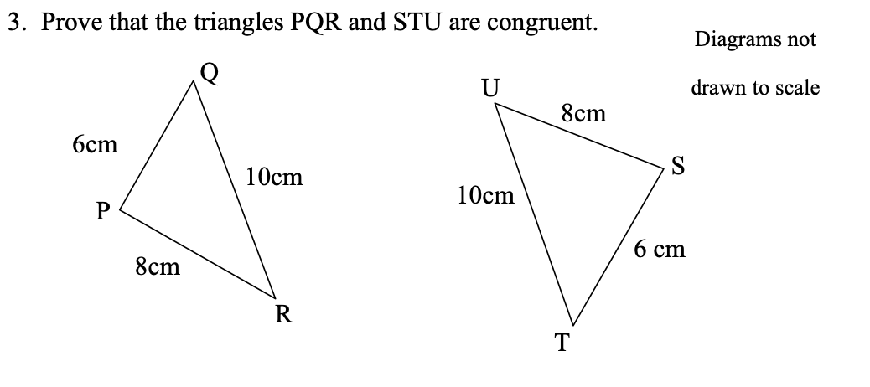
Questions

Slide 13
Booklet

