Slide 1
Circle Theorem 1
The angle at the centre is twice the angle at the circumference.
When they are subtended by the same arc
$$2x$$
Subtended: The angle made by a line, arc or object
$$x$$
Aim: Prove and use circle theorems

Slide 2
$$A$$
$$B$$
$$80°$$
$$O$$
$$40°$$
$$x°$$
$$C$$
Aim: Prove and use circle theorems

Slide 3
$$A$$
$$84°$$
$$B$$
$$x°$$
$$O$$
$$42°$$
$$C$$
Aim: Prove and use circle theorems

Slide 4
$$A$$
$$60°$$
$$x°$$
$$O$$
$$B$$
$$30°$$
$$C$$
Aim: Prove and use circle theorems

Slide 5
$$220°$$
$$O$$
$$A$$
$$B$$
$$110°$$
$$x°$$
$$C$$
Aim: Prove and use circle theorems

Slide 6
1
3
Sketch the diagram and work out the value of angles x and y. State reason for your answer.
Sketch the diagram and work out the value of angle a. State a reason for your answer.
2
Sketch the diagram and work out the size of the reflex angle AOB. State reasons for your answer.
Aim: Prove and use circle theorems

Slide 7
1
$$52°$$
Sketch the diagram and work out the value of angle a. State a reason for your answer.
The angle at the centre is twice the angle at the circumference (when subtended from the same arc)
Aim: Prove and use circle theorems

Slide 8
$$92°$$
2
$$46°$$
Sketch the diagram and work out the size of the reflex angle AOB. State reasons for your answer.
Angles on a straight line sum to 180º
The angle at the centre is twice the angle at the circumference (when subtended from the same arc)
Aim: Prove and use circle theorems

Slide 9
3
$$220°$$
$$140°$$
Sketch the diagram and work out the value of angles x and y. State reason for your answer.
$$110°$$
The angle at the centre is twice the angle at the circumference (when subtended from the same arc)
Angles around a point sum to 360º
Aim: Prove and use circle theorems

Slide 10
Circle Theorem 2
Every angle subtended at the circumference of a semicircle by the diameter is a right angle
Angle in a semi circle
Aim: Prove and use circle theorems

Slide 11
Can you spot the link?
$$90°$$
$$180°$$
Aim: Prove and use circle theorems

Slide 12
1
2
Sketch the diagram:
work out the size of the angle BAD. State reasons for your answer.
work out the size of the angle CBD. State reasons for your answer.
Sketch the diagram:
work out the size of the angle ACB. State reasons for your answer.
work out the size of the angle DBC. State reasons for your answer.
work out the size of the angle BOA. State reasons for your answer.

Slide 13
1
Sketch the diagram:
work out the size of the angle BAD. State reasons for your answer.
work out the size of the angle CBD. State reasons for your answer.
Angle subtended at the circumference of a semicircle by a diameter is a right angle.
$$35°$$
$$110°$$
Angles on a straight line sum to 180 º
$⊿OCB$ is an Isosceles triangle therefore base angles are equal.
Angles in a triangle sum to 180º
$$∠OBC+ ∠OCB=180−110$$
$$∠OBC+ ∠OCB=70$$
$$∠OBC= ∠OCB=35$$

Slide 14
2
Sketch the diagram:
work out the size of the angle ACB. State reasons for your answer.
work out the size of the angle DBC. State reasons for your answer.
work out the size of the angle BOA. State reasons for your answer.
$$35°$$
$$35°$$
$$110°$$
$$55°$$
Angle subtended at the circumference of a semicircle by a diameter is a right angle.
$⊿OAB$ is Isosceles
$∠OAB= ∠ABO=35$
$$∠ACB=180−90−35$$
$$∠BAO=180−35−35$$
Angles in a triangle sum to 180 º
$∠BAO=110$
$$∠ACB=55$$
Angles on a straight line sum to 180 º
$$∠DBC=180−55=35$$

Slide 15
Circle Theorem 3
Angles subtended at the circumference in the same segment of a circle are equal.
$$x°$$
$$x°$$
$$x°$$
Aim: Prove and use circle theorems

Slide 16
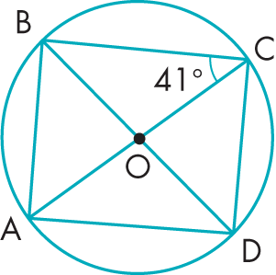
1
2
3
Sketch the diagram:
work out the size of the angle DBC. State reasons for your answer.
work out the size of the angle ACD. State reasons for your answer.
Sketch the diagram:
work out the size of the angle PQR. State reasons for your answer.
work out the size of the angle PRQ. State reasons for your answer.
work out the size of the angle POQ. State reasons for your answer.
Sketch the diagram:
work out the size of the angle ADB. State reasons for your answer.
work out the size of the angle DBA. State reasons for your answer.
work out the size of the angle CAD. State reasons for your answer.

Slide 17
1
Angles subtended at the circumference in the same segment of a circle are equal.
$$20°$$
Sketch the diagram:
work out the size of the angle DBC. State reasons for your answer.
work out the size of the angle ACD. State reasons for your answer.
$$70°$$
Angles subtended at the circumference in a semi circle is a right angle and angles in a triangle sum to 180º

Slide 18
2
Angle at the circumference in a semi-circle is a right angle
Angle at the centre is twice the angle at the circumference
Sketch the diagram:
work out the size of the angle PQR. State reasons for your answer.
work out the size of the angle PRQ. State reasons for your answer.
work out the size of the angle POQ. State reasons for your answer.
$$112°$$
$$90°$$
$$56°$$
Angles subtended at the circumference in the same segment of a circle are equal.

Slide 19
3
$$49°$$
Sketch the diagram:
work out the size of the angle ADB. State reasons for your answer.
work out the size of the angle DBA. State reasons for your answer.
work out the size of the angle CAD. State reasons for your answer.
$$49°$$
$$49°$$
$$41°$$
$$41°$$
Angles subtended in the same segment are equal
Angles subtended at the circumference in a semi circle is a right angle and angles in a triangle sum to 180º
.
Angle subtended at the circumference in a semi circle is a right angle and angles subtended in the same sector are eqaul

Slide 20
Circle Theorem 4
The sum of the opposite angles of a Cyclical Quadrilateral is 180º
$$B$$
$$A$$
$$O$$
$$D$$
$$C$$
Aim: Prove and use circle theorems

Slide 21
Sketch the diagram and then work out the sizes of the lettered angles in each circle.
1
2
3
4
5
6
Aim: Prove and use circle theorems

Slide 22
Sketch the diagram and then work out the sizes of the lettered angles in each circle.
1
$$95°$$
$$50°$$
Aim: Prove and use circle theorems

Slide 23
Sketch the diagram and then work out the sizes of the lettered angles in each circle.
2
$$90°$$
$$92°$$
$$90°$$
Aim: Prove and use circle theorems

Slide 24
Sketch the diagram and then work out the sizes of the lettered angles in each circle.
3
Allied angles sum to 180º
$$110°$$
$$110°$$
$$70°$$
Aim: Prove and use circle theorems

Slide 25
Sketch the diagram and then work out the sizes of the lettered angles in each circle.
4
$$91°$$
$$91°$$
$$89°$$
$$89°$$
Aim: Prove and use circle theorems

Slide 26
Sketch the diagram and then work out the sizes of the lettered angles in each circle.
5
Vertically opposite angles are equal
$$60°$$
Angles on a straight line sum to 180º
$$120°$$
$$40°$$
$$40°$$
Aim: Prove and use circle theorems

Slide 27
Sketch the diagram and then work out the sizes of the lettered angles in each circle.
6
Vertically opposite angles are equal
$$68°$$
$$68°$$
$$44°$$
Angles on a straight line sum to 180º
$$136°$$
Isosceles: base angles are equal
$$68°$$
Aim: Prove and use circle theorems

Slide 28
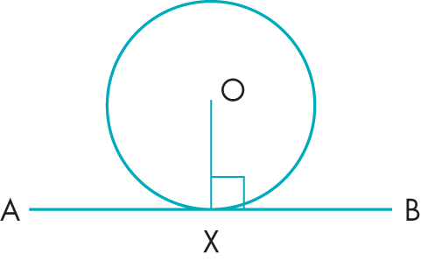
Circle Theorem 5
A tangent to a circle is perpendicular to the radius drawn to the point of contact
Aim: Prove and use circle theorems

Slide 29
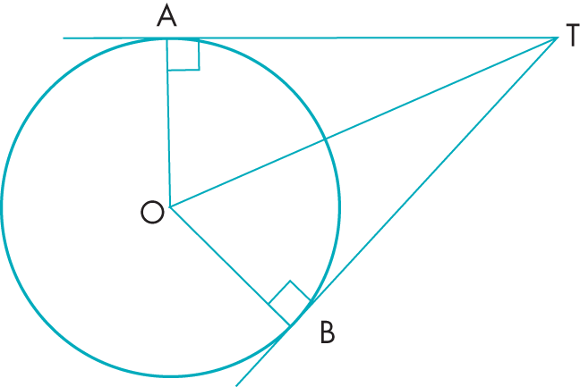
What does ……………………………….. Look like?
Circle Theorem - Tangents
What can you say about AT and BT
$$∠OAT=∠OBT$$
$OT$ is a common side so $⊿OAT$ and $⊿OBT$ are Congruent
So $AT=BT$
$$∠ATO=∠BTO$$
Congruent: The same shape and size. Two shapes are congruent when you can Turn, Flip and/or Slide one so it fits exactly on the other.
Aim: Prove and use circle theorems

Slide 30
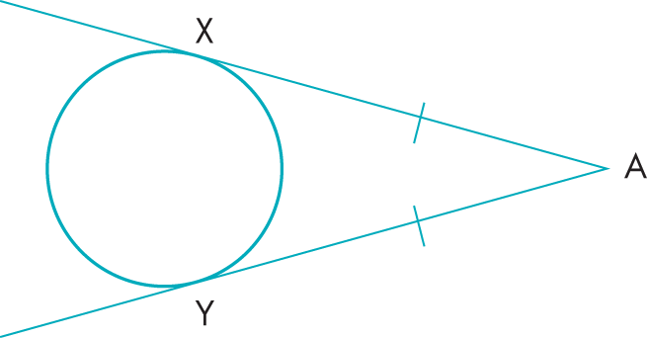
Circle Theorem 6
Tangents to a circle from an external point to the point of contact are equal.
$$AX=AY$$
Aim: Prove and use circle theorems

Slide 31
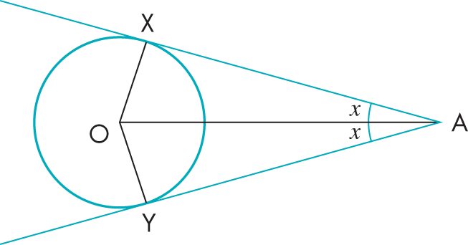
Circle Theorem 7
The line joining an external point to the centre of the circle bisects the angle between the tangents.
$$∠XAO=∠YAO$$
Aim: Prove and use circle theorems

Slide 32
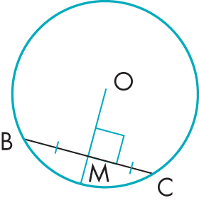
Circle Theorem 8
A radius bisects a chord at 90°.
$$BM=CM$$
Aim: Prove and use circle theorems

Slide 33
What does ……………………………….. Look like?
Circle Theorem - Tangents
Aim: Prove and use circle theorems

Slide 34
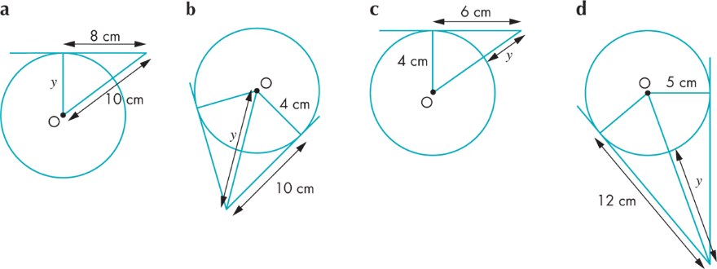
$TP$ and $TQ$ are tangents to a circle with centre $O$. Find the value of $x$
1
2
3
4
Each diagram shows tangents to a circle with centre $O$. Find the value of $x$ and $y$in each case
7
6
8
5
$$c^{2}=a^{2}+b^{2}$$
Aim: Prove and use circle theorems

Slide 35
$TP$ and $TQ$ are tangents to a circle with centre $O$. Find the value of $x$
1
Aim: Prove and use circle theorems

Slide 36
$TP$ and $TQ$ are tangents to a circle with centre $O$. Find the value of $x$
2
Aim: Prove and use circle theorems

Slide 37
$TP$ and $TQ$ are tangents to a circle with centre $O$. Find the value of $x$
3
Aim: Prove and use circle theorems

Slide 38
$TP$ and $TQ$ are tangents to a circle with centre $O$. Find the value of $x$
4
Aim: Prove and use circle theorems

Slide 39
Each diagram shows tangents to a circle with centre $O$. Find the value of $x$ and $y$in each case
5
Aim: Prove and use circle theorems

Slide 40
Each diagram shows tangents to a circle with centre $O$. Find the value of $x$ and $y$in each case
6
Aim: Prove and use circle theorems

Slide 41
Each diagram shows tangents to a circle with centre $O$. Find the value of $x$ and $y$in each case
7
Aim: Prove and use circle theorems

Slide 42
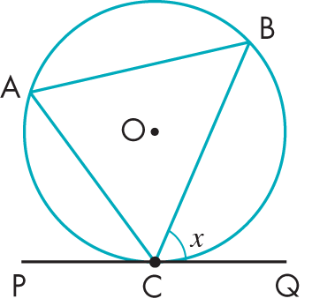
We can use the alternate segment theorem to find the sizes of angles in circles
The segment containing $∠BCQ$ is called the Alternate Segment of $x$ ($∠BCQ$) because it is on the other side of chord $BC$
Aim: Prove and use circle theorems

Slide 43
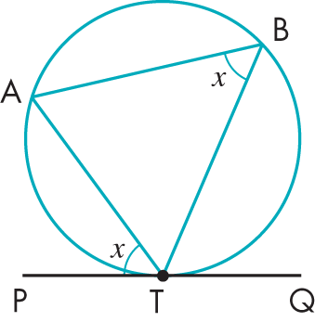
Circle theorem 9
Alternate Segment Theorem.
The angle between a tangent and a chord through the point of contact is equal to the angle in the alternate segment.
Aim: Prove and use circle theorems

Slide 44
What does ……………………………….. Look like?
Alternate Segment Theorem
Aim: Prove and use circle theorems

Slide 45
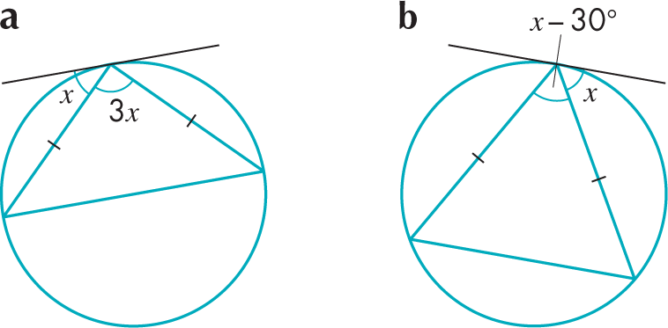
2
Find the lettered angles.
Find the size of the lettered angles
in each diagram.
1
a
b
a
b
3
In each diagram, find the value of x.
a
b
Aim: Prove and use circle theorems

Slide 46
Find the size of the lettered angles
in each diagram.
1
a
b
$$80°$$
$$75°$$
$$40°$$
$$80°$$
$$65°$$
$$52°$$
Aim: Prove and use circle theorems

Slide 47
Find the lettered angles.
2
a
b
$$75°$$
$$75°$$
$$40°$$
$$30°$$
$$40°$$
$$40°$$
$$75°$$
Aim: Prove and use circle theorems

Slide 48
3
In each diagram, find the value of x.
a
b
$$x$$
$$x$$
$$x$$
$$x$$
$$5x=180°$$
$$x$$
$$x=36°$$
$$x$$
$$3x−30=180°$$
$$3x=210°$$
$$x=70°$$
Aim: Prove and use circle theorems

Slide 49
Circle Theorems
On the scrap paper list/draw/sketch as many of the 9 Circle Theorems as you can.
$$x$$
$$2x$$
$$90°$$
$$90°$$

Slide 50
Circle Theorems
On the scrap paper list/draw/sketch as many of the 9 Circle Theorems as you can.
$$x$$
$$x$$
$$c$$
$$x$$
$$x$$
$$b$$
$$2x$$
$$a$$
$$d$$
$$a+b=180°$$
$$90°$$
$$c+d=180°$$
$$90°$$

Slide 51
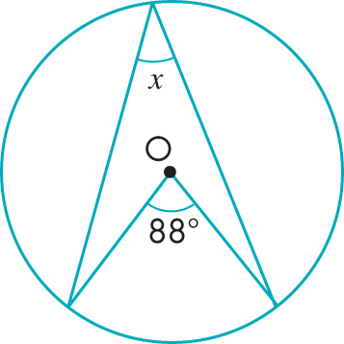
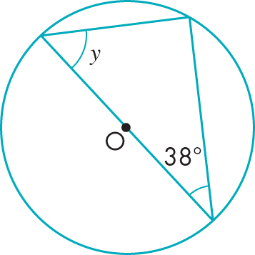
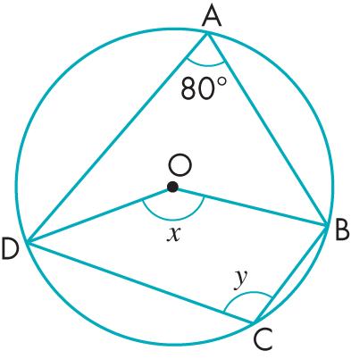
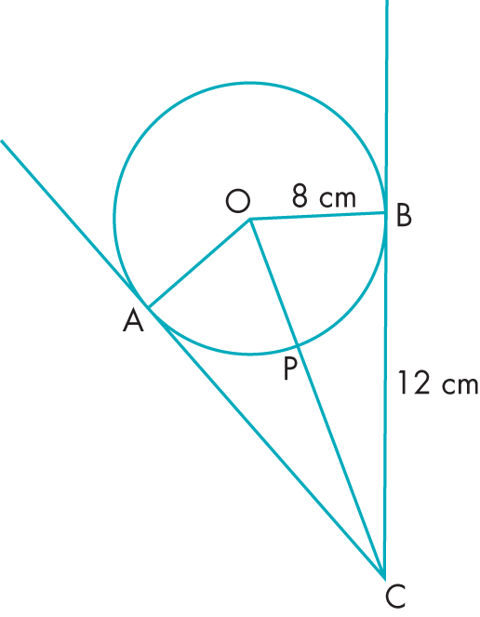
Write down the value of $x$.
Write down the value of y.
1
3
CM
2
4
AC and BC are both tangents to the circle, centre O.
A, B, C and D are all points on the circumference of a circle, centre O.
a. Explain how you know that the value of x is 160°.
b. Give a reason why y is 100°.
Calculate the length of PC. State any assumptions you make.
EV

Slide 52
1
Write down the value of $x$.
Both angles are subtended from the same arc/chord. Angle at the centre is twice the angle at the circumference.
$$44°$$

Slide 53
2
Write down the value of y.
Angle suntended from a diameter, at the circumference is a right-angle.
Angles in a triangle sum to 180º.
$$52°$$

Slide 54
3
A, B, C and D are all points on the circumference of a circle, centre O.
a. Explain how you know that the value of x is 160°.
b. Give a reason why y is 100°.
DOB is twice DAB (Angles subtended from the same arc. Angle at centre is twice angle at the circumference).
DAB and DCB sum to 180o as ABCD is a cyclic quadrilateral (opposite angle sum to 180º).

Slide 55
4
AC and BC are both tangents to the circle, centre O.
Calculate the length of PC. State any assumptions you make.
Radius to a point of contact of a tangent forms a right-angle with the tangent.
Pythagoras’ Theorem.
$$OP=\sqrt{{12}^{2}+8^{2}}$$
$$OP=\sqrt{208}$$
$$OP=14.4 cm (1d.p.)$$
$$PC=14.4−8=6.4 cm$$

Slide 56
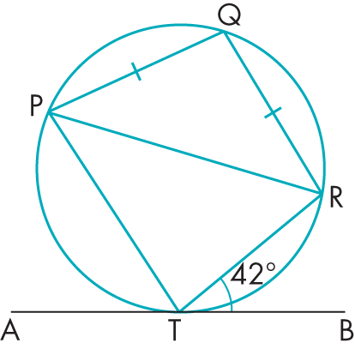
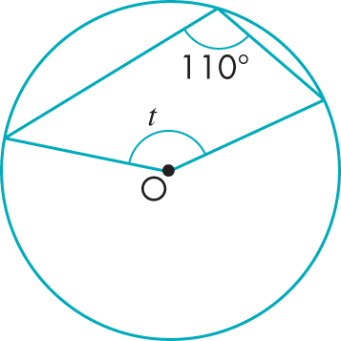
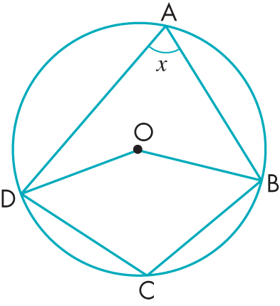
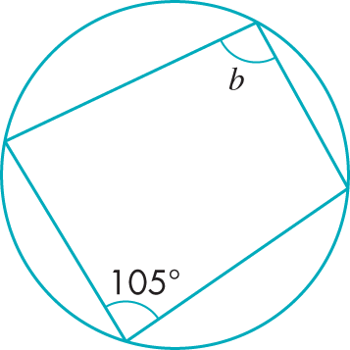
Calculate the value of t, stating any assumptions you have made.
2
PQRT is a cyclic quadrilateral
ATB is a tangent to the circle at point T.
PQ=RQ
∠RTB=42º
If PT is parallel with QR, show that ∠PTR=84º.
1
3
A, B, C and D are all points on the circumference of a circle, centre O.
Show that OBCD could only be a rhombus if x=60º
4
CM
Write down the value of b.

Slide 57
1
Calculate the value of t, stating any assumptions you have made.
Angles subtended from the same arc. Angle at centre is twice angle at the circumference.
Angles around a point sum to 360º.
$$140°$$
$$220°$$

Slide 58
Alternate segment theory.
PQRT is a cyclic quadrilateral
2
ATB is a tangent to the circle at point T.
PQ=RQ
∠RTB=42º
If PT is parallel with QR, show that ∠PTR=84º.
Alternate angle
Base angles (Isosceles)
Internal angle 180º
$$96°$$
$$42°$$
$$42°$$
$$42°$$
Cyclic quadrilateral (opposite angle sum to 180º).
$$84°$$

Slide 59
3
A, B, C and D are all points on the circumference of a circle, centre O.
Show that OBCD could only be a rhombus if x=60º
Rhombus – Equal sides, opposite angles equal, opposite sides parallel
$$2x$$
DOB must equal DCB
$$180−x$$
$$2x=180−x$$
$$3x=180$$
$$x=60$$

Slide 60
4
Write down the value of b.
Cyclic quadrilateral (opposite angle sum to 180º).
$$75°$$

Slide 61
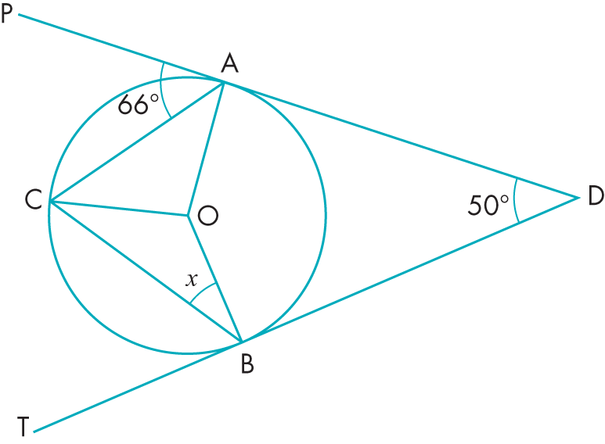
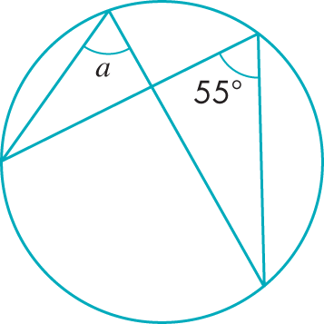
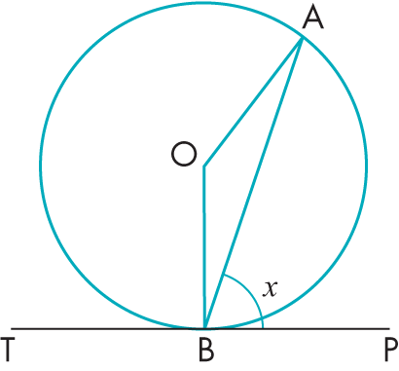
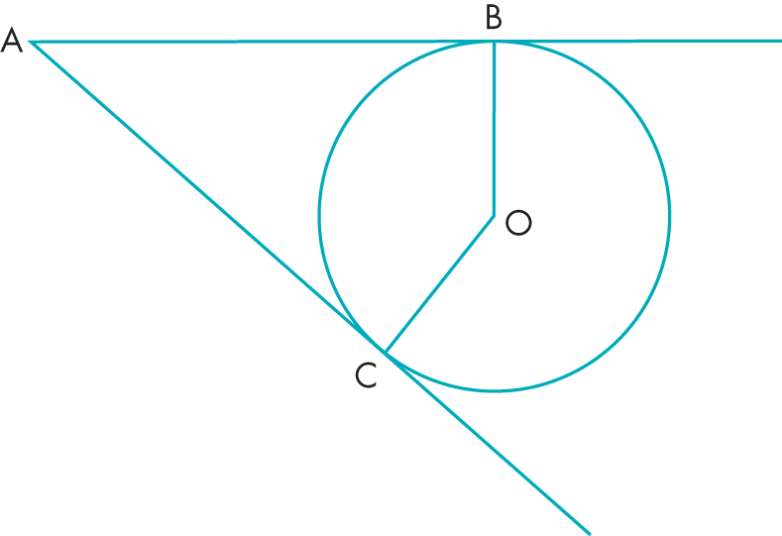
PD and TD are tangents, at A and B respectively, of a circle, centre O.
Write down the value of a.
2
PS
1
Eve calculated x to be 41°.
Show that she is correct.
A and B are two points on the circumference of a circle, centre O.
On the diagram, lines AB and AC are both tangents of a circle, centre O.
3
CM
CM
4
Prove that ∠AOB will always be 2x.
Prove that the quadrilateral ABOC would always be cyclic.

Slide 62
Write down the value of a.
Angles subtended at the circumference in the same segment are equal.
$$55°$$
1

Slide 63
PD and TD are tangents, at A and B respectively, of a circle, centre O.
2
$$24°$$
$$24°$$
$$65°$$
$$25°$$
$$132°$$
$$41°$$
$$25°$$
$$98°$$
$$65°$$
$$41°$$
Eve calculated x to be 41°.
Show that she is correct.

Slide 64
PD and TD are tangents, at A and B respectively, of a circle, centre O.
2
$$24°$$
$$24°$$
$$65°$$
$$41°$$
$$130°$$
$$41°$$
Eve calculated x to be 41°.
Show that she is correct.

Slide 65
3
A and B are two points on the circumference of a circle, centre O.
Prove that ∠AOB will always be 2x.
$$90−x$$
$$180−(90−x)−(90−x)$$
$$180−90+x−90+x$$
$$90−x$$
$$2x$$

Slide 66
4
On the diagram, lines AB and AC are both tangents of a circle, centre O.
Prove that the quadrilateral ABOC would always be cyclic.

