Slide 1
Indices the basics
LO: Can I simplify indices?
Calculate $10−2×5$
Work out the value of $3x+y$ when $x=2$ and $y=5$.
Calculate the area of the triangle.
3 cm
5 cm

Slide 2
Indices
Indices tells you how many times you need to multiply the number.
For example
4³
2⁵
9²

Slide 3
Quick questions
Evaluate the following
12²
7²
4²
10³
11² - 3²

Slide 4
First two rules
To multiply indices you add them.
$$x^{6} × x^{2}= x^{6+2}=x^{8}$$
$$x^{6}=x × x × x × x × x × x$$
$$x^{2}=x × x$$
More examples
$$x^{7} × x^{5}$$
$$x^{10} × x^{6}$$
$$x^{5} × x^{4}× x^{}$$
To divide indices you subtract them
$$x^{6}÷x^{2}$$
$$\frac{x^{6}}{x^{2}}=x^{6−2}=x^{4}$$
$$\frac{x × x × x × x × x × x }{x × x }$$
More examples
$$x^{12} ÷ x^{4}$$
$$x^{9} ÷ x^{3}$$
$$x^{8} × x^{6}÷ x^{}$$

Slide 5
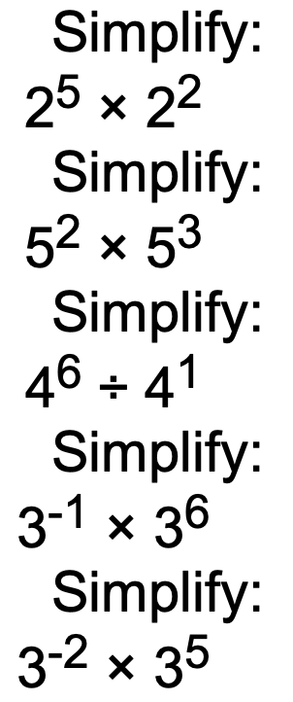
Class questions

Slide 6
Questions

Slide 7
More challenging questions
If there are numbers in front you just multiply these or divide them.

Slide 8
Third rule
When an indices have another index then you multiply them
$${\left(x^{6}\right)}^{3}= x^{6×3}=x^{18}$$
$$x^{6}× x^{6}×{ x}^{6} =x^{18}$$
More examples
$${\left(x^{12}\right)}^{4}$$
$${\left(x^{4}\right)}^{4}$$
$${\left(x^{7}\right)}^{10}$$

Slide 9
Questions

Slide 10
$$x^{7}×x^{15}$$
$${4x}^{5}×3x^{3}$$
$${{(x}^{5})}^{16}$$
$${0.5x}^{3}×8x^{3}$$
$$x^{0.5}×x^{0.5}$$
$${15x}^{4}÷15x^{3}$$
$$x^{12}÷x^{−3}$$
$${12x}^{12}÷4x^{3}$$
$$x^{5}÷x^{5}$$
$${{(2x}^{7})}^{5}$$
$$x^{0}$$
$${7x}^{2}×2x^{7}$$
$${{(3x}^{5})}^{3}$$
$${20x}^{5}÷2x^{7}$$
$$x^{12}×x^{12}$$
$$x^{5}÷x÷x^{2}$$
$${4x}^{3}÷8x^{4}$$
$$x^{51}÷x^{14}$$
$${{(x}^{2})}^{4}$$
$$x^{11}×x^{9}×x^{2}$$
$${15x}^{7}÷3x^{2}$$
$${{(10x}^{10})}^{3}$$
$$x^{−2}×x^{−5}$$
$${2x}^{4}×10x^{2}$$
$$x^{3}÷x^{4}$$

