Slide 1
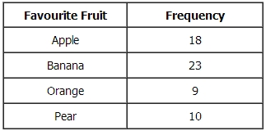
Multiplying and dividing fractions
LO: Can I multiply and divide fractions?
Simplify $x^{3}×x^{5}$.
Find the n^{th} term of the sequence: 3 7 11 15…
Mike asked 60 students to name their favourite fruit. Here are his results. Draw an accurate pie chart for his results.

Slide 2
Recap on converting
Mixed number
Improper fraction
$$2\frac{1}{6} 3\frac{5}{8} 1\frac{1}{9}$$
$$\frac{17}{6} \frac{21}{4} \frac{26}{7}$$
Reciprocal
$$7 \frac{1}{4} \frac{2}{5}$$

Slide 3
Multiplying fractions
To multiply fractions you multiply the denominators together and the numerators together. Always check to see if you can simply.
For examples
$\frac{2}{5}×\frac{4}{9}$
$\frac{9}{4}×\frac{10}{3}$
$1\frac{3}{4}×2\frac{1}{3}$

Slide 4
Steps
Step 1:
Convert any mixed numbers in to improper
Step 2:
Multiply both numerators and both denominators.
Step 3:
Check to see if you can simplify

Slide 5
Whiteboards
$\frac{10}{7}×\frac{4}{9}$
$1\frac{4}{5}×4\frac{1}{2}$
$2\frac{2}{3}×3\frac{3}{8}$

Slide 6
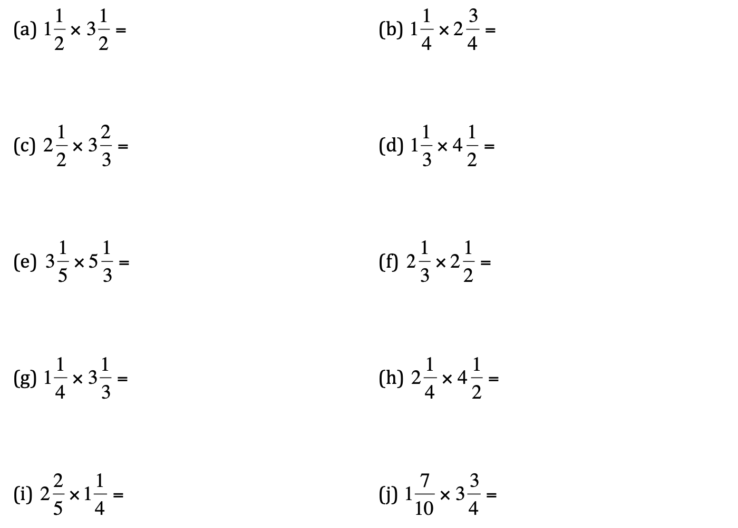
Questions

Slide 7
Dividing mixed numbers
To divide fractions you multiply with the reciprocal of the second fraction. KFC is a way to remember this. Keep Flip Change
For examples
$\frac{1}{4}÷\frac{2}{7}$
$\frac{13}{5}÷\frac{15}{6}$
$2\frac{1}{2}÷1\frac{3}{8}$

Slide 8
Steps
Step 1:
Convert to improper fractions
Step 2:
Flip the second fraction around.
Step 3:
Then multiply the fraction

Slide 9
Class example
Convert to mixed numbers
$3\frac{3}{4}÷1\frac{6}{7}$
$2\frac{1}{4}÷\frac{15}{6}$

Slide 10
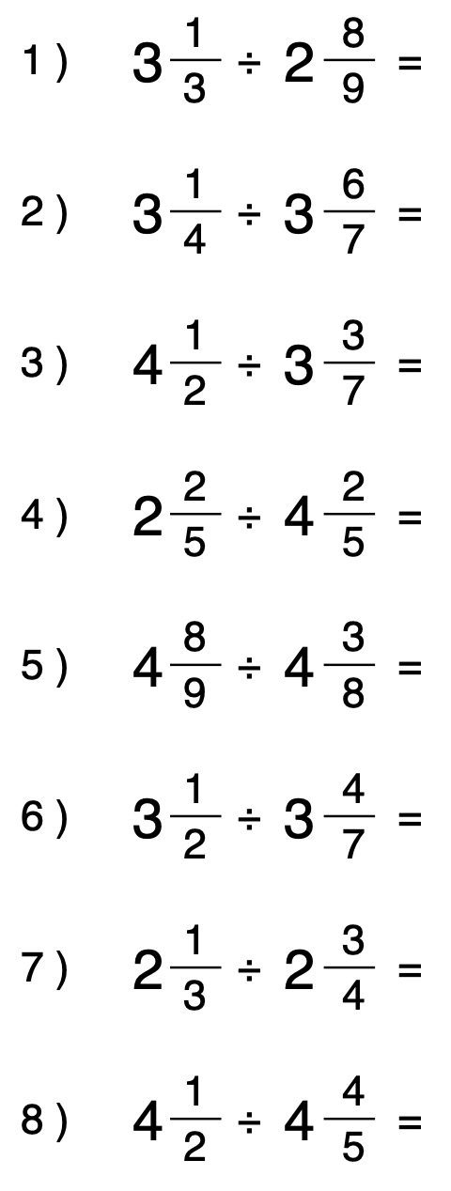
Questions

Slide 11
GCSE Questions

