Slide 1
Adding and subtracting fractions
LO: Can I add and subtract fractions?
Complete the table of values to sketch the graph of $y=2x−1$.
Describe fully the single transformation which maps the blue shape onto the red shape.
$$x$$ | -2 | -1 | 0 | 1 | 2
$$y$$
Order the following fractions from smallest to largest:
$\frac{1}{3}$ $\frac{1}{4}$ $\frac{2}{5}$ $\frac{3}{10}$

Slide 2
Recap on converting
Mixed number
Improper fraction
$$1\frac{3}{5} 4\frac{2}{7} 2\frac{12}{19}$$
$$\frac{13}{5} \frac{22}{7} \frac{32}{19}$$

Slide 3
Adding and subtracting fractions
To add fractions you need to make sure the denominator is the same.
This is done by finding a common multiple or by multiplying the two denominators. Don’t forget to multiply the numerators.
For examples
$\frac{2}{5}+\frac{4}{9}$
$\frac{3}{8}+\frac{5}{11}$
$\frac{9}{4}+\frac{10}{3}$
For examples
$\frac{4}{9}−\frac{2}{5}$
$\frac{5}{11}−\frac{3}{8}$
$\frac{10}{3}−\frac{9}{4}$
Subtraction is the same, but you subtract the numerators

Slide 4
Steps
Step 1:
Make the denominators the same by multiplying
Step 2:
’Cross multiply’ for the numerators.
Step 3:
Add or subtract the numerators depending on the question

Slide 5
Whiteboards
$\frac{3}{7}+\frac{4}{9}$
$\frac{4}{5}−\frac{3}{8}$
$\frac{5}{3}+\frac{4}{11}$

Slide 6
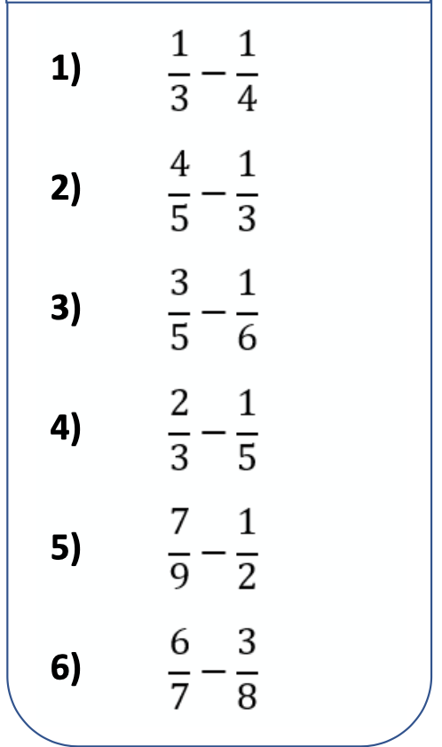
Questions
$$\frac{9}{4}+\frac{4}{3}$$
$$\frac{7}{2}−\frac{2}{9}$$
$$\frac{10}{3}−\frac{11}{2}$$
$$\frac{14}{8}+\frac{8}{3}$$
$$\frac{11}{5}+\frac{7}{4}$$
$$\frac{10}{3}−\frac{7}{4}+\frac{3}{2}$$

Slide 7
Adding and subtracting mixed numbers
To add mixed numbers convert them to improper and add like previously. This is the same for subtracting. Try the first example on your whiteboards.
For examples
$1\frac{1}{4}+2\frac{2}{7}$
$3\frac{3}{5}+1\frac{5}{6}$
$4\frac{1}{2}−3\frac{3}{8}$

Slide 8
Steps
Step 1:
Convert to improper fractions
Step 2:
Make the denominator the same and either add or subtract.
Step 3:
Read the question to see which form the answer should be in.

Slide 9
Class example
Convert to mixed numbers
$3\frac{3}{4}−1\frac{6}{7}$
$2\frac{1}{4}+\frac{15}{6}$

Slide 10
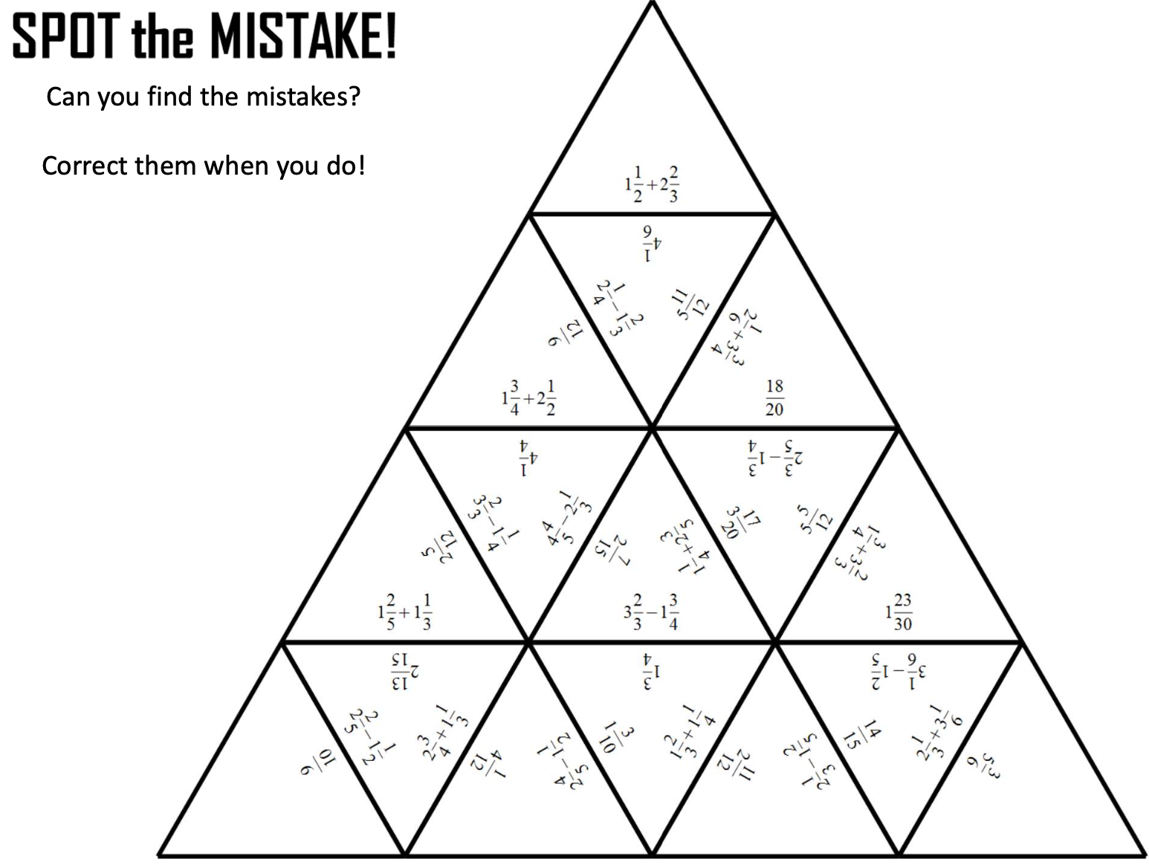
Questions – Find the mistakes

Slide 11
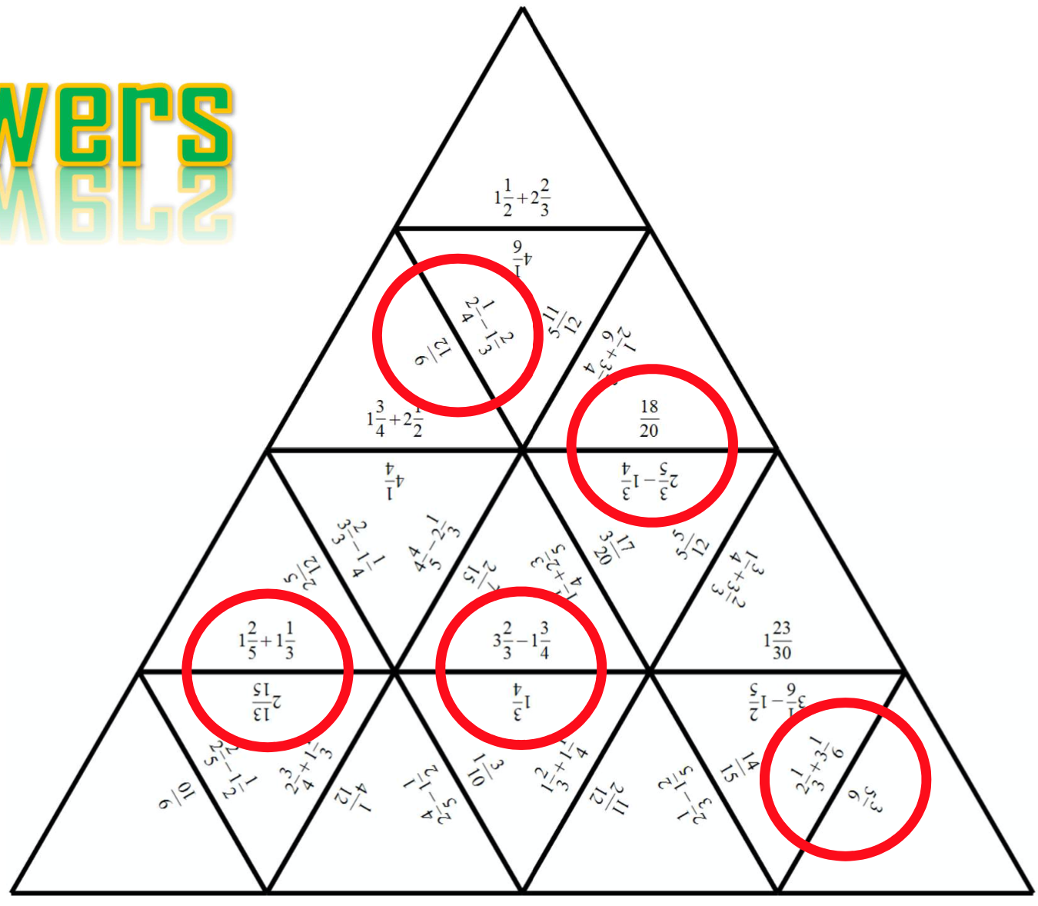
Answers

Slide 12
GCSE Questions

