Slide 1
Converting fractions
LO: Can I convert between improper and mixed numbers?
Calculate the highest common factor of 36 and 24.
Calculate the size of the missing angle $x$.
Divide £72 in the ratio 4 : 5.
Solve $3n+4=19$
$$x°$$
$$120°$$

Slide 2
Differences
Mixed number
Improper fraction
A mixed number is where you have a whole number (Integer) and a fraction where the numerator is less than the denominator.
Examples
$$1\frac{3}{5} 4\frac{2}{7} 11\frac{12}{19}$$
An improper fraction is a fraction where the numerator is greater than the denominator
Examples
$$\frac{13}{5} \frac{22}{7} \frac{32}{19}$$

Slide 3
Converting mixed to improper
To convert a mixed number to an improper you will need to calculate the number of parts the whole number is equal to. You then add this number on to the fraction.
For examples
$1\frac{2}{5}$
$2\frac{3}{8}$
$4\frac{6}{11}$

Slide 4
Steps
Step 1:
Multiply the Whole number by the denominator
Step 2:
Add this amount to the numerator
Step 3:
Write this over the same denominator.

Slide 5
Class example
Convert to improper fractions
$1\frac{3}{7}$
$2\frac{6}{7}$
$4\frac{1}{9}$

Slide 6
Converting mixed to improper
To convert an improper fraction to a mixed number you need to calculate the amount of whole parts you have. The remainder will be the fraction.
For examples
$\frac{17}{4}$
$\frac{23}{5}$
$\frac{26}{7}$

Slide 7
Steps
Step 1:
See how many times the denominator goes into the numerator exactly.
Step 2:
This is the whole number. The remainder will be the numerator of the fraction
Step 3:
The denominator will be the same from the question.

Slide 8
Class example
Convert to mixed numbers
$\frac{13}{7}$
$\frac{26}{7}$
$\frac{41}{9}$

Slide 9
Whiteboards
Convert to improper fractions or mixed numbers
$\frac{21}{4}$
$2\frac{3}{7}$
$7\frac{2}{5}$
$\frac{61}{7}$

Slide 10
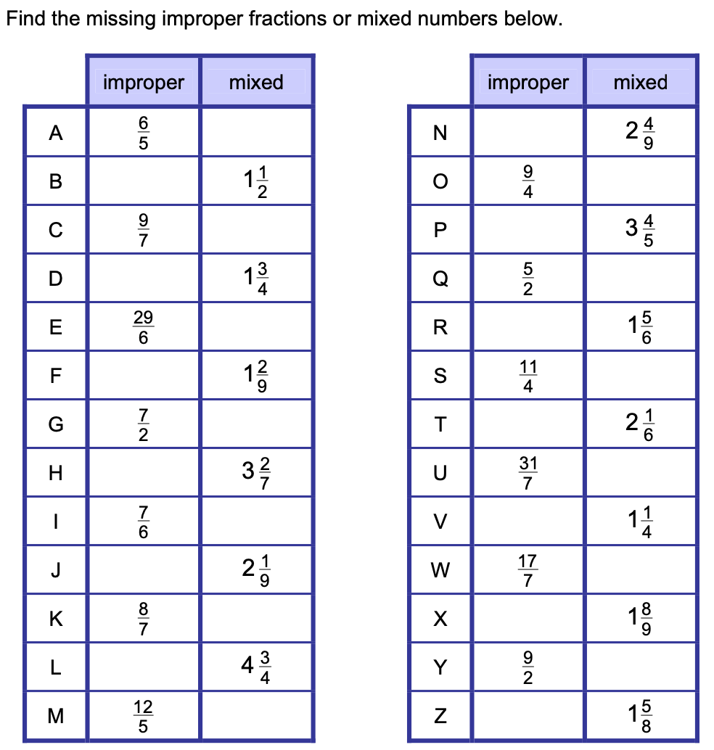
Questions

Slide 11
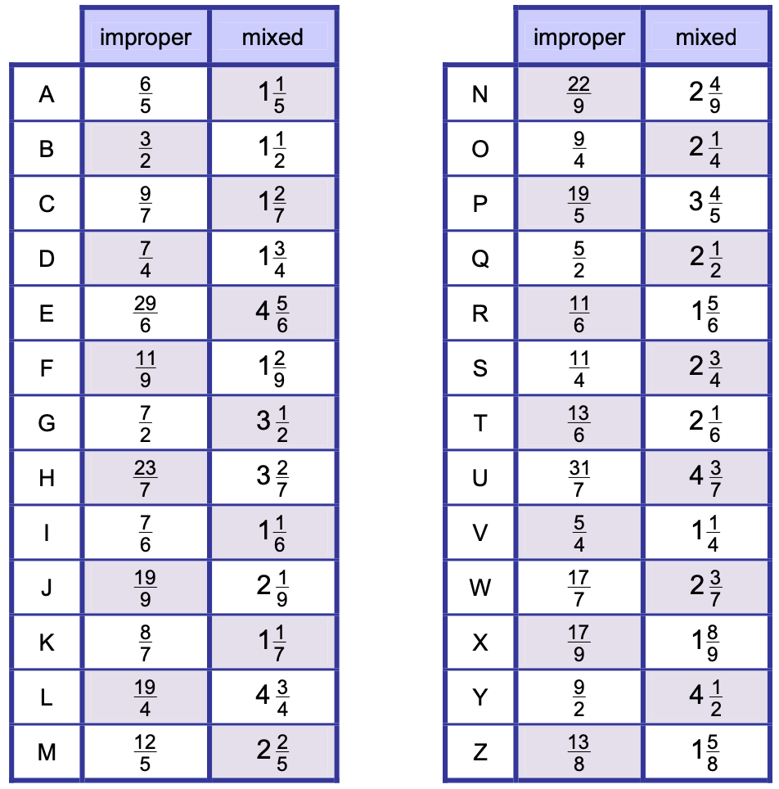
Answers

Slide 12
Reciprocals
Reciprocals are useful when dividing fractions. Other applications are looking at perpendicular lines. To find the reciprocal of a number we swap the numerator with the denominator.
In some cases we would need to convert the number to a fraction.
The rules
If the number is a whole number like 7, we can write this as $\frac{7}{1}$
If the number is a decimal like 0.25, we can write this as a fraction $\frac{1}{4}$

Slide 13
Reciprocals
Examples
3
$\frac{2}{7}$
$\frac{12}{5}$
0.2

Slide 14
Steps
Step 1:
Make sure the number is in a fraction form
Step 2:
Switch the numerator and denominator around
If a question as you to explain what a reciprocal is then say the product of a number and its reciprocal equals to 1

Slide 15
Class example
Convert to mixed numbers
6
$\frac{4}{13}$
$2\frac{1}{8}$

Slide 16
Questions
Write down the reciprocal of $2$.
Write down the reciprocal of $5$.
$$\frac{1}{6}$$
3. Write down the reciprocal of
4. Write down the reciprocal of
$$\frac{1}{7}$$
$$\frac{7}{9}$$
5. Write down the reciprocal of
6. Write down the reciprocal of
$$\frac{3}{5}$$
7. Find the reciprocal of $0.5$
8. Find the reciprocal of $0.75$

