Slide 1
Parallel vectors
LO: Can I show two vectors are parallel? (Grade 8)
Success Criteria
Understand how to show parallel vectors. (Grade 7)
Proving colinear. (Grade 8)
Involving ratio with proof. (Grade 9)

Slide 2
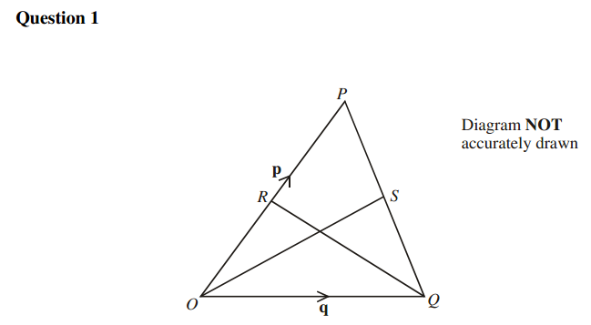
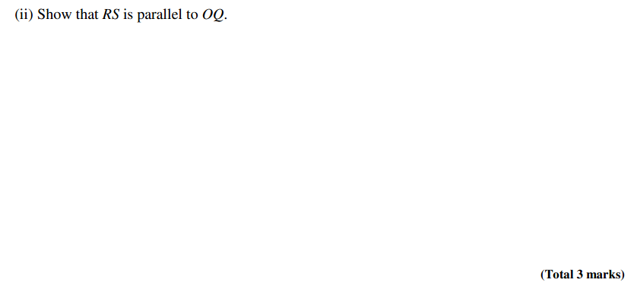
Proving vectors are parallel
RS
is a multiple of
\

Slide 3
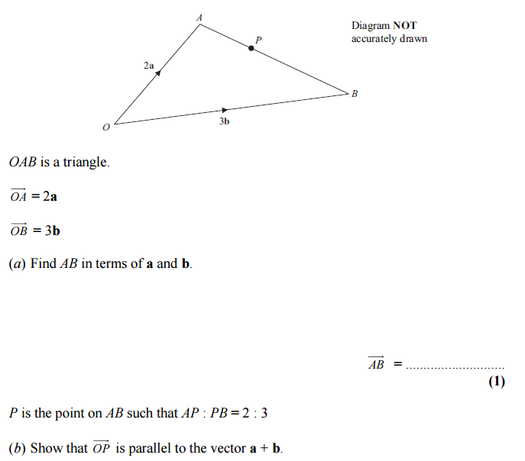
Proving vectors are parallel

Slide 4
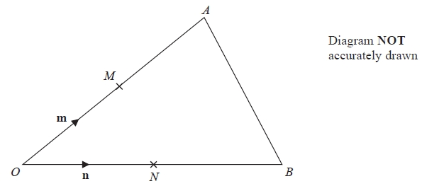
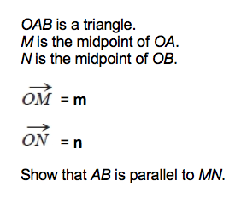
Whiteboards

Slide 5
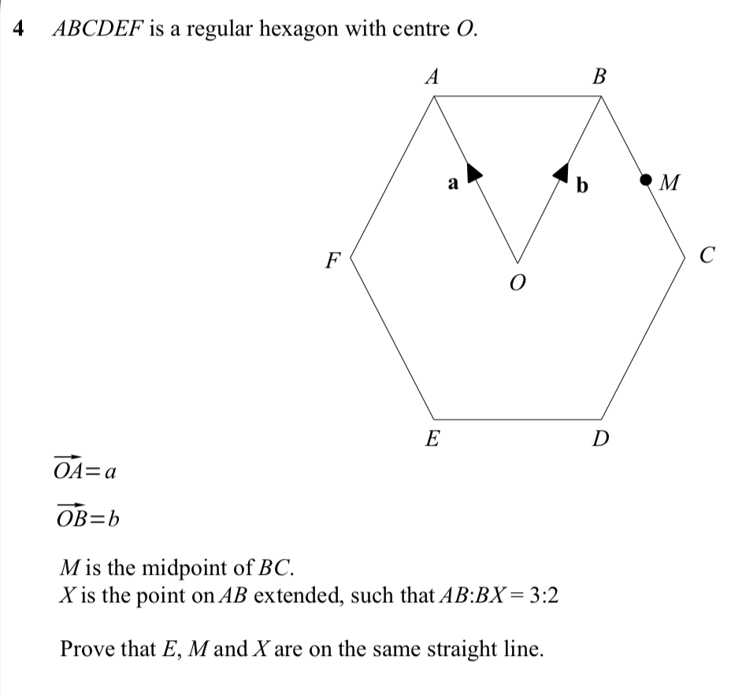
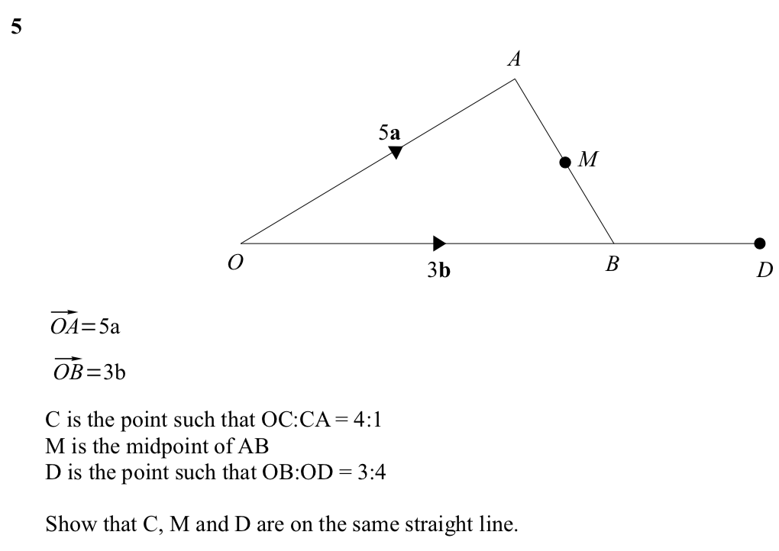
Questions

Slide 6
Straight lines
Questions sometimes requires you to show points lie on a straight line or to use this property. For points to be on a straight line it means they are going in the same direction.
This is also known as collinear.
To do this you need to find two vectors which involves all three points in the same direction.
For example
Show OAC is a straight line
If XYZ is a straight line then $\vec{xz}$ must be a scalar multiple of $\vec{xy}$

Slide 7
Another example
M is the midpoint of CD and AX = 2XC
BW: WC = 1:5
Show B, X, M are on a straight line

