Slide 1
Vectors
LO: Can I find resultant vectors? (Grade 7)
Success Criteria
Finding a resultant vectors from two or more vectors (Grade 6)
Finding vectors with midpoints(Grade 7)
Finding vectors with ratios and fractions (Grade 7)

Slide 2
Vectors
Many
paths to get
to the same place
Plan a route from Bond Street to Embankment.
Victoria to Leicester Square.
What does this have to do with vectors?

Slide 3
Vectors
When finding a vector you can only use the vectors that are given to you.
E
D
i) BA
ii) CB
iii) DC
iv) AC
v) AD
= - a
= - b
= - c
= a + b
= a + b + c
c
F
C
b
a
A
B

Slide 4
Questions
= a
= b
= c
= c + b
= – c – b – c
= – a + c
= a – c
= – a – b
E
D
i) ED
ii) FE
iii) AF
iv) AE
v) DA
vi) BF
vii) EC
viii) DF
c
F
C
b
a
A
B

Slide 5
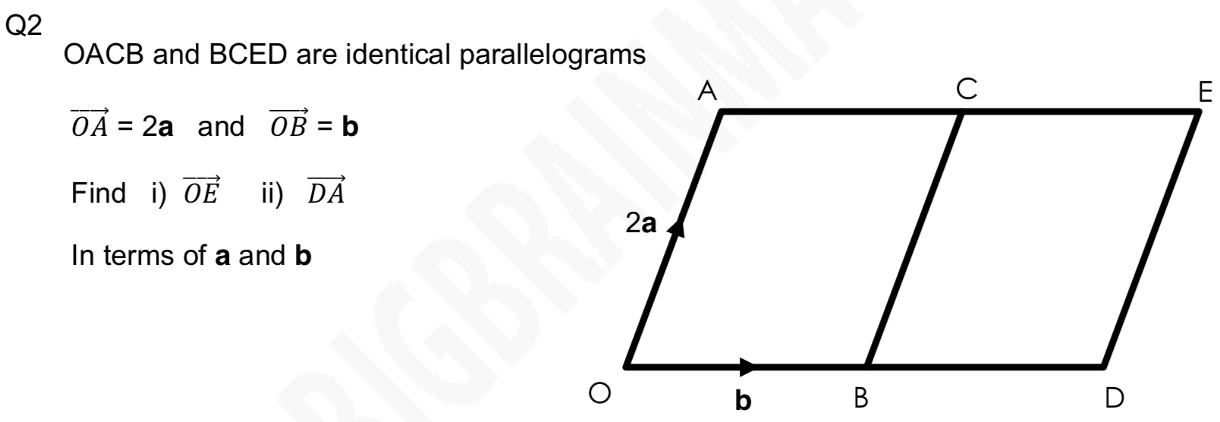
Questions

Slide 6
Vectors with midpoints and ratio
When working out a midpoint we need half of the vector.

Slide 7
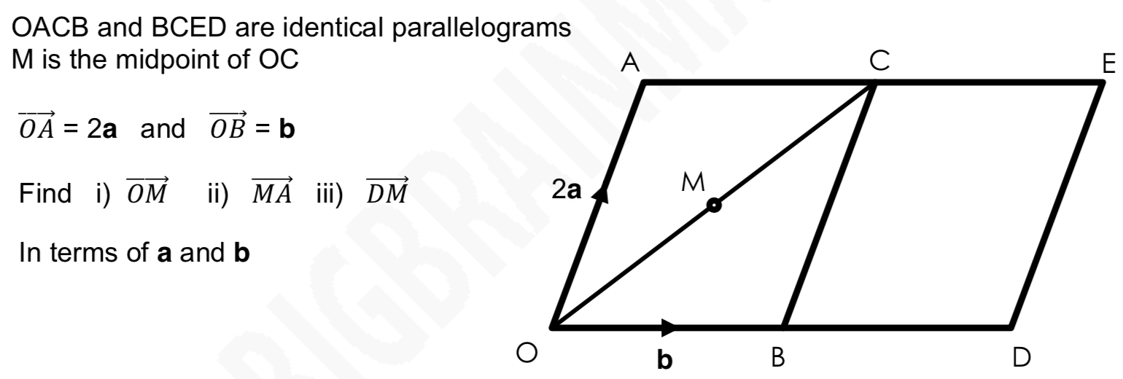
Vectors with midpoints and ratio
When working out a midpoint we need half of the vector.

Slide 8
Vectors with midpoints and ratio

Slide 9
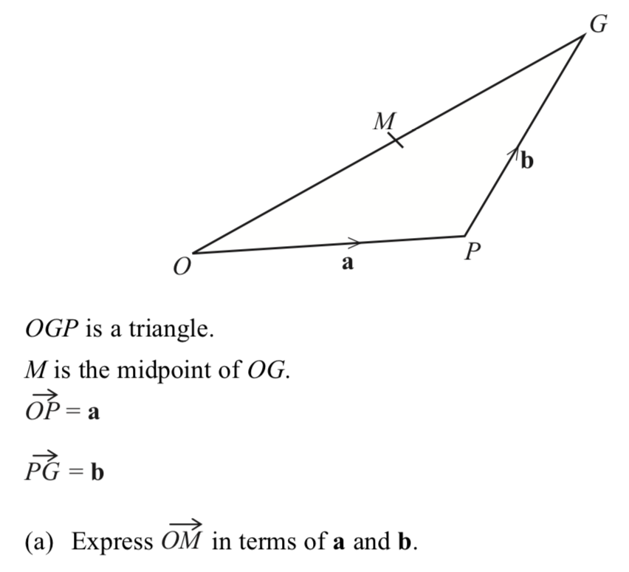
Whiteboards

Slide 10
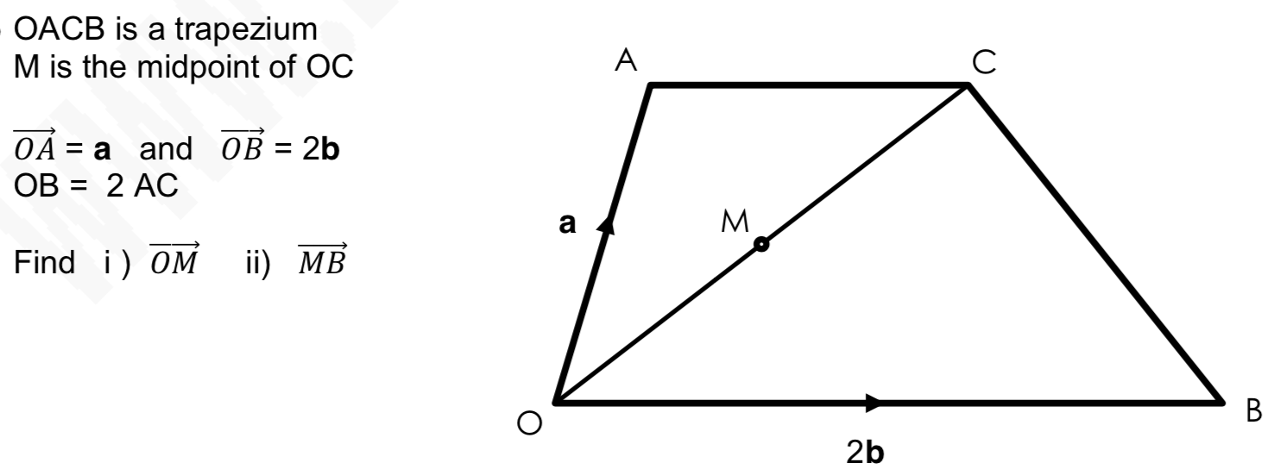
Whiteboards

Slide 11
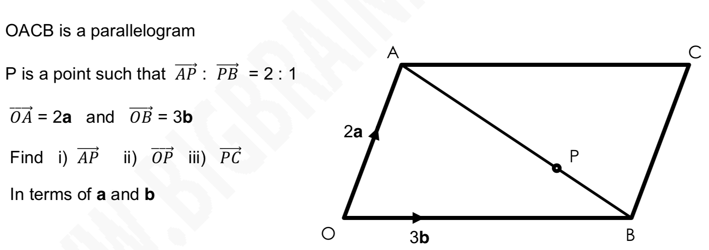
Whiteboards

Slide 12
Worksheet

