Slide 1
Vectors
LO: Can I understand basic vectors? (Grade 5)
Success Criteria
Understand notation, arithmetic calculations and scaler multiples. (Grade 4)
Find resultant vectors. (Grade 5)

Slide 2
Vectors
Vectors have magnitude and direction. If they have the same direction then they are the same vector.
The same vector can have a different magnitude. This is known as a scale.
a
2a
$\frac{1}{2}$ a

Slide 3
Vectors
Vectors with opposite direction have a negative value.
Vectors are parallel if they have the same direction regardless of length. This means you can factor out a scaler to have identical vectors.
a
-a
-2a

Slide 4
Column vectors
Vectors are in two forms.
Column Vector Algebraically
$$\left({4 \atop 2}\right)$$
When you see AB this means the vector from point A to B
Bold letter a
Underlined a
a
A
B
b
F
C
c
E
D

Slide 5
Whiteboards
$$b$$
$$a$$
$$a=\left(\begin{matrix}1 \\ 3\end{matrix}\right) b=\left(\begin{matrix}5 \\ 1\end{matrix}\right) \\ c=\left(\begin{matrix}2 \\ −3\end{matrix}\right) d=\left(\begin{matrix}−4 \\ 2\end{matrix}\right) \\ e=\left(\begin{matrix}−4 \\ −4\end{matrix}\right) f=\left(\begin{matrix}−1 \\ 1\end{matrix}\right) \\ g=\left(\begin{matrix}0 \\ −3\end{matrix}\right)$$
$$d$$
$$f$$
?
$$e$$
$$g$$
$$c$$

Slide 6
Vectors
$$\vec{XZ}=a=\left(\begin{matrix}2 \\ 5\end{matrix}\right)$$
$$\vec{ZY}=b=\left(\begin{matrix}5 \\ 3\end{matrix}\right)$$
$$\vec{XY}=\left(\begin{matrix}7 \\ 8\end{matrix}\right)$$
i.e.
$$a+b=\left(\begin{matrix}2 \\ 5\end{matrix}\right)+\left(\begin{matrix}5 \\ 3\end{matrix}\right)=\left(\begin{matrix}7 \\ 8\end{matrix}\right) \\ \vec{XZ}+\vec{ZY}=\vec{XY}$$
What do you notice about the numbers in $\left(\begin{matrix}7 \\ 8\end{matrix}\right)$ when compared to $\left(\begin{matrix}2 \\ 5\end{matrix}\right)$ and $\left(\begin{matrix}5 \\ 3\end{matrix}\right)$?
$$Y$$
$$b$$
$$Z$$
$$a$$
$$X$$

Slide 7
Arithmetic vectors
We can add, subtract and multiply vectors.
a = $\left({4 \atop 2}\right)$ b = $\left({3 \atop 4}\right)$ c = $\left({−2 \atop 6}\right)$
a + b
2b
3c +2a
4a – c

Slide 8
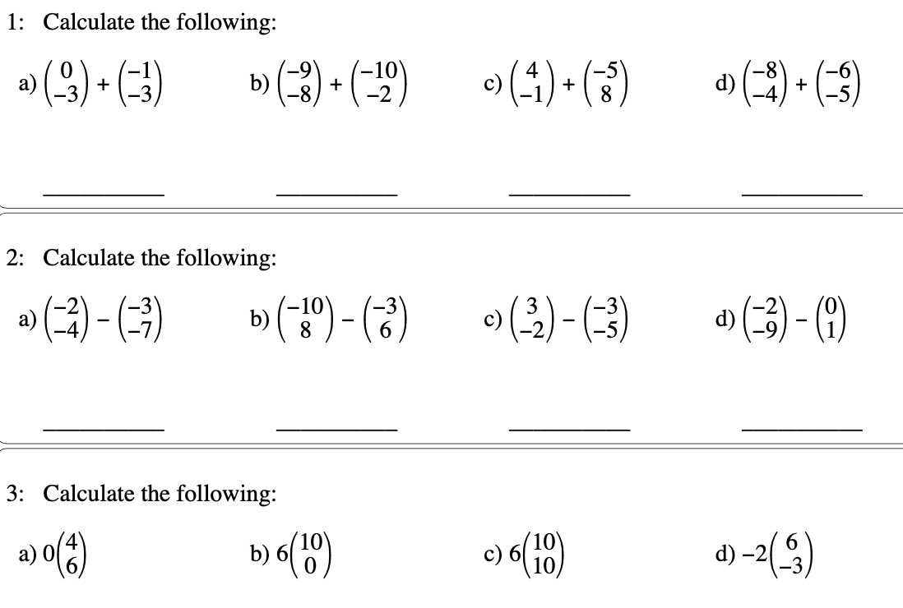
Arithmetic vector worksheet
Mock Set 2
𝐚 =$\left({1 \atop 4}\right)$ and𝐛 = $\left({2 \atop 3}\right)$
Write down as a column vector
𝐚 + 𝐛
2a +3b
2b - a

Slide 9
Finding a vector
When given two points and want to find the vector you subtract the second point from the first.
For example
A = (3,5) and B = (6,10)
C = (-3,8) D = (2, 3)

Slide 10
Length or magnitude
How could we find the length of a vector?
Example $\left({3 \atop 4}\right)$
Hint: use a diagram.
Use Pythagoras

Slide 11
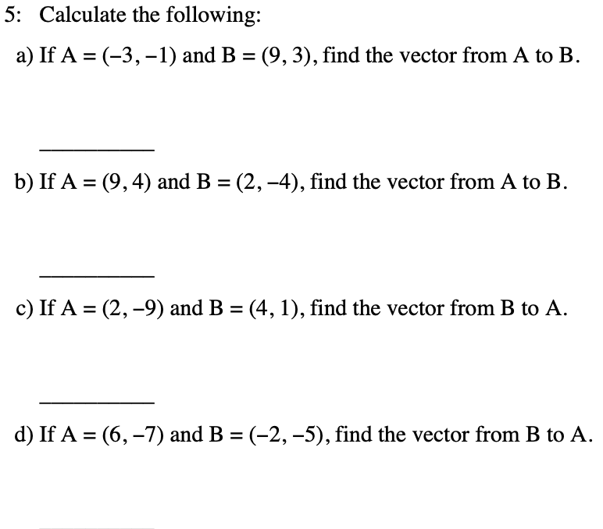
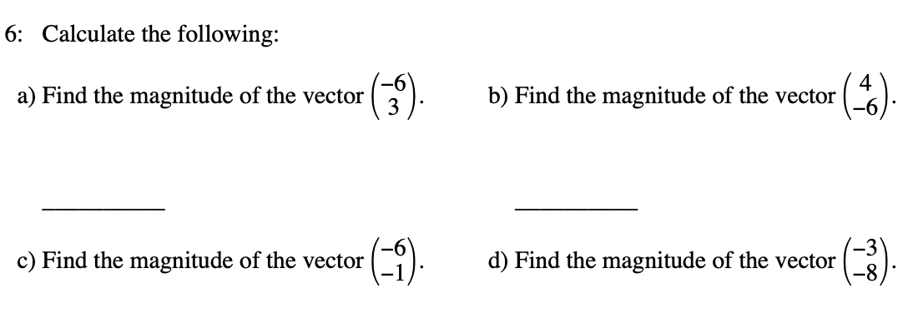

Slide 12
Random questions

Slide 13
a. AP =
b. AB =
c. OQ =
d. PO =
e. PQ =
f. PN =
g. ON =
h. AN =
i. BP =
j. QA =
a
b – a
2b
- 2a
2b – 2a
b – a
a + b
b
2a - b
a – 2b
Q
B
N
b
P
O
a
A
A, B and N are midpoints

