Slide 1
Number
Bounds/Error intervals
Checking calculations/estimating/ rounding
Compound measures
Index laws
LCM and HCF
Order of operation and arithmetic
Powers, roots and reciprocals
Product of primes
Combinations & permutations
Recurring decimals
Standard form
Operations with fractions
Percentages
Functional maths
Simplifying surds
Title page

Slide 2
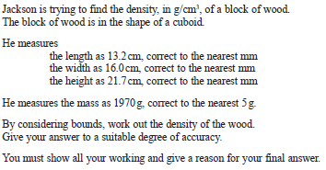
Bounds and error intervals
Back to Number
Home

Slide 3
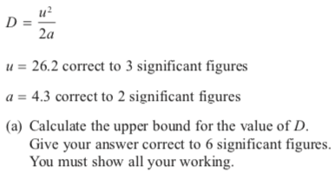

Slide 4
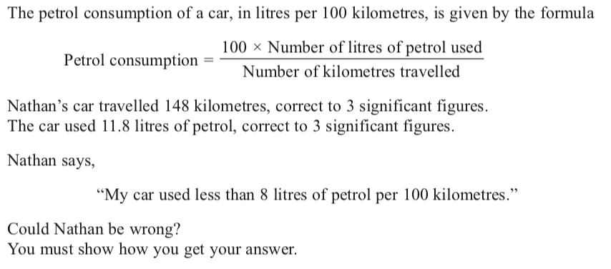
Bounds and error intervals

Slide 5
Checking and estimating
Back to Number
Home

Slide 6
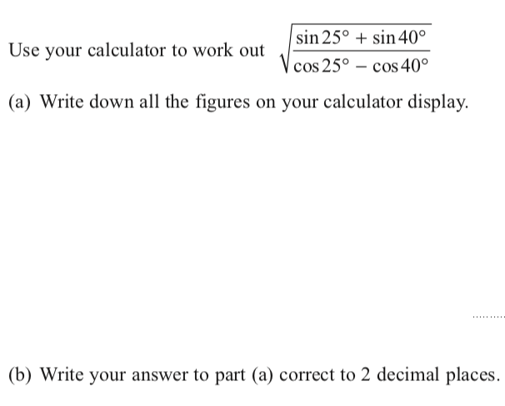
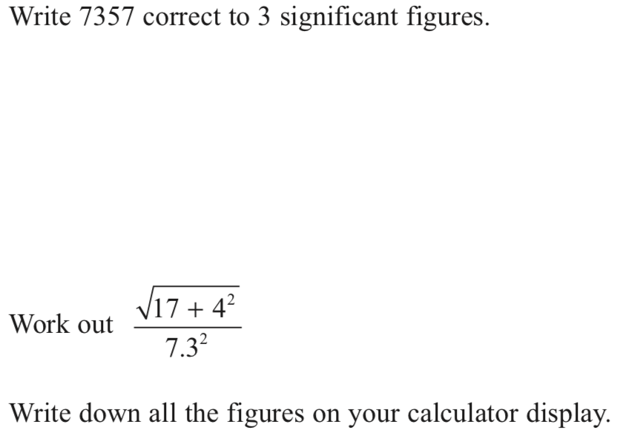

Slide 7
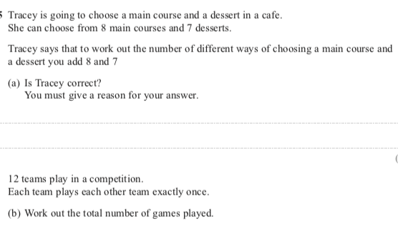
Combinations & permutations
Back to Number
Home

Slide 8
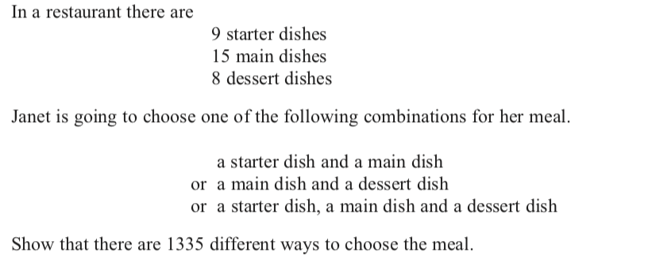
Combinations & permutations
Back to Number
Home

Slide 9
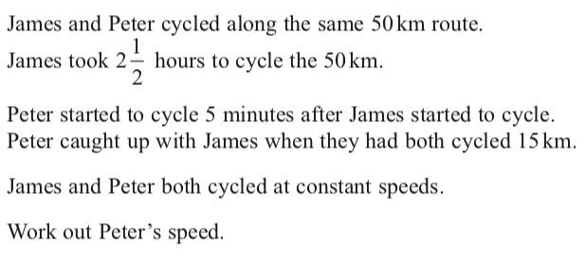
Compound measures
Back to Number
Home

Slide 10
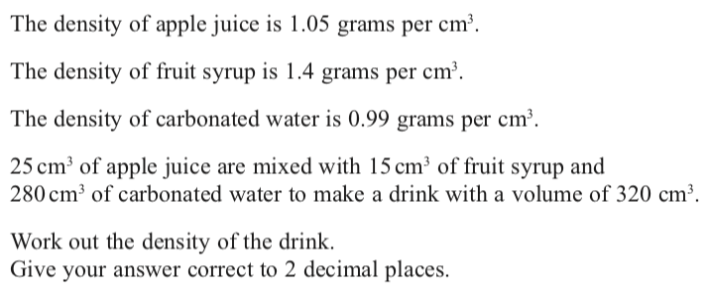
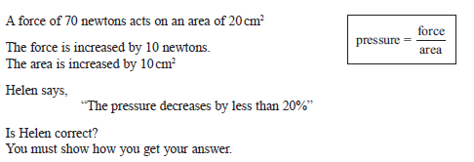
Compound measures
Back to Number
Home

Slide 11
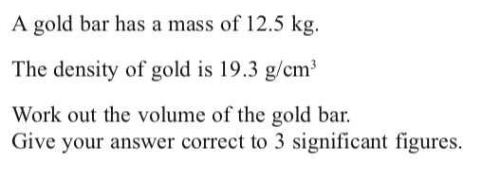
Compound measures
Back to Number
Home

Slide 12
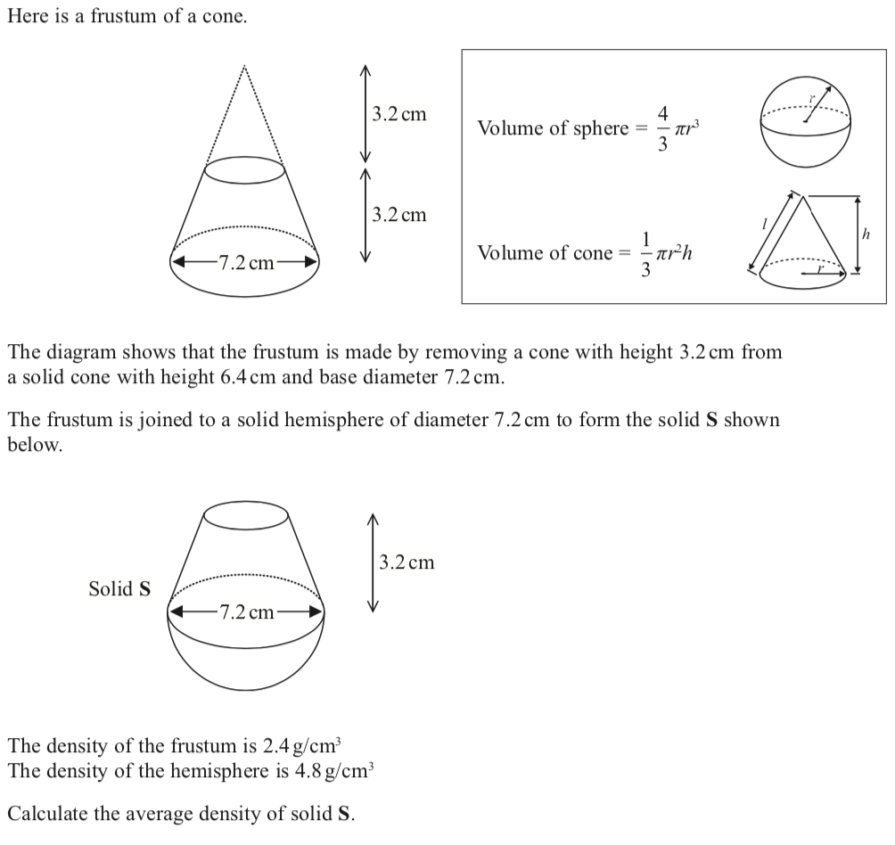
Compound measures

Slide 13
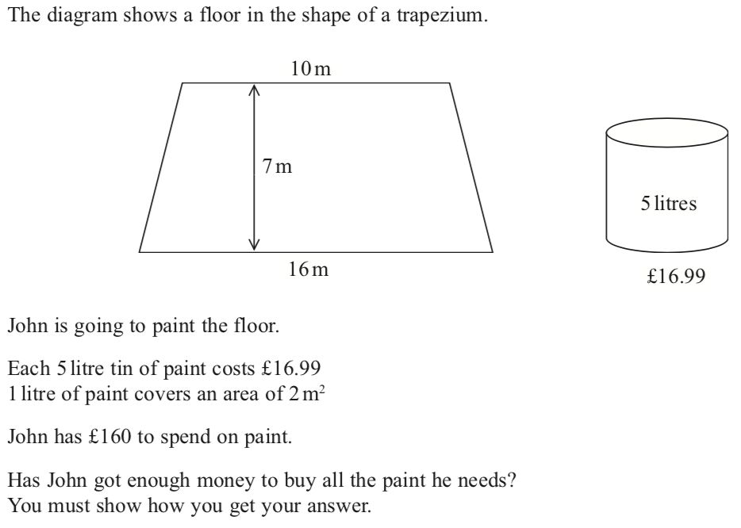
Functional maths

Slide 14
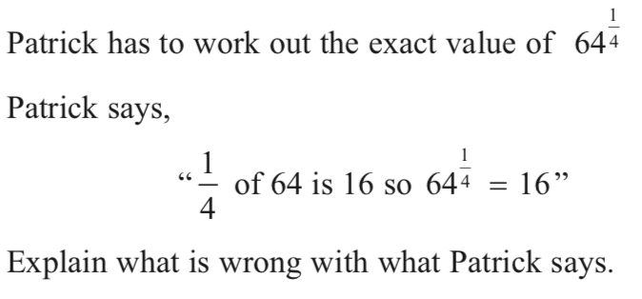
Index laws
Back to Number
Home

Slide 15
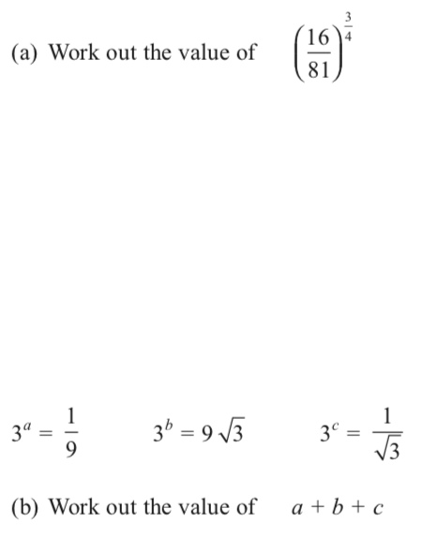
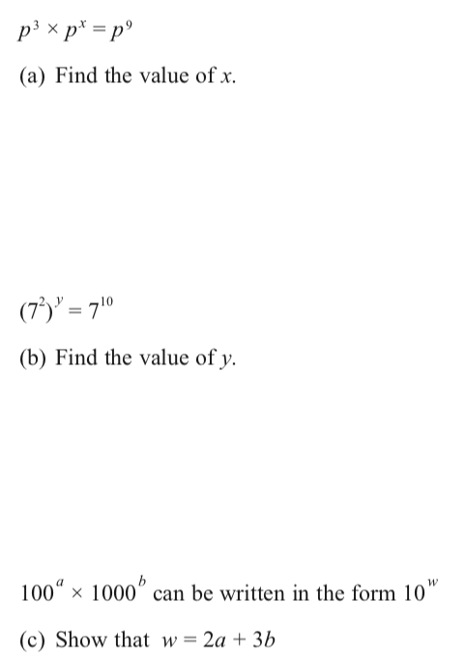
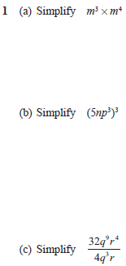
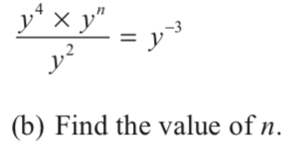
Index laws
Back to Number
Home

Slide 16
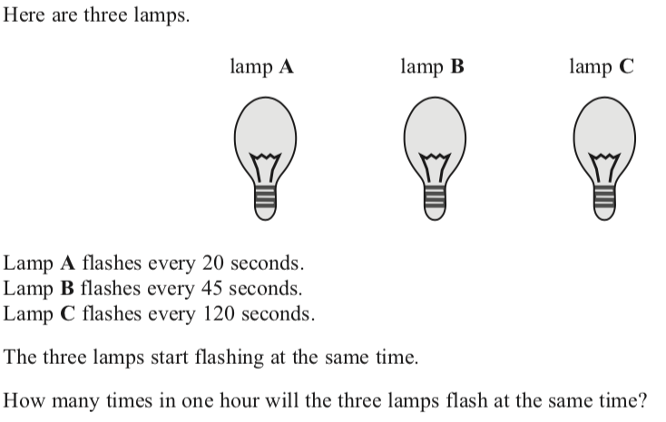
HCF & LCM
Back to Number
Home

Slide 17
Operations with fractions
Back to Number
Home

Slide 18
Order of operation and arithmetic
Back to Number
Home

Slide 19
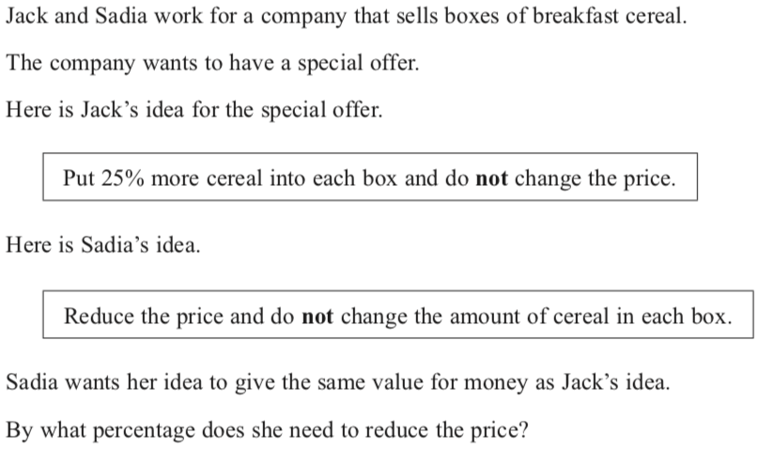
Percentages

Slide 20
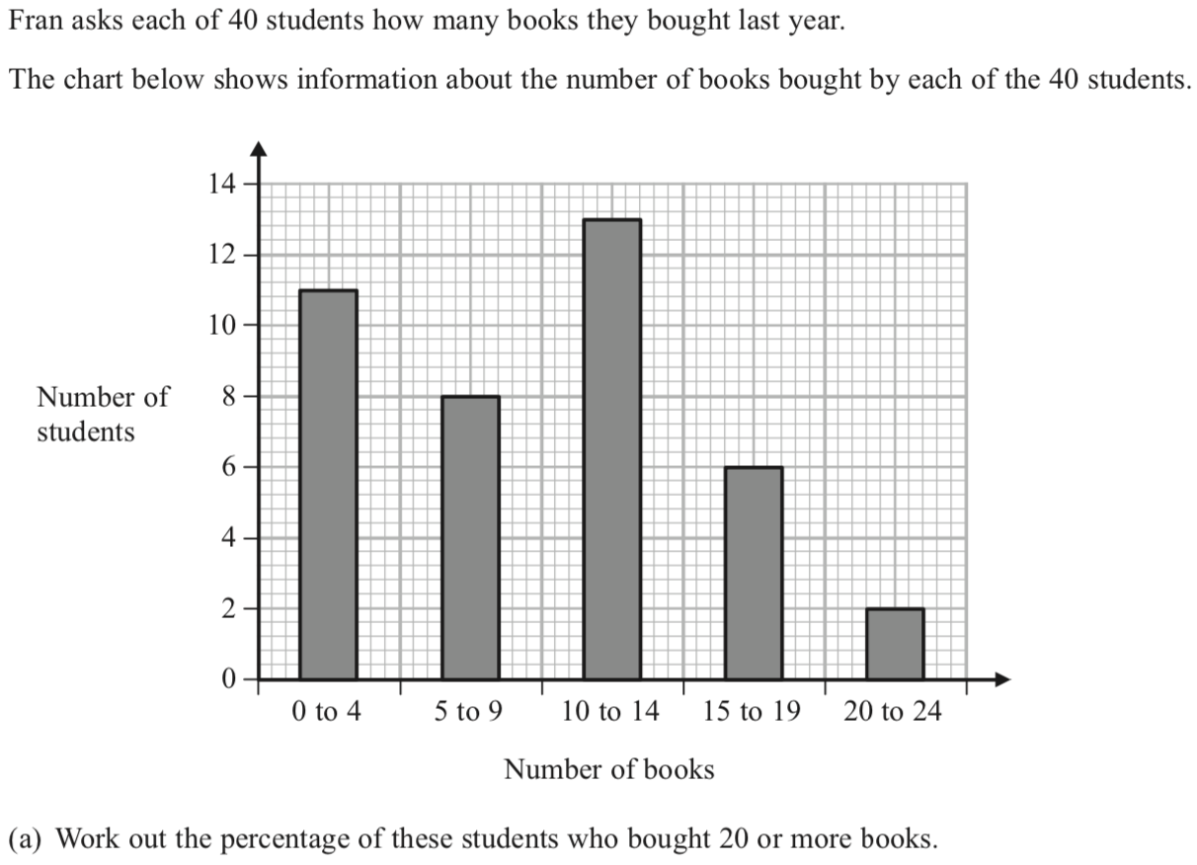
Percentages

Slide 21
Powers, roots and reciprocals
Back to Number
Home

Slide 22
Product of primes
Back to Number
Home

Slide 23
Recurring decimals
Back to Number
Home

Slide 24
Simplifying Surds
Back to algebra
Home

Slide 25
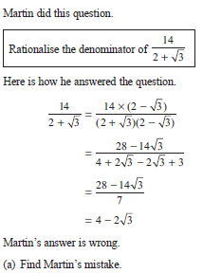
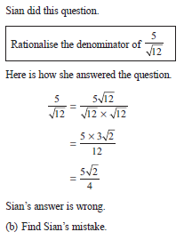
Simplifying Surds

Slide 26
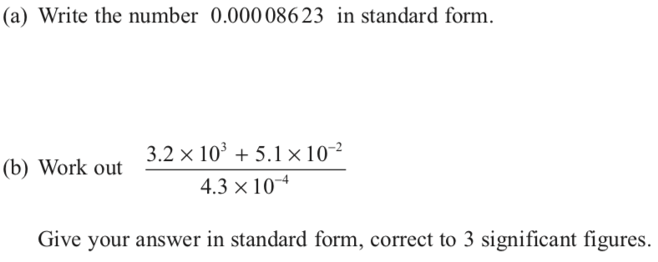
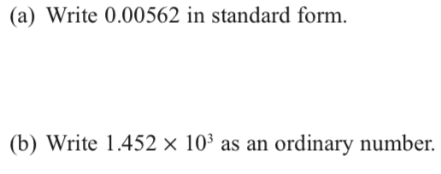
Standard form
Back to Number
Home

Slide 27
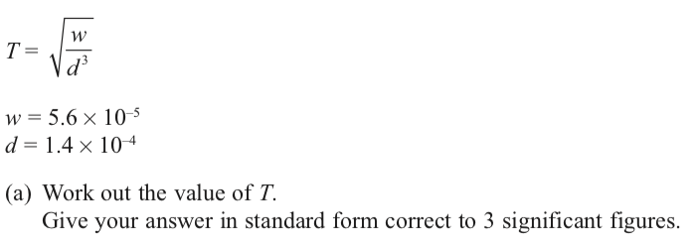
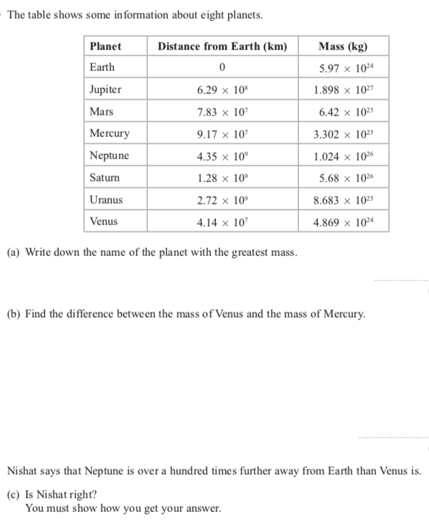
Standard form
Back to Number
Home

