Slide 1
Algebra
Algebraic fractions
Algebraic Proof (with decimals)
Area under a graph
Changing the subject
Equation of a circle
Equation of a line and tangent
Expanding binomials
Factorising and solving
Functions
Quadratic Graphs
Identifying parallel lines
Inequalities
Iteration
Sequences
Simultaneous equations
Writing and solving equations
Linear graphs
Trig graphs
Circle graphs
Other graphs
Transformation of graphs
Title page

Slide 2
Algebraic fractions
Back to algebra
Home

Slide 3
Algebraic fractions
Back to algebra
Home

Slide 4
Algebraic Proof
Back to algebra
Home

Slide 5
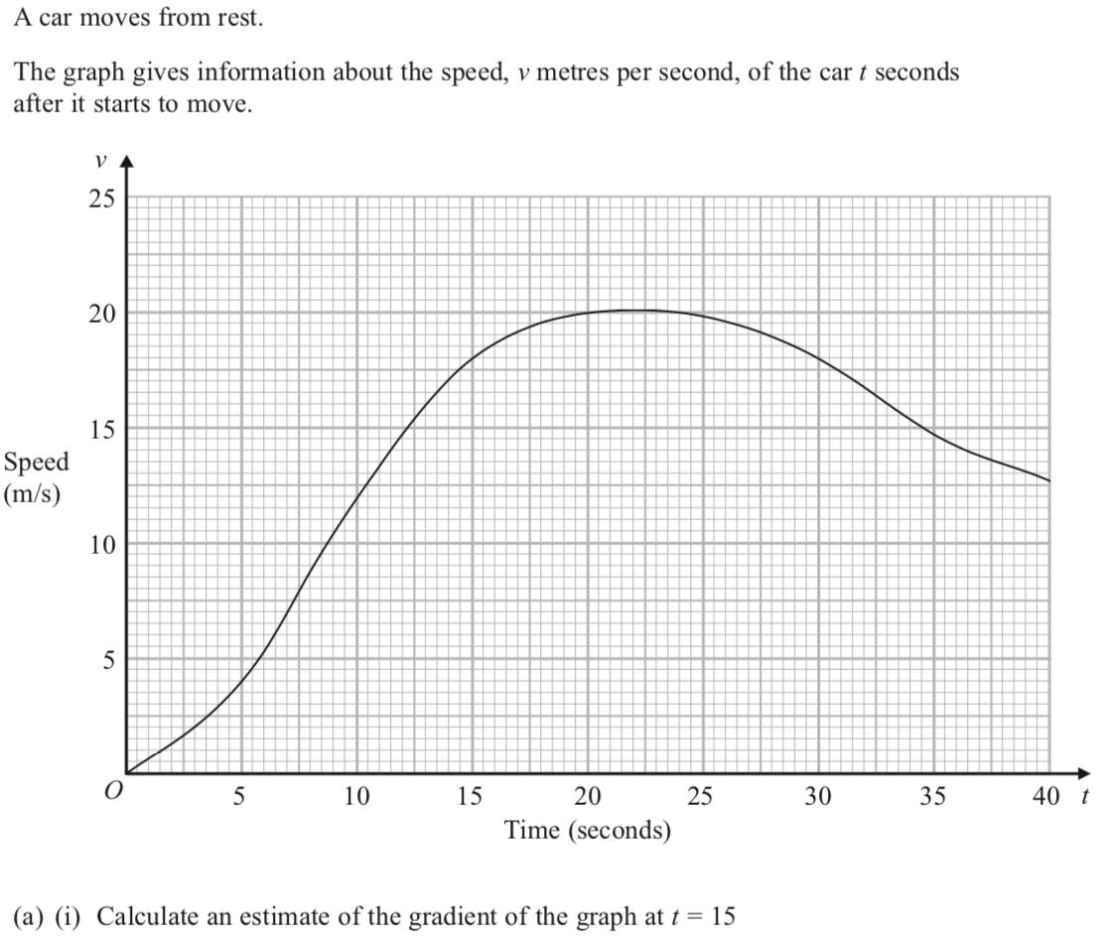
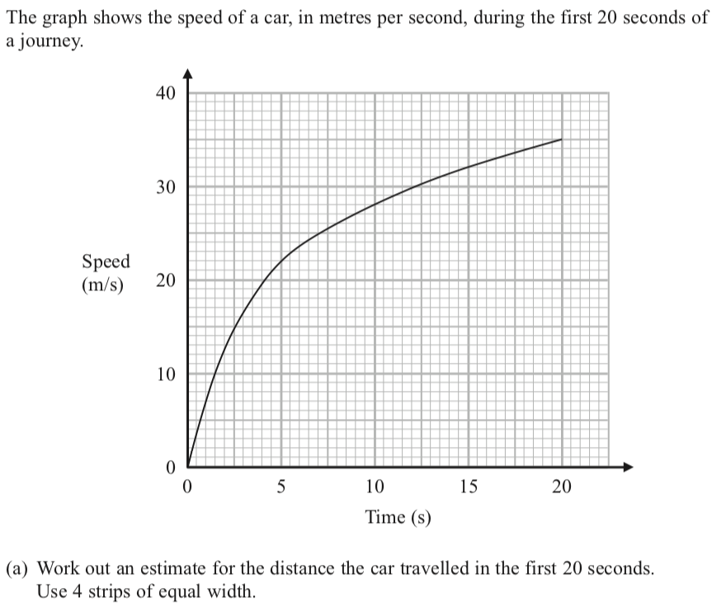
Area under the curve
Back to algebra
Home

Slide 6
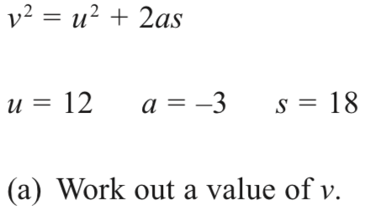
Changing the subject
Back to algebra
Home

Slide 7
Equation of a line 1
Back to algebra
Home

Slide 8
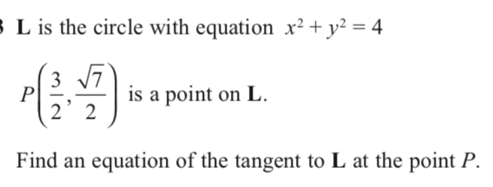
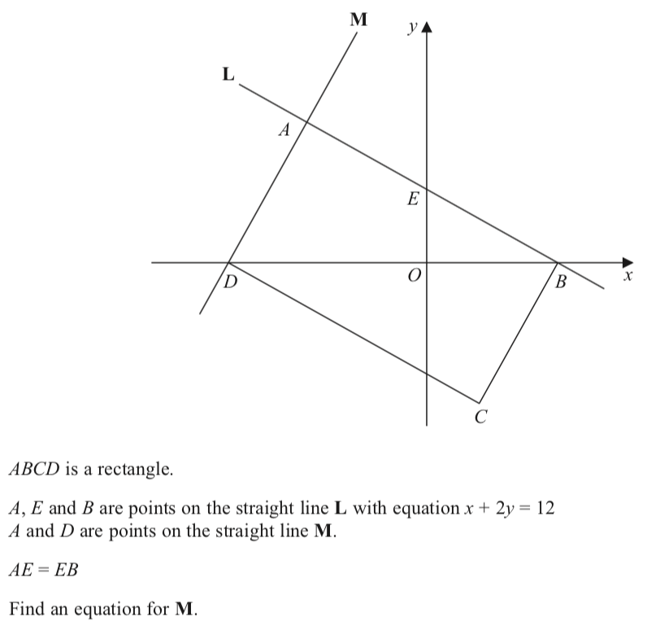
Equation of a line 1
Back to algebra
Home

Slide 9
Equation of a line 2

Slide 10
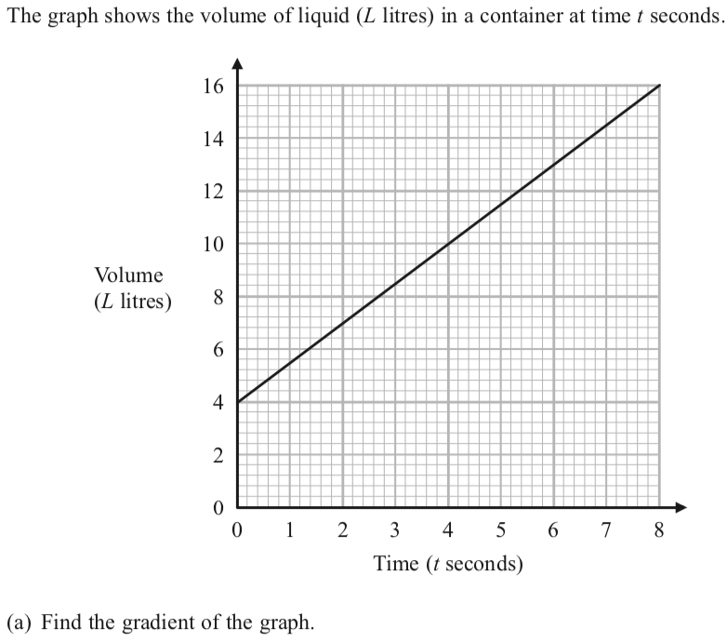
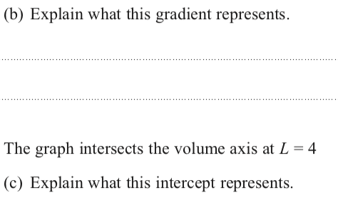
Equation of a line 2

Slide 11
Expanding binomials
Back to algebra
Home

Slide 12
Expanding binomials
Back to algebra
Home

Slide 13
Factorising
Back to algebra
Home

Slide 14
Functions
Back to algebra
Home

Slide 15
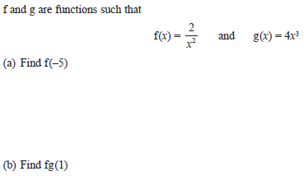
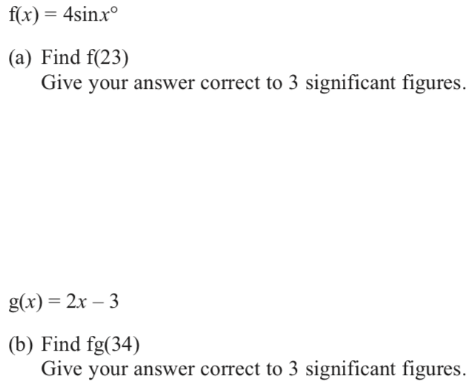
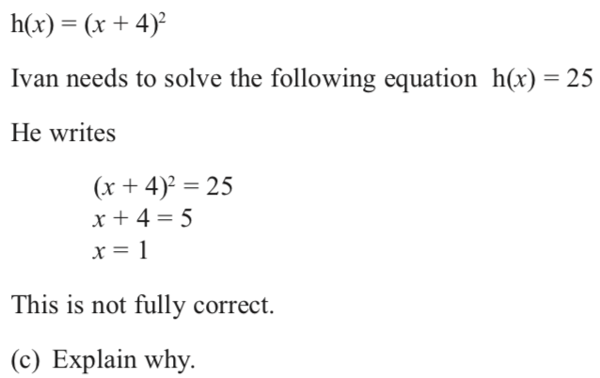
Functions
Back to algebra
Home

Slide 16
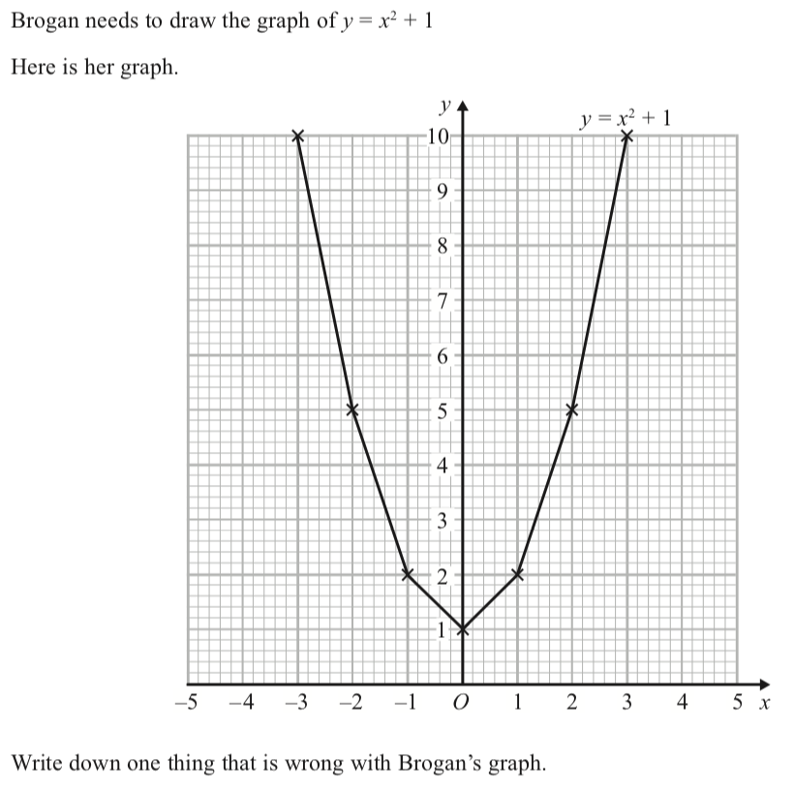
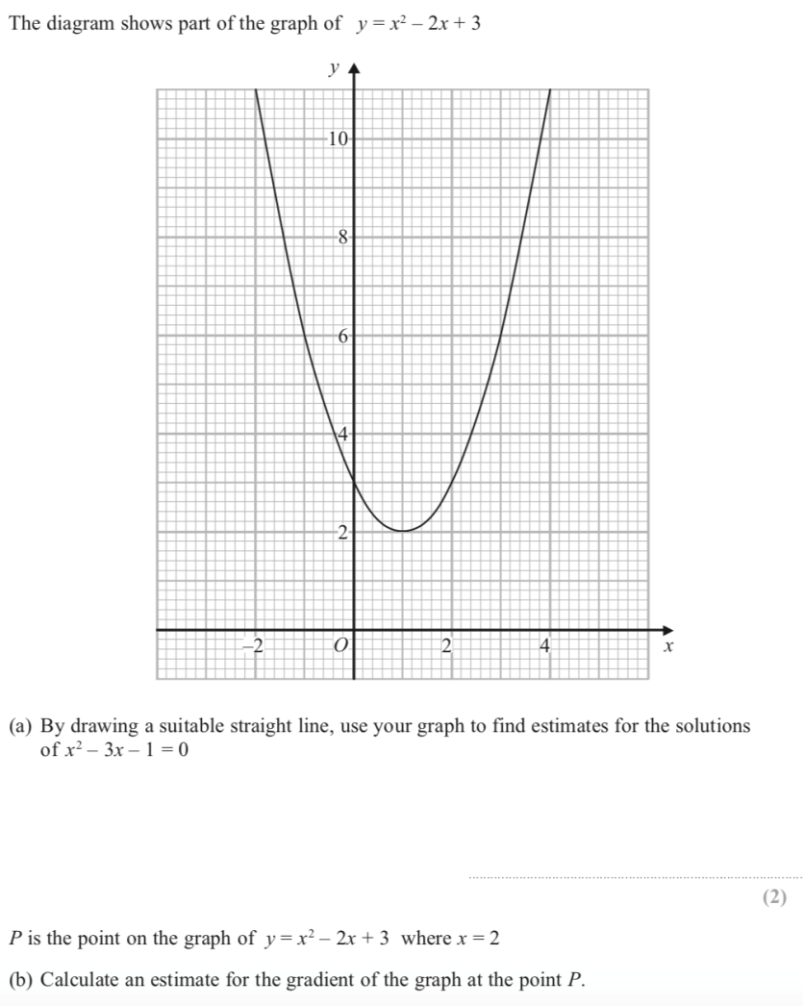
Quadratic Graphs 1
Back to algebra
Home

Slide 17
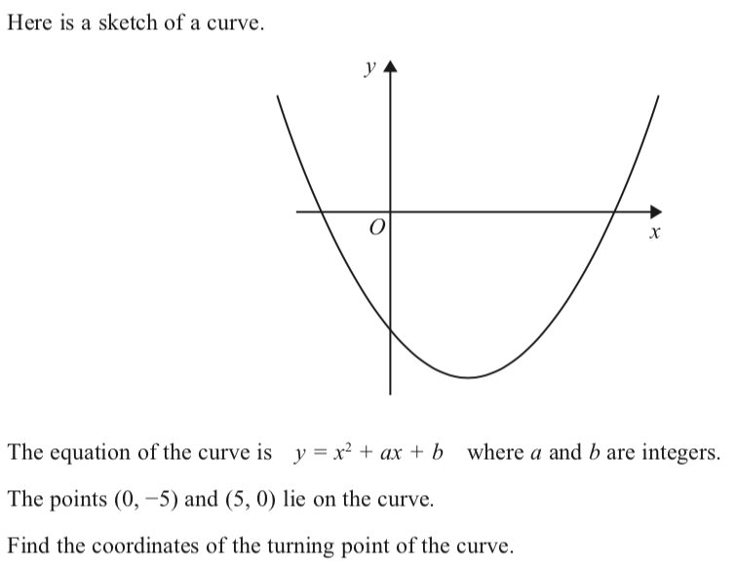
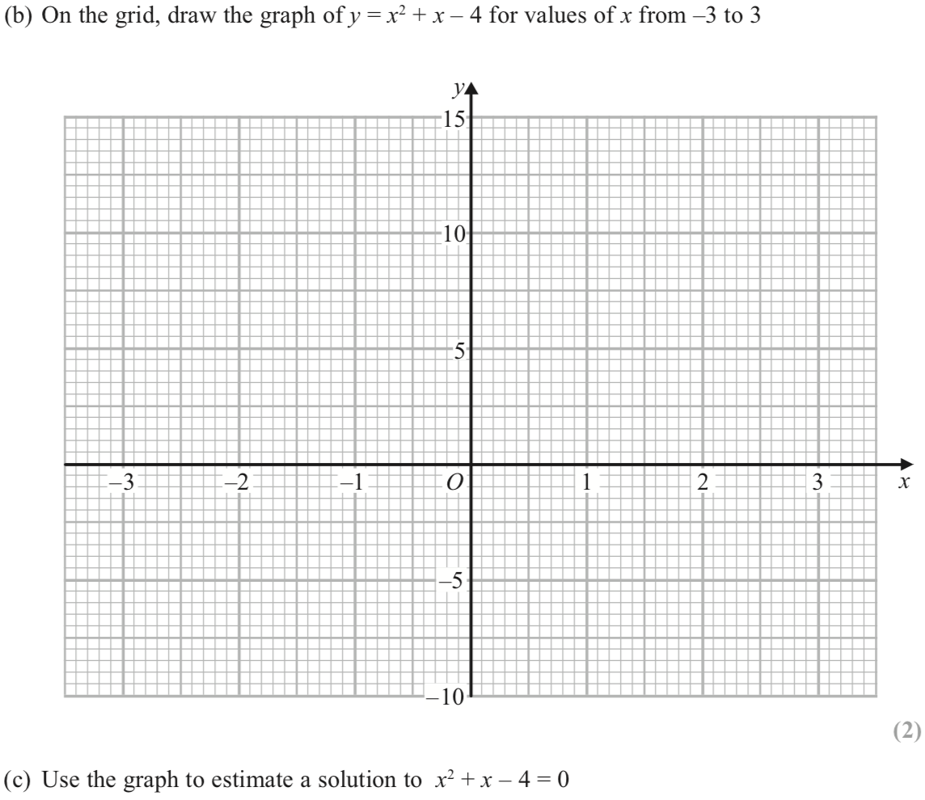
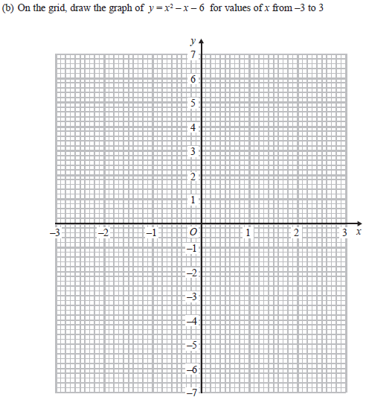
Quadratic Graphs 2
Back to algebra
Home

Slide 18
Circle graphs

Slide 19
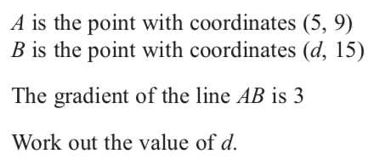
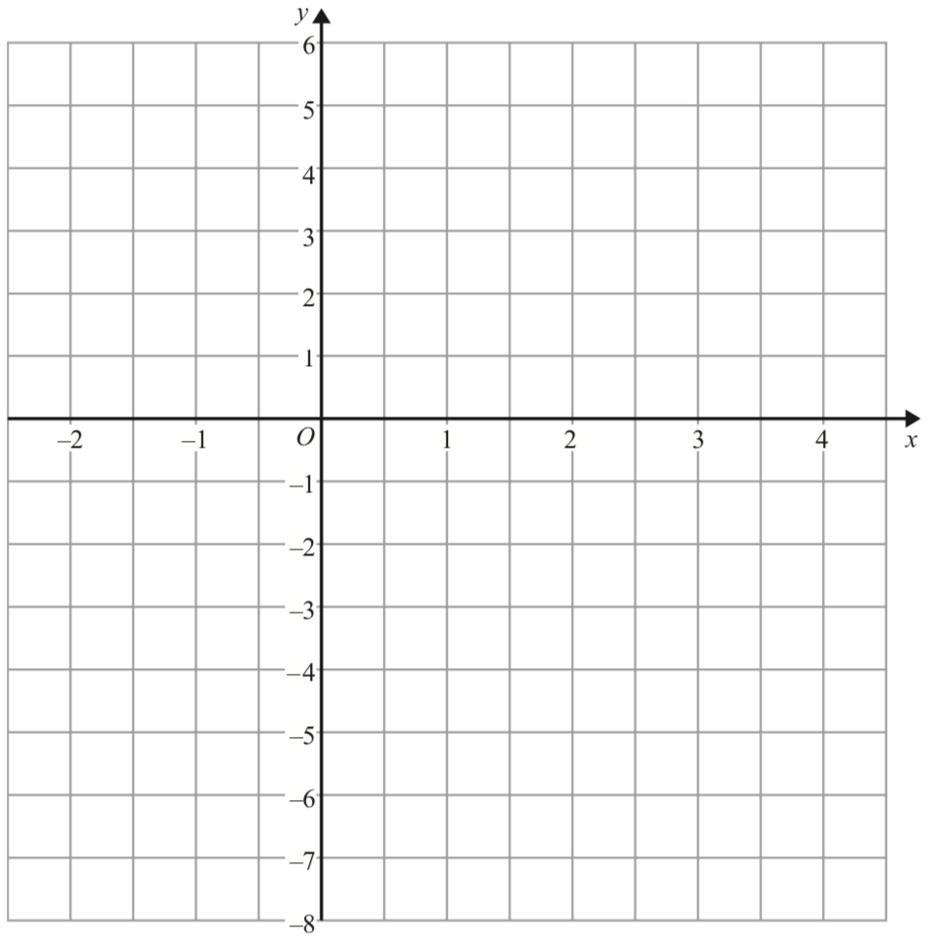
Linear graphs

Slide 20
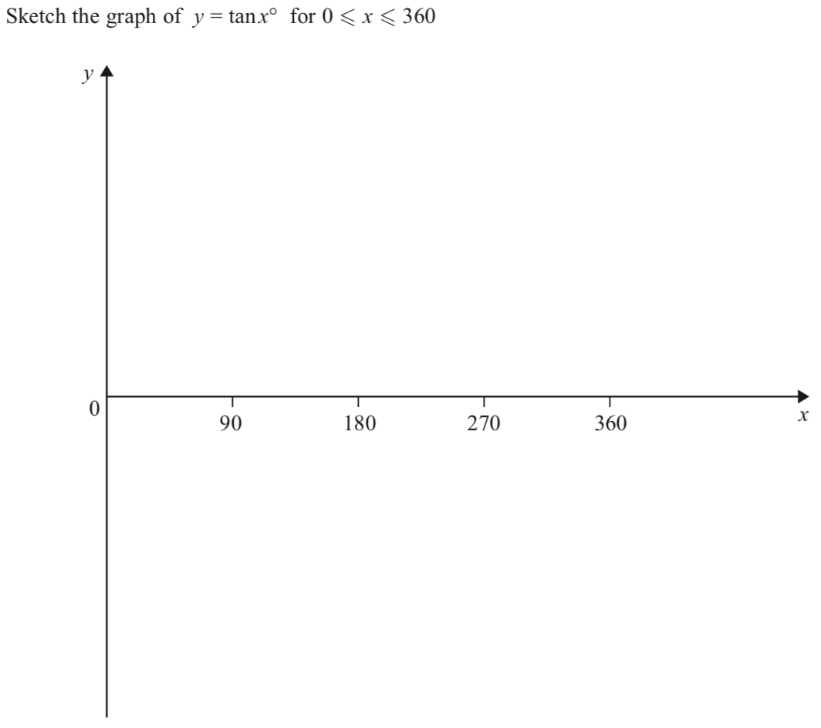
Trig graphs

Slide 21
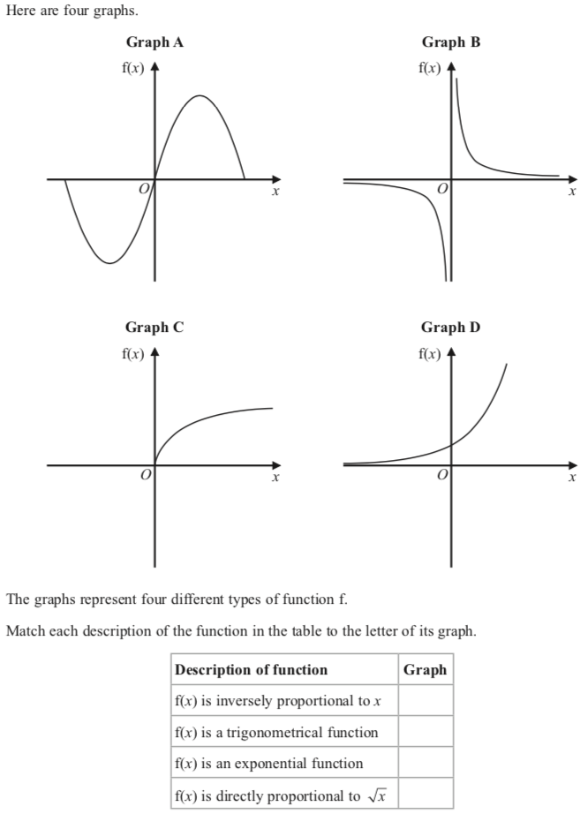
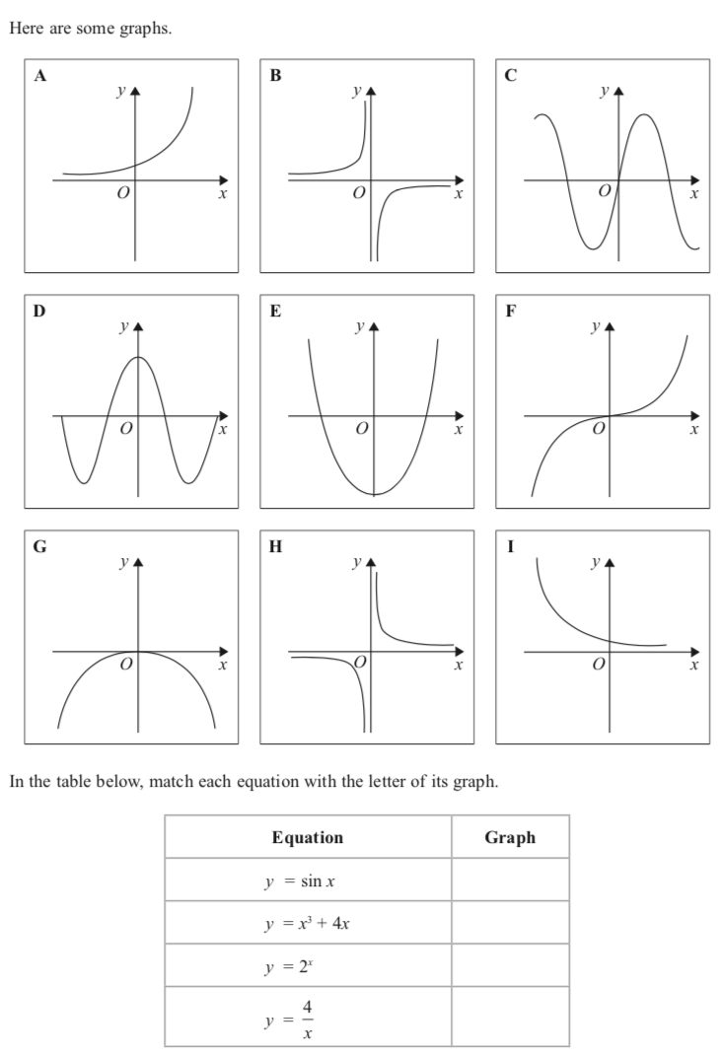
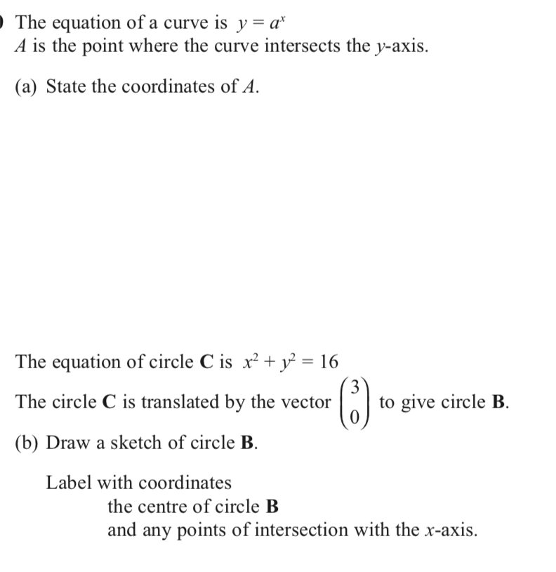
Other Graphs

Slide 22
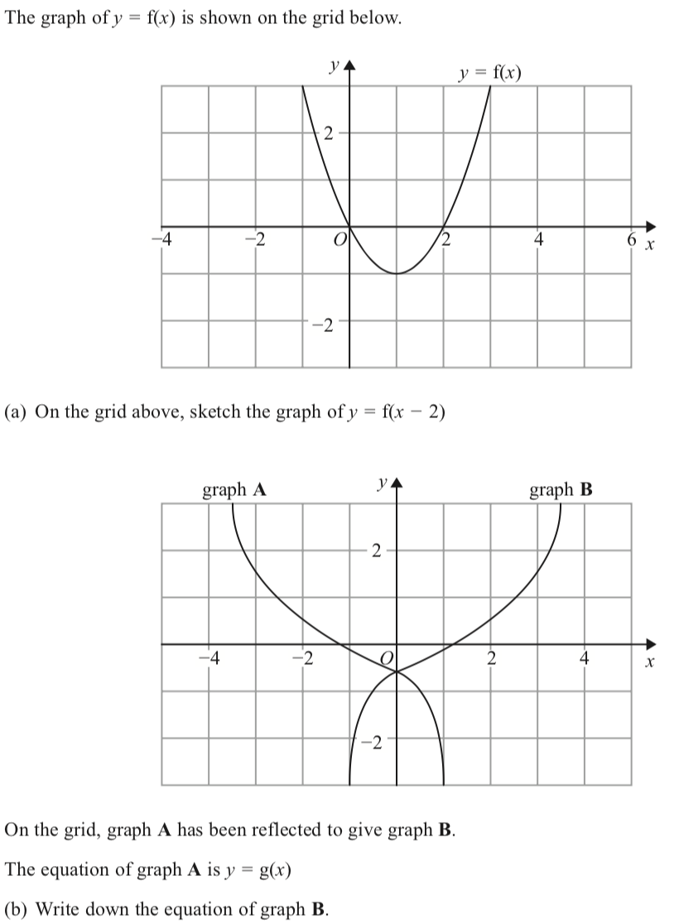
Transformation of graphs

Slide 23
Identifying parallel lines
Back to algebra
Home

Slide 24
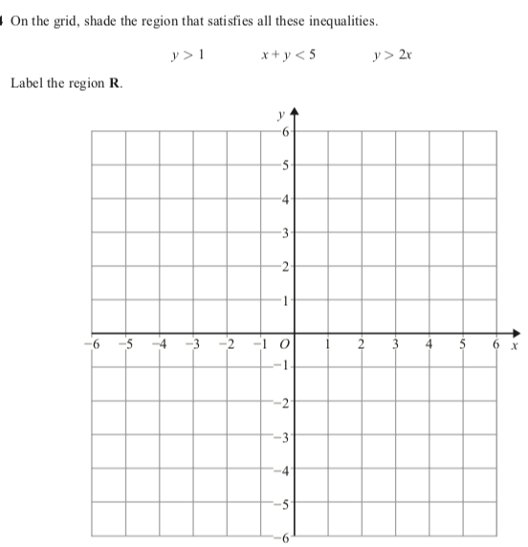
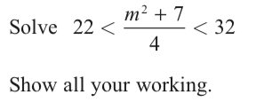
Inequalities
Back to algebra
Home

Slide 25
Inequalities
Back to algebra
Home

Slide 26
Iteration
Back to algebra
Home

Slide 27
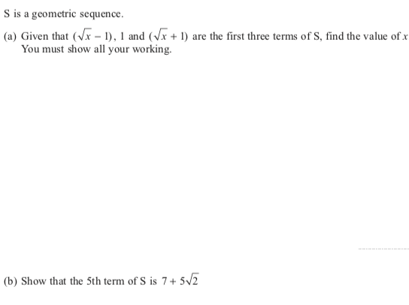
Sequences
Back to algebra
Home

Slide 28
Sequences
Back to algebra
Home

Slide 29
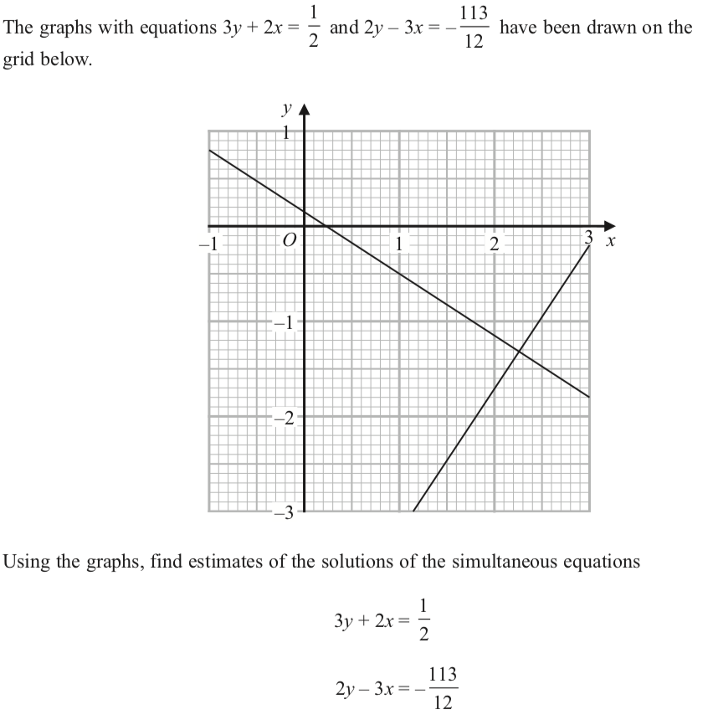
Simultaneous equations
Back to algebra
Home

Slide 30
Simultaneous equations
Back to algebra
Home

Slide 31
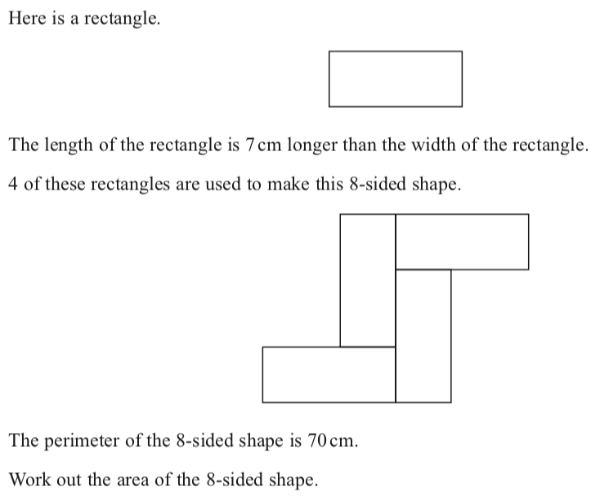
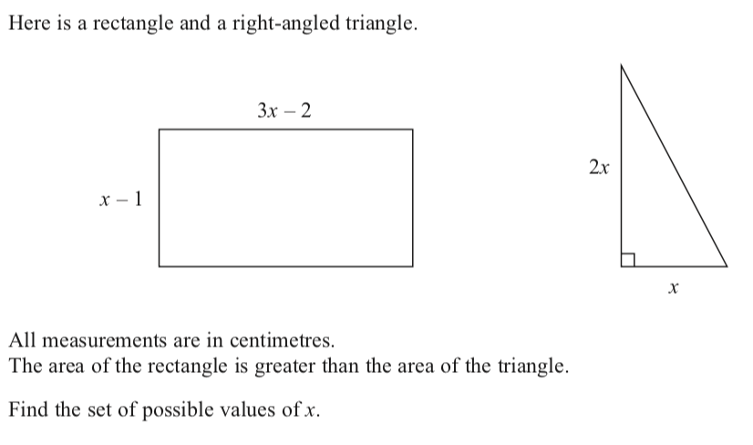
Writing and solve equations
Back to algebra
Home

Slide 32
Writing and solve equations
Back to algebra
Home

