Slide 1
Geometry and Measures
Angles
Area of triangle/sine and cosine rule
Circle theorems
Circles (inc arc and sector)
Congruence and similarity
Plans and elevations
Pythagoras
Transformations
Trig and Trig ratios
Vectors
Surface area and volume
3D Trig
Drawing problem solving
Title page

Slide 2
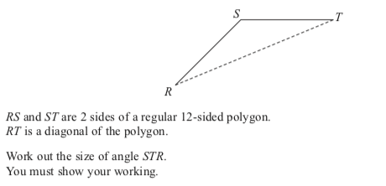
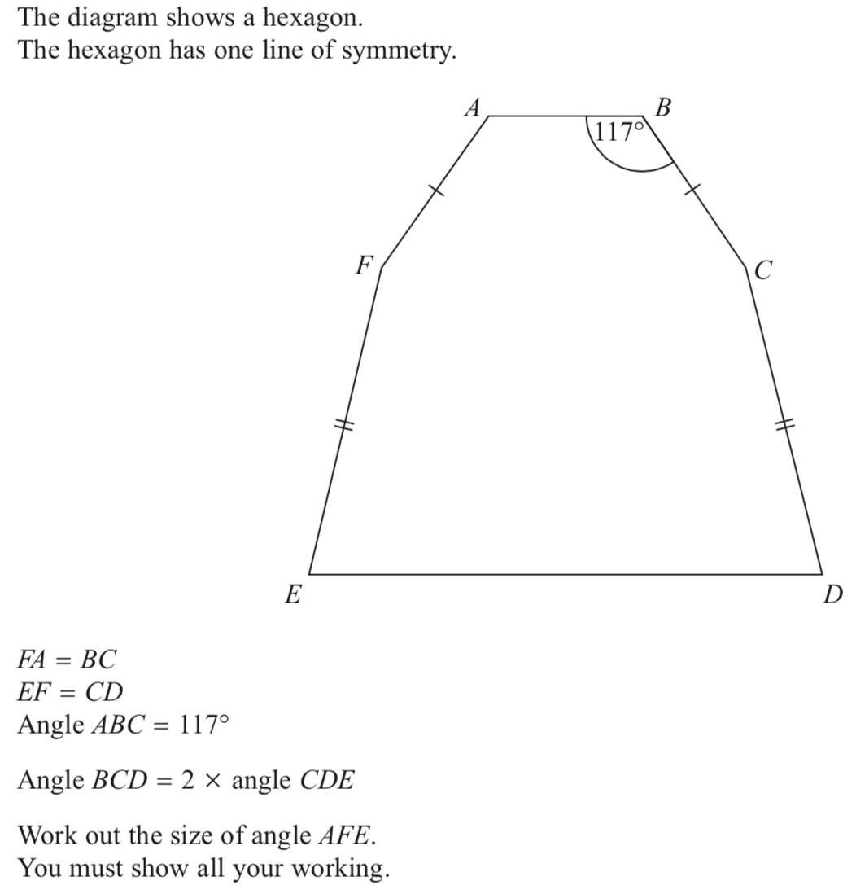
Angles
Back to G and M
Home

Slide 3
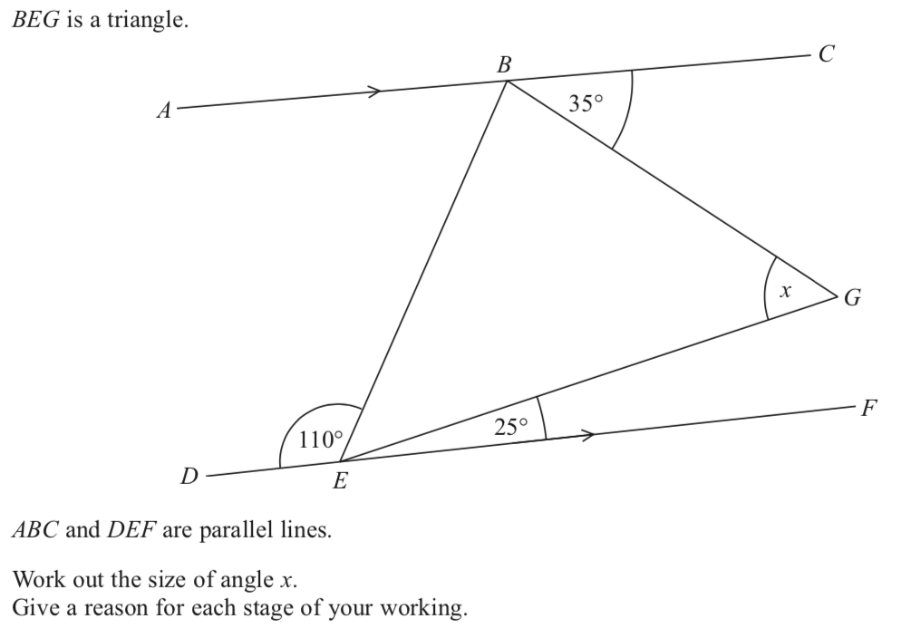
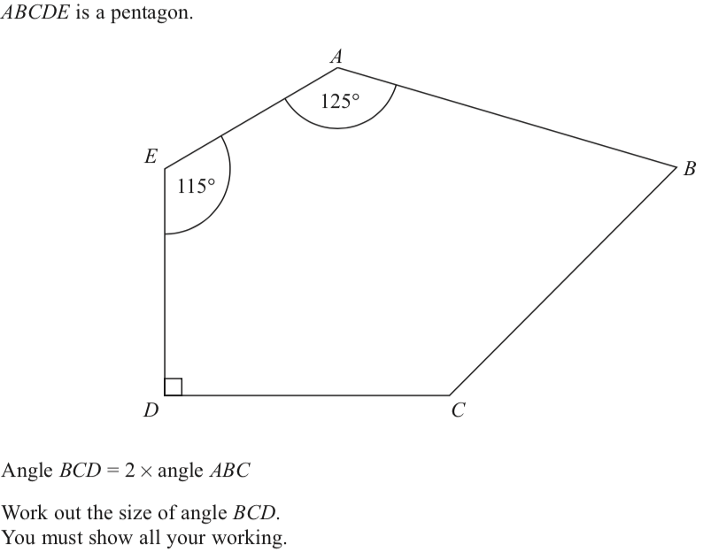
Angles
Back to G and M
Home

Slide 4
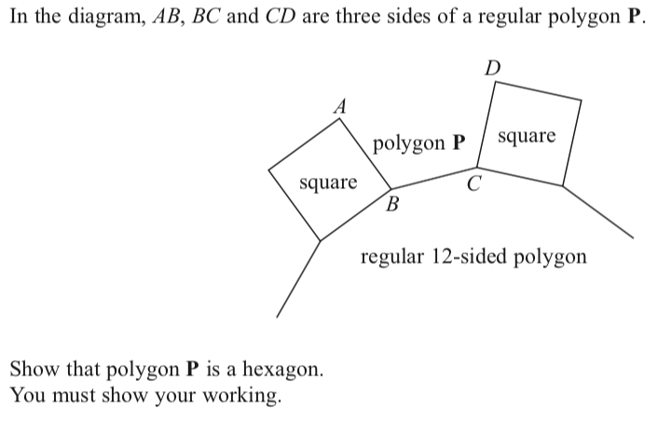
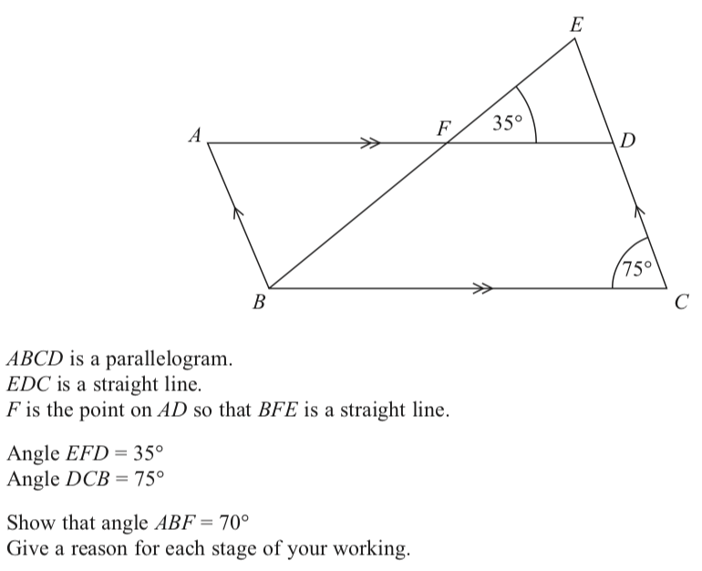
Angles
Back to G and M
Home

Slide 5
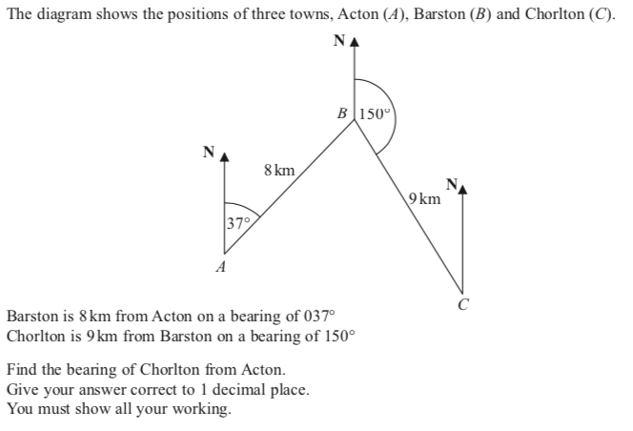
Area of a triangle, sine and cosine rule
Back to G and M
Home

Slide 6
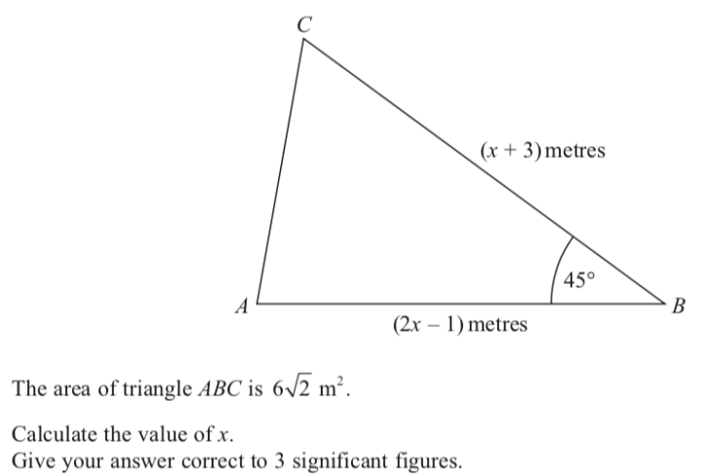
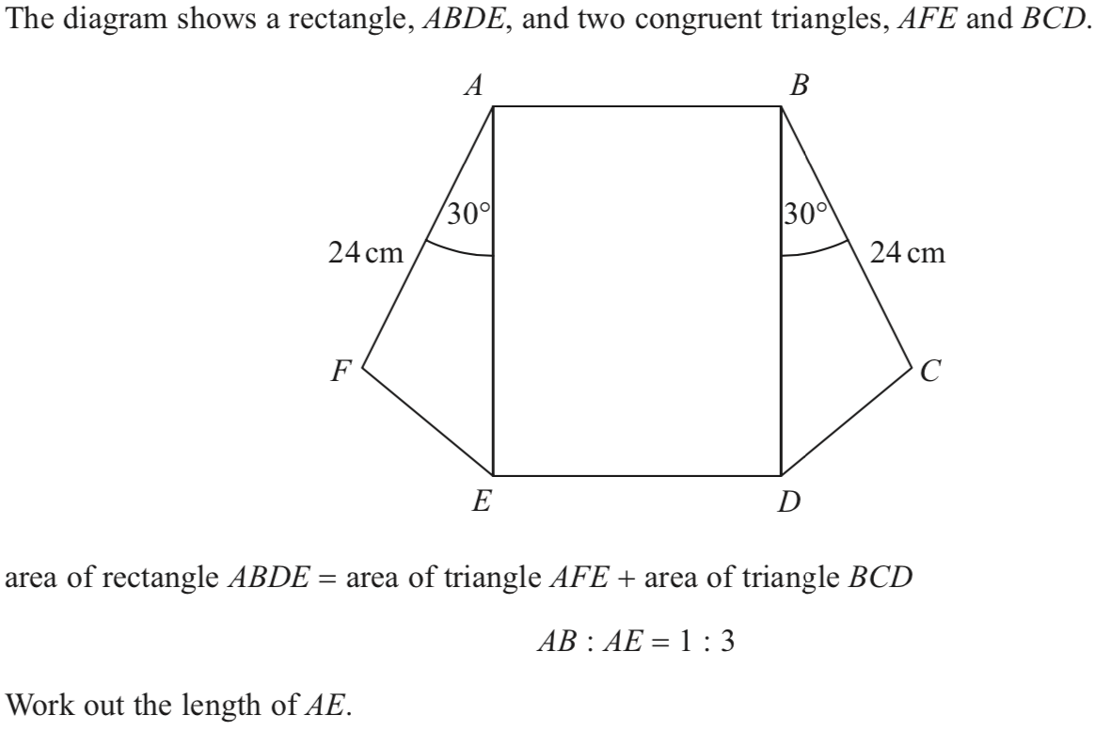
Area of a triangle, sine and cosine rule
Back to G and M
Home

Slide 7
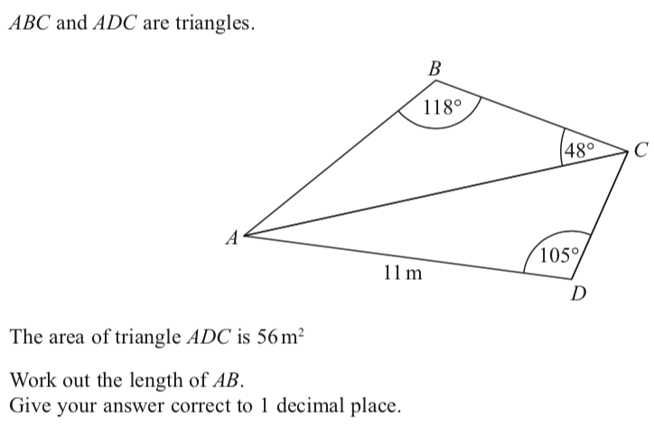
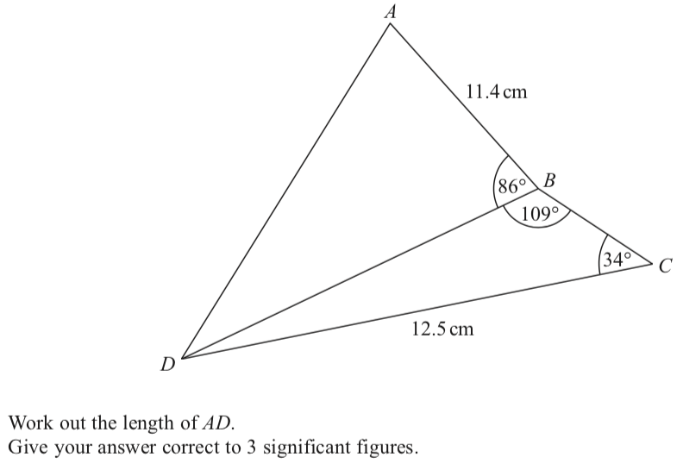
Area of a triangle, sine and cosine rule
Back to G and M
Home

Slide 8
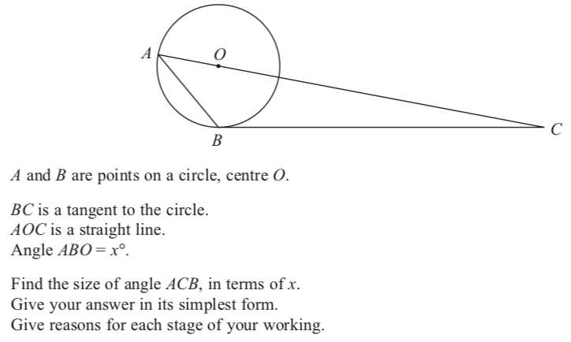
Circle theorems
Back to G and M
Home

Slide 9
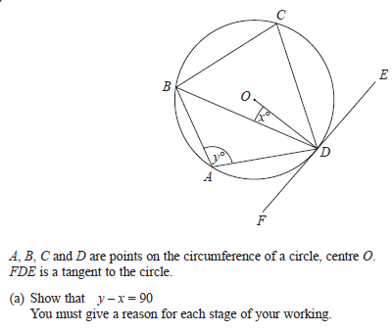
Circle theorems
Back to G and M
Home

Slide 10
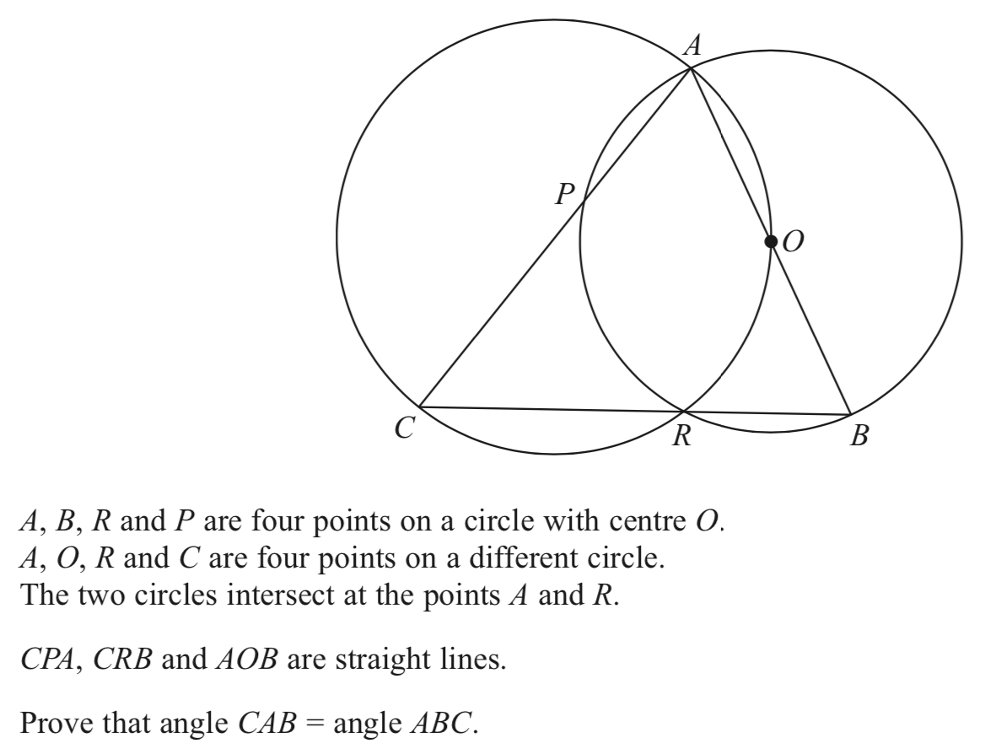
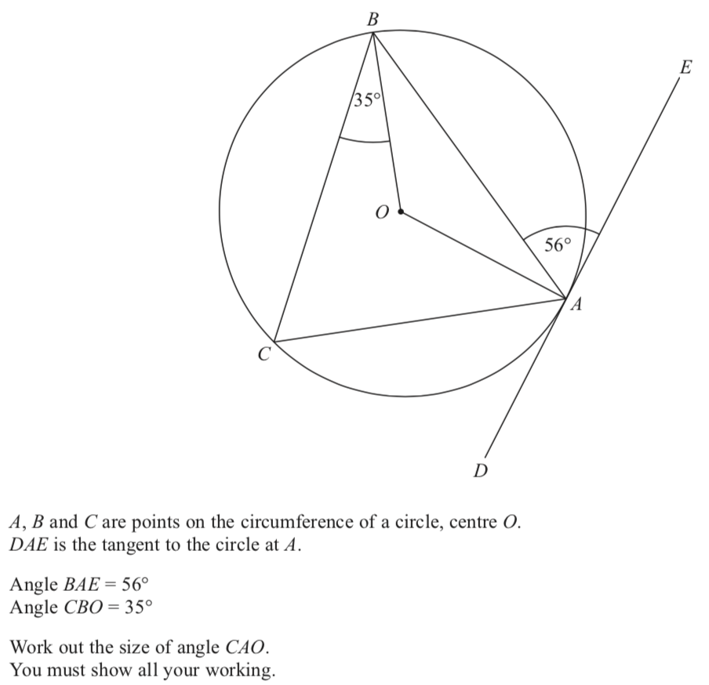
Circle theorems
Back to G and M
Home

Slide 11
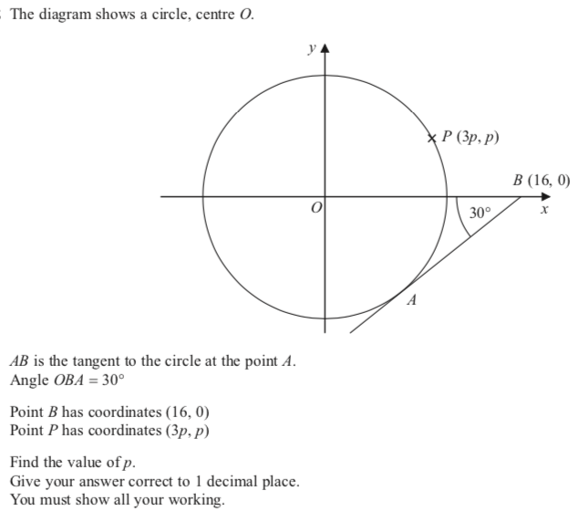
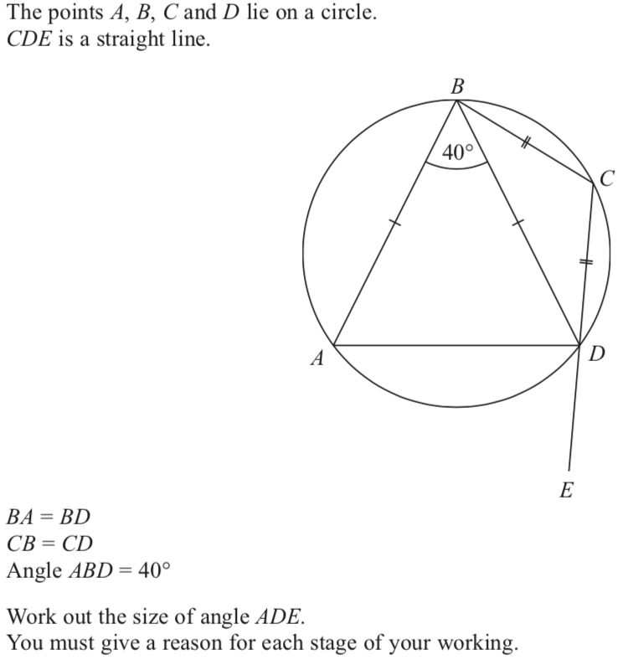
Circle theorems
Back to G and M
Home

Slide 12
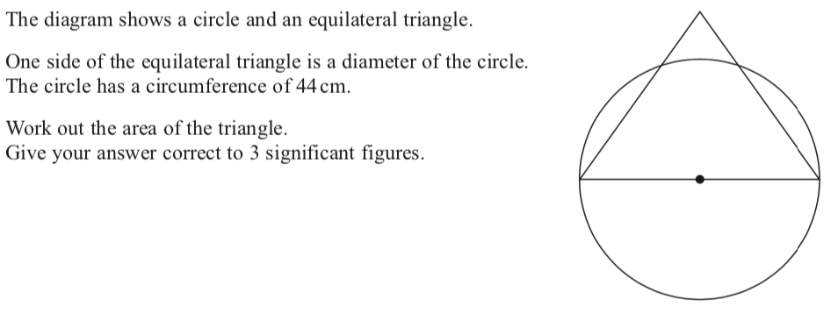
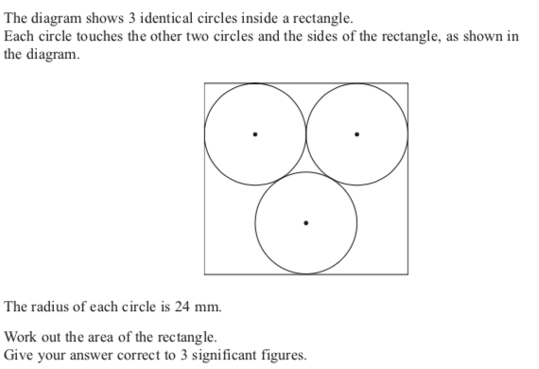
Circles
Back to G and M
Home

Slide 13
Circles
Back to G and M
Home

Slide 14
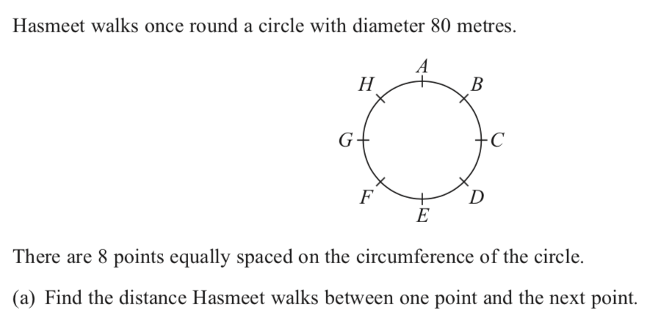
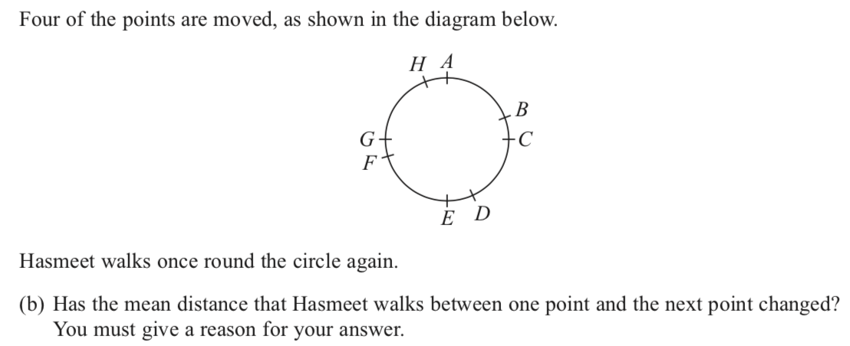
Circles
Back to G and M
Home

Slide 15
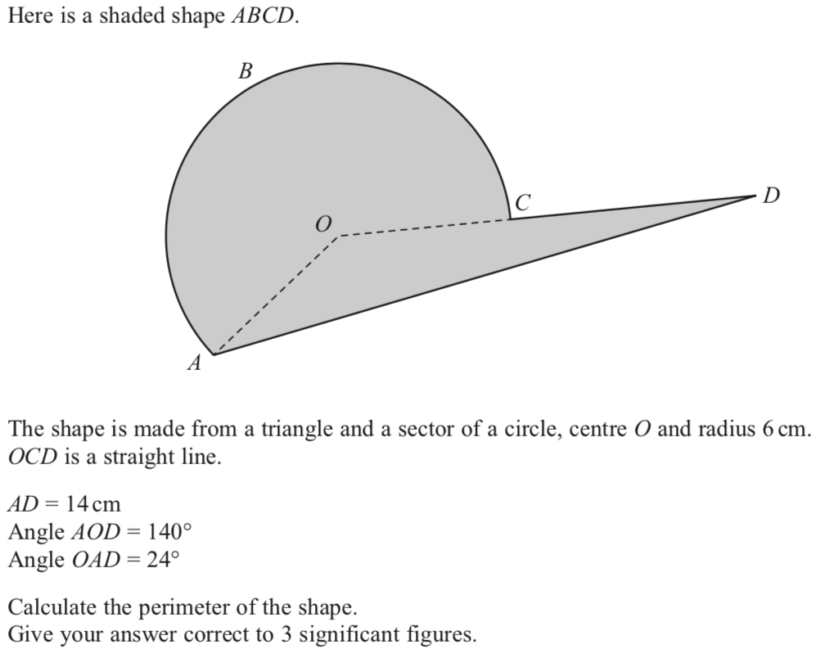
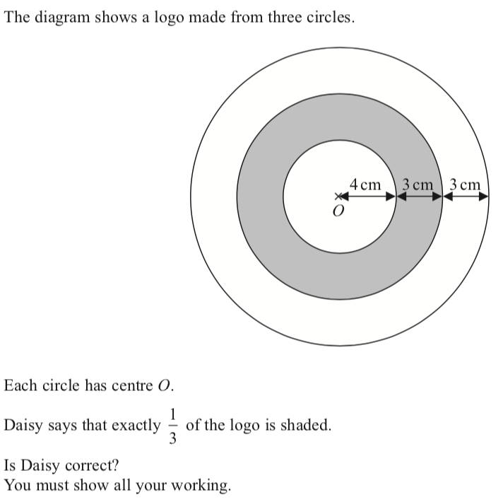
Circles 2

Slide 16
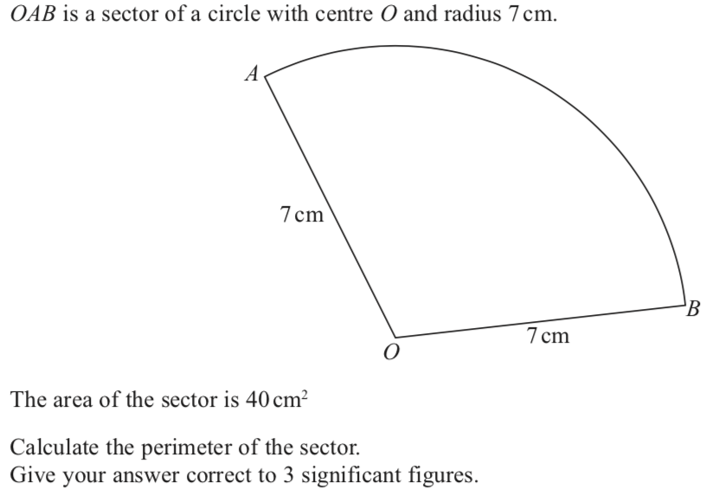
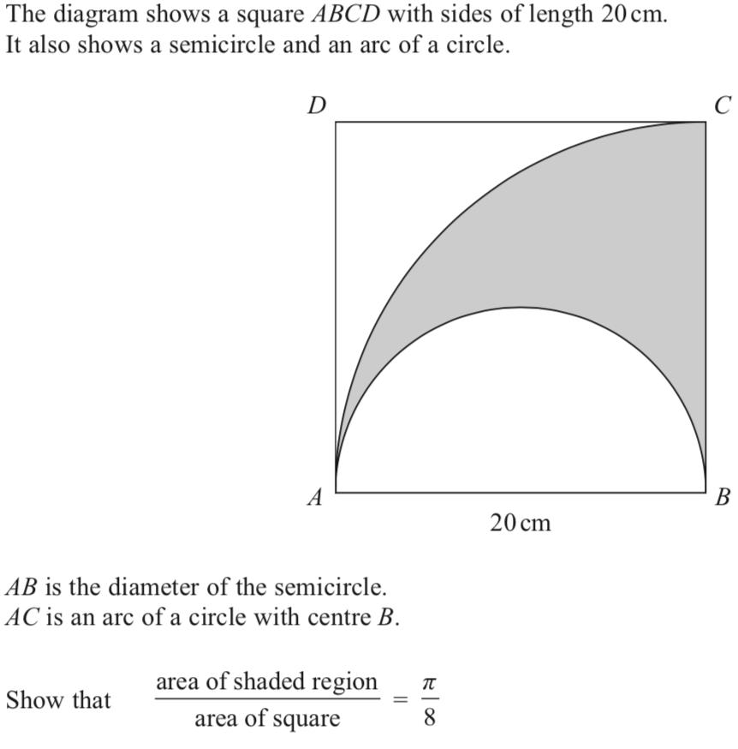
Circles 2

Slide 17
Congruency and similarity
Back to G and M
Home

Slide 18
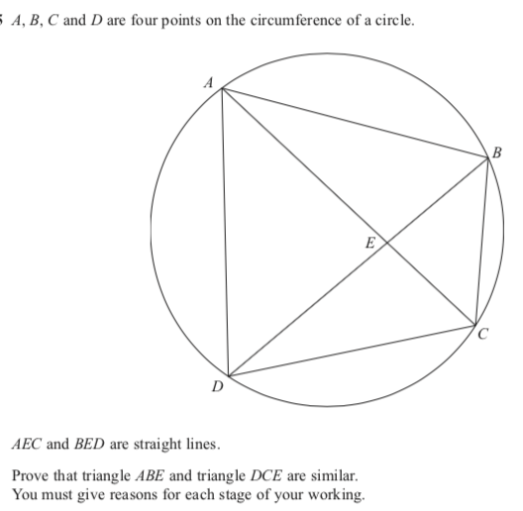
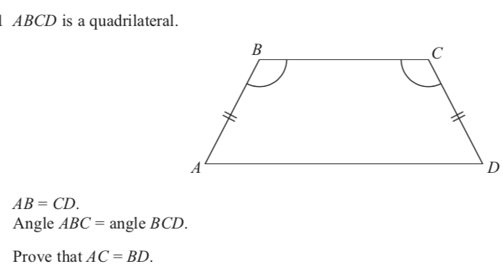
Congruency and similarity
Back to G and M
Home

Slide 19
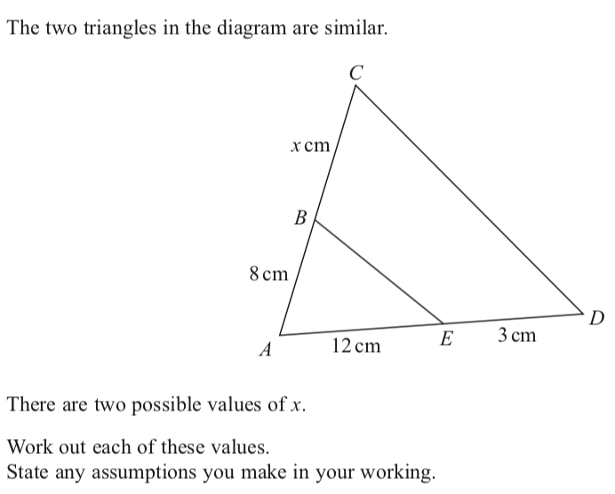
Congruency and similarity
Back to G and M
Home

Slide 20
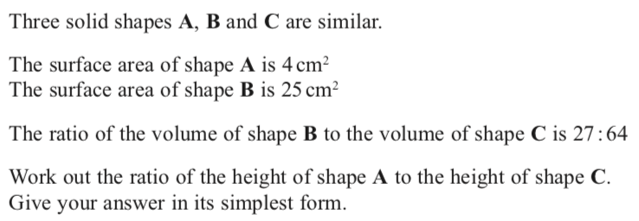
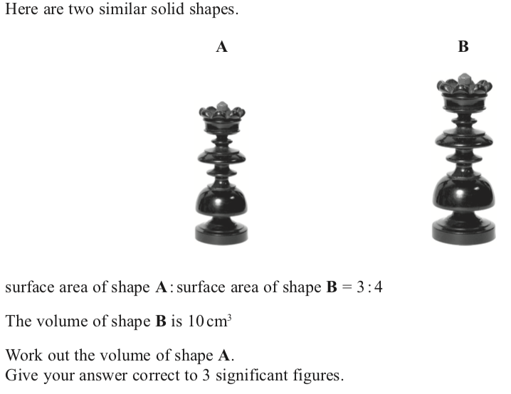
Congruency and similarity 2

Slide 21
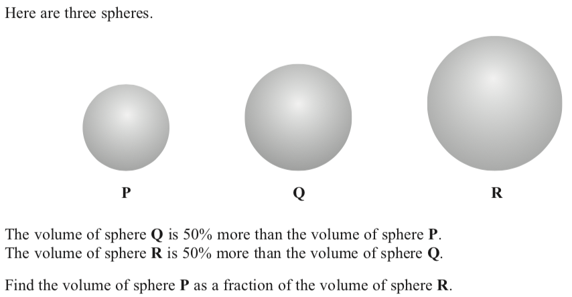
Congruency and similarity 2

Slide 22
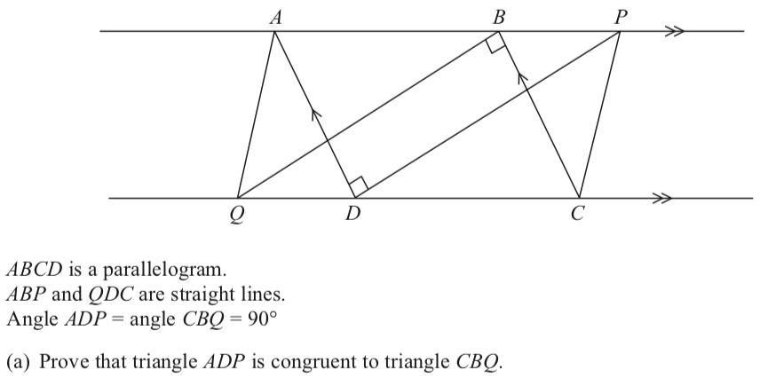
Congruency and similarity 2

Slide 23
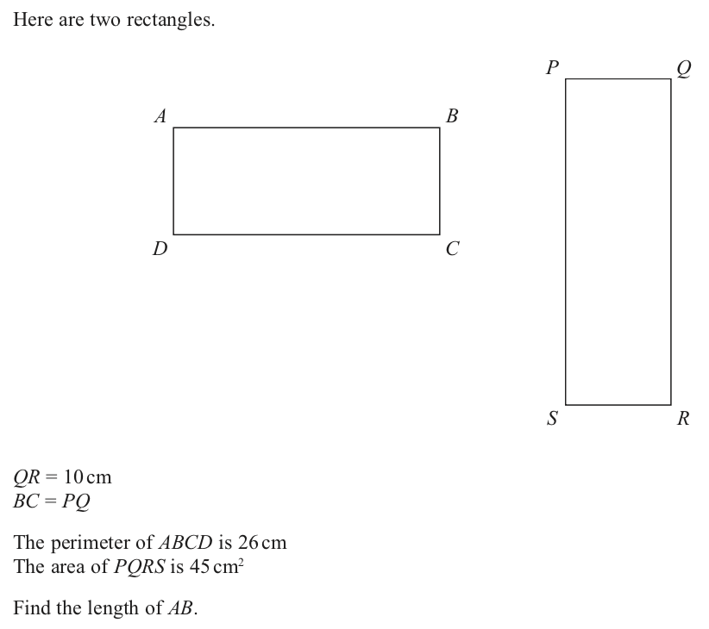
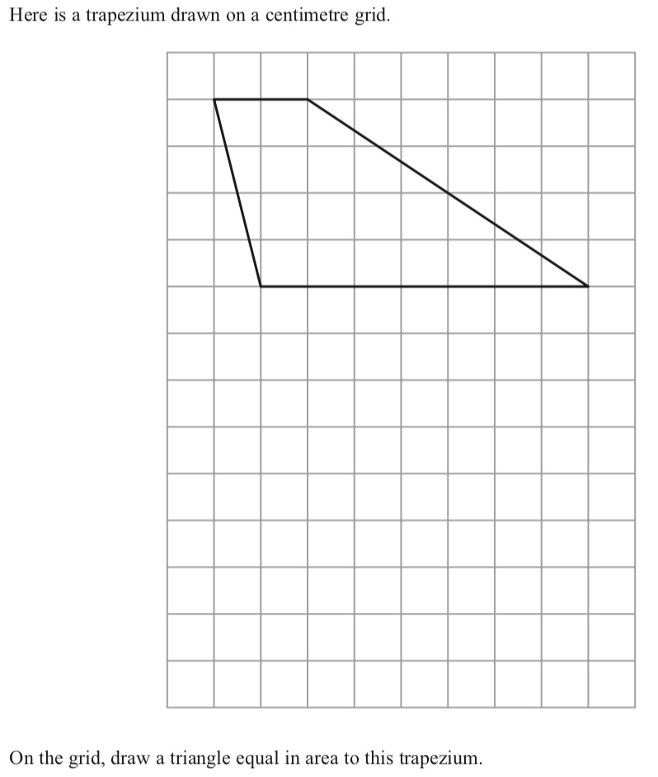
Drawing problem solving

Slide 24
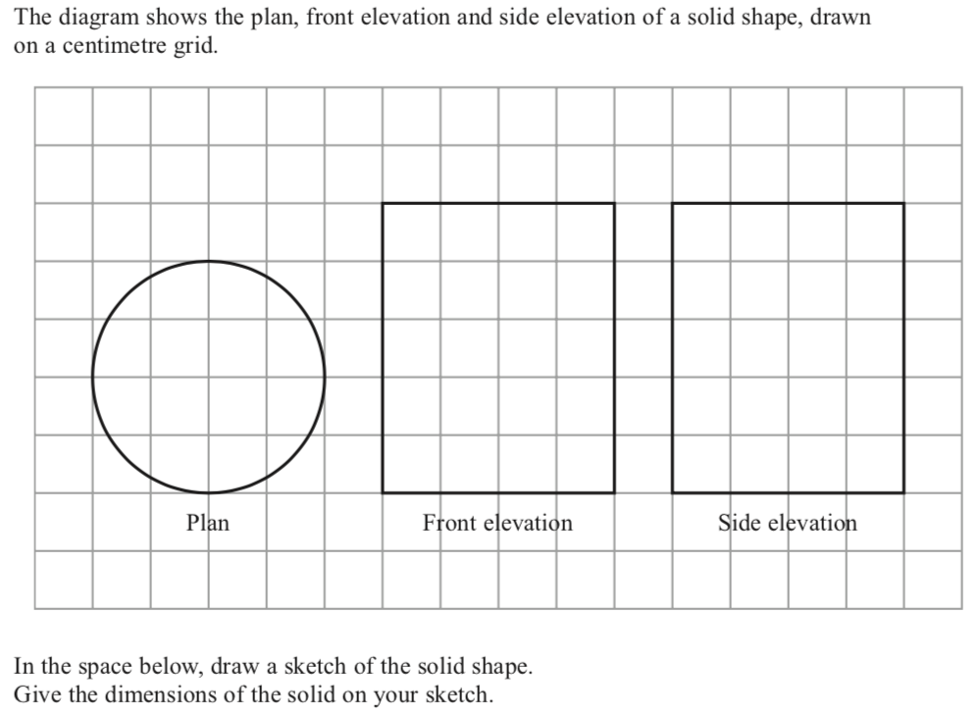
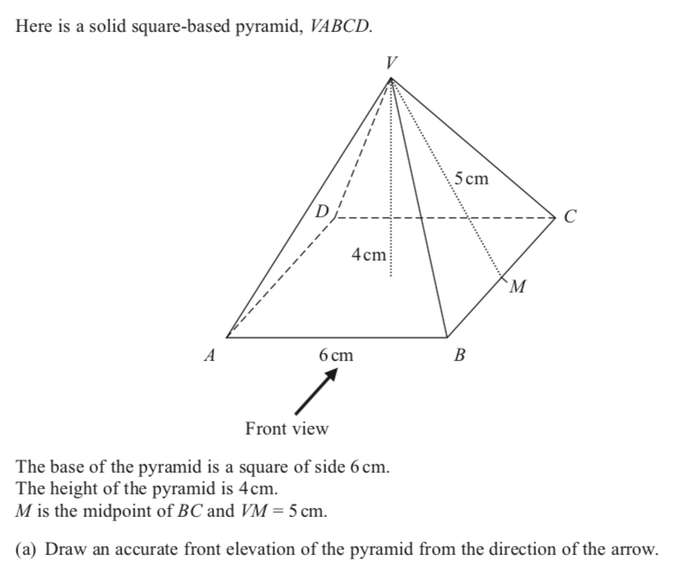
Plans and elevations
Back to G and M
Home

Slide 25
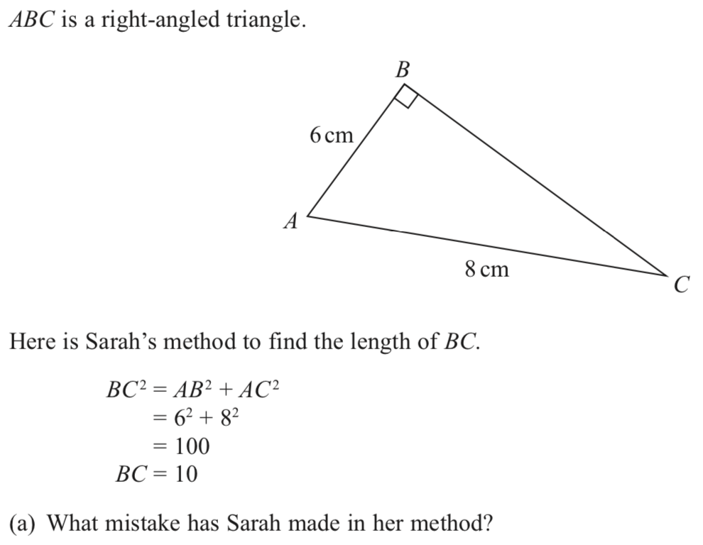
Pythagoras
Back to G and M
Home

Slide 26
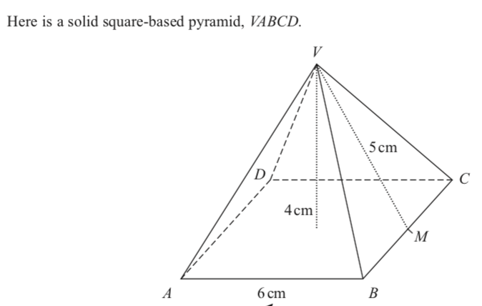
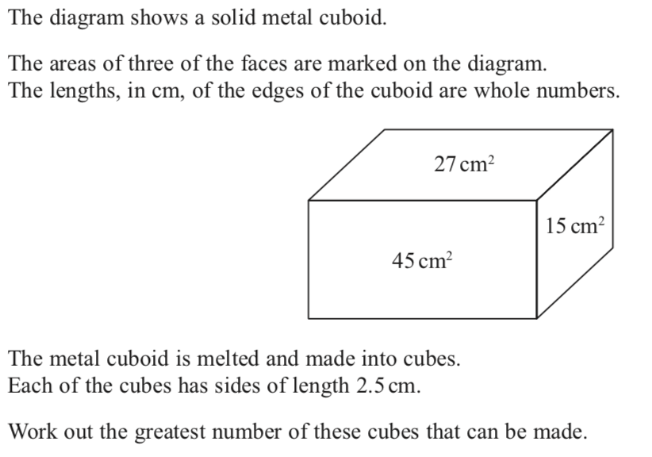
Surface area and volume
Back to G and M
Home

Slide 27
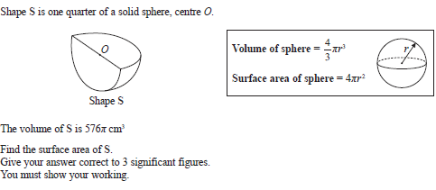
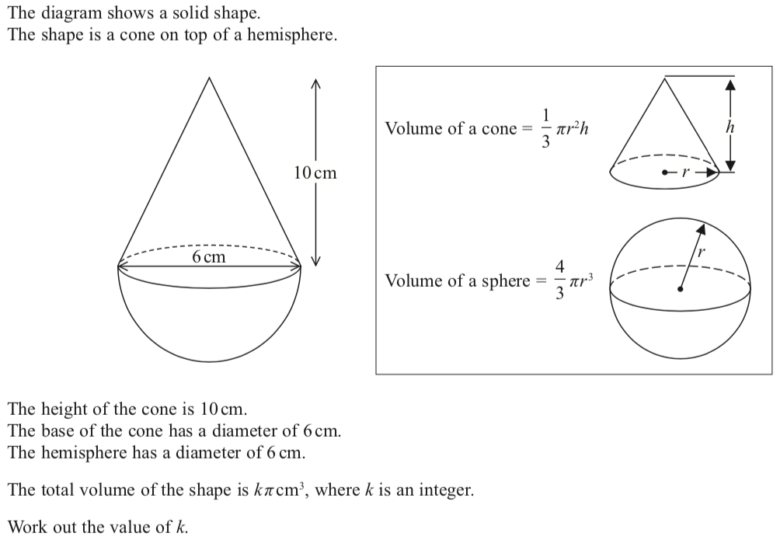
Surface area and volume
Back to G and M
Home

Slide 28
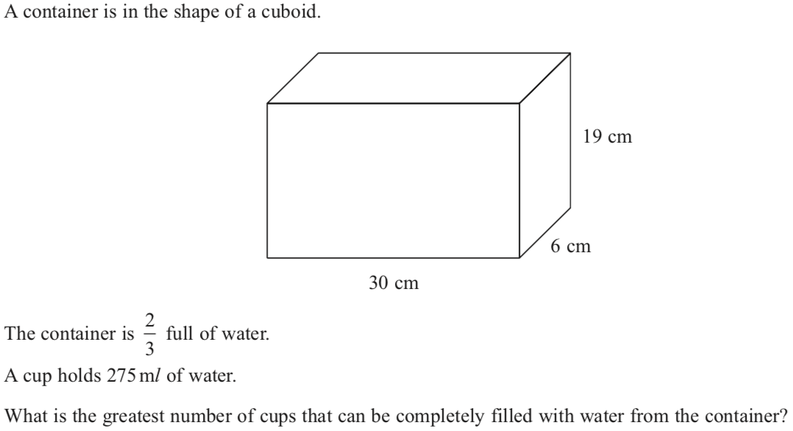
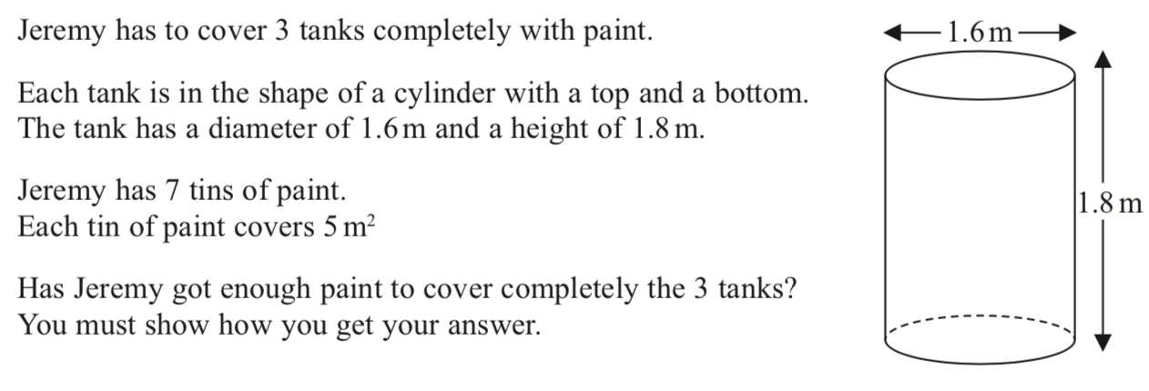
Surface area and volume 2
Back to G and M
Home

Slide 29
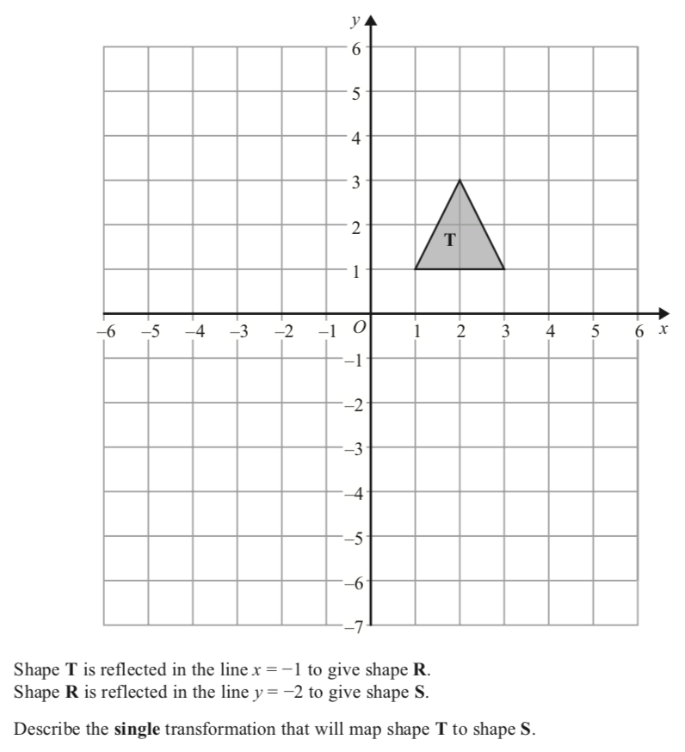
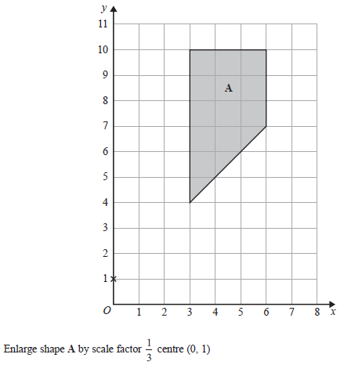
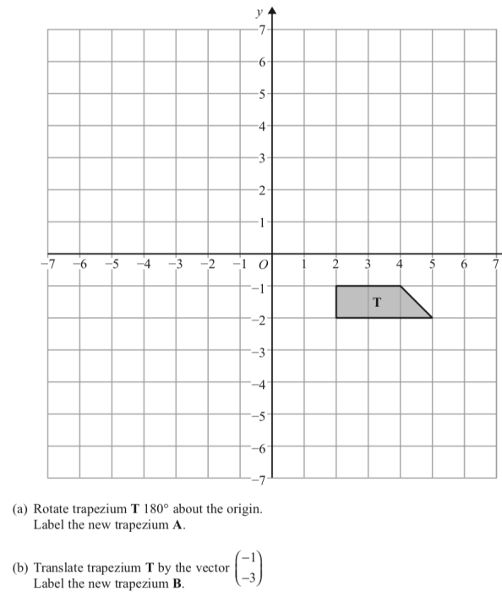
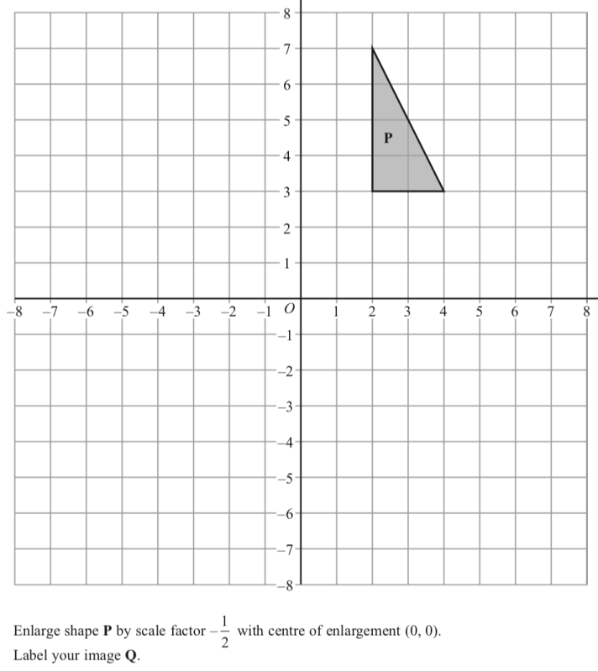
Transformations
Back to G and M
Home

Slide 30
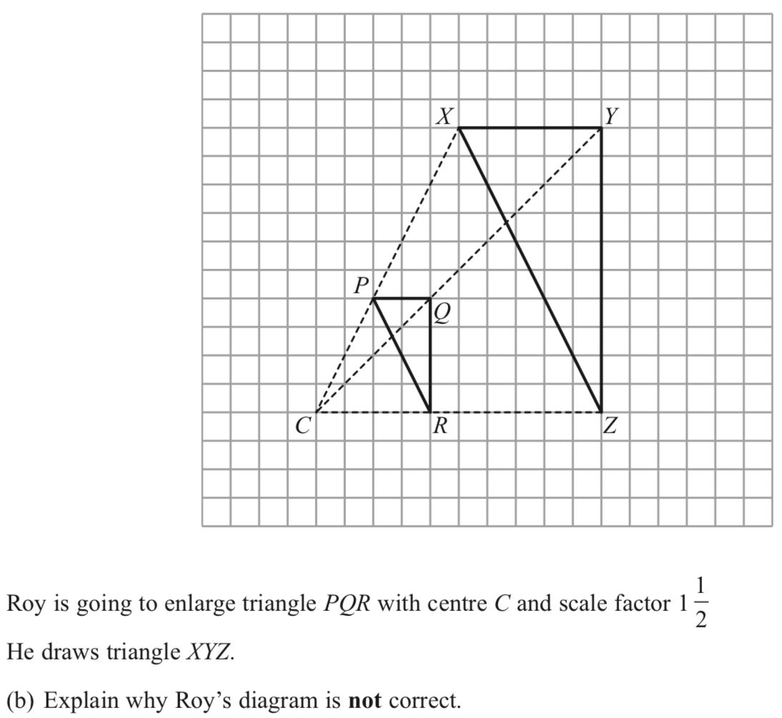
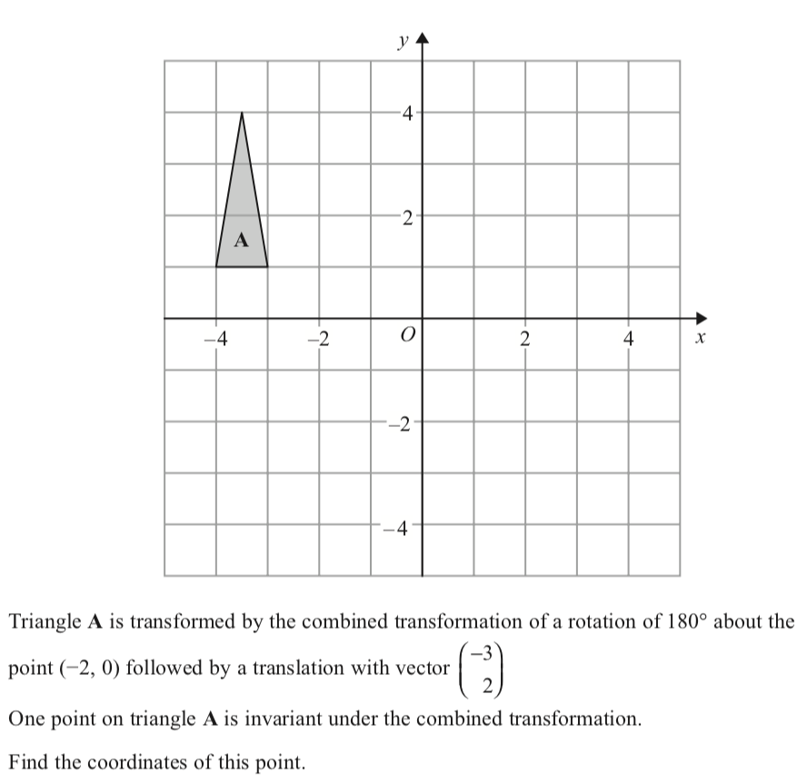
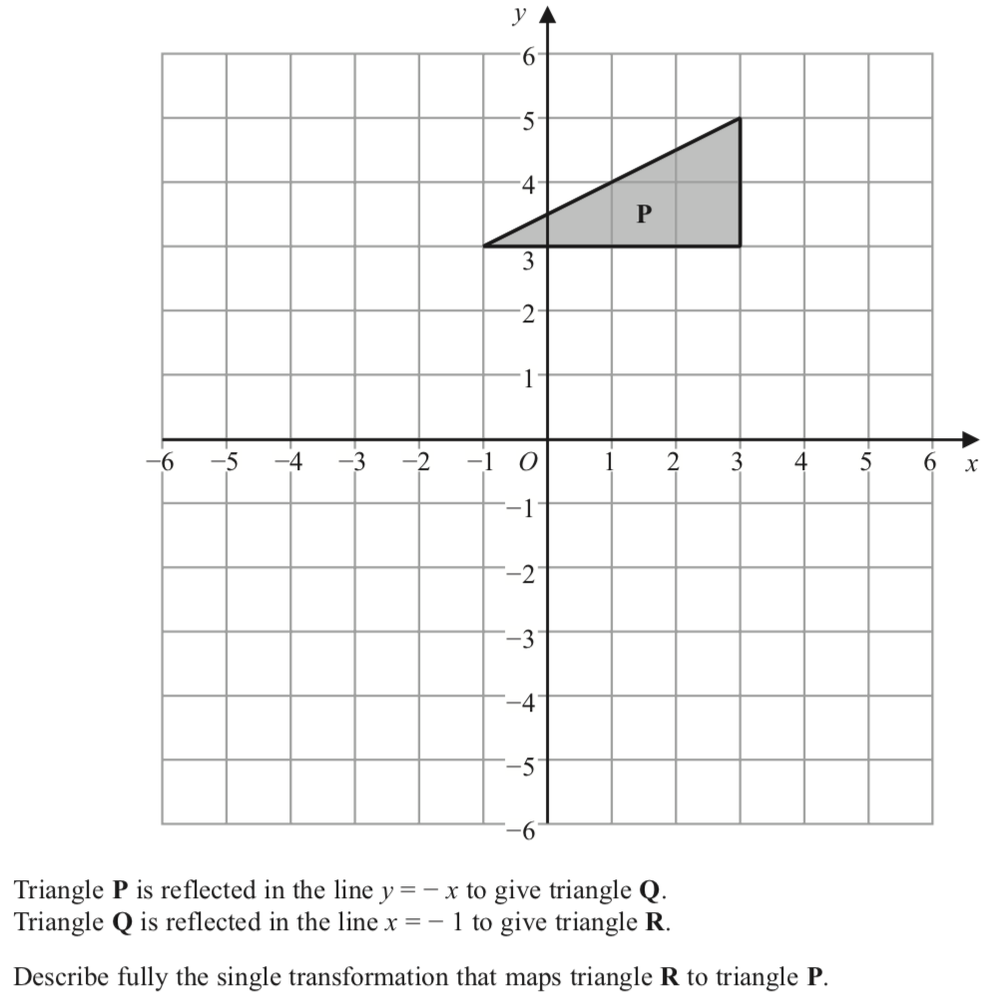
Transformations 2

Slide 31
Trig and trig ratios
Back to G and M
Home

Slide 32
Trig and trig ratios
Back to G and M
Home

Slide 33
Trig and trig ratio

Slide 34
Trig and trig ratios
Back to G and M
Home

Slide 35
3D trig

Slide 36
3D trig

Slide 37
Vectors
Back to G and M
Home

Slide 38
Vectors
Back to G and M
Home

Slide 39
Vectors
Back to G and M
Home

Slide 40
Vectors
Back to G and M
Home

