Slide 1
Statistics
Averages
Boxplots
Cumulative frequency
Histograms
Scatter graphs
Frequency polygons
Time series
Title page

Slide 2
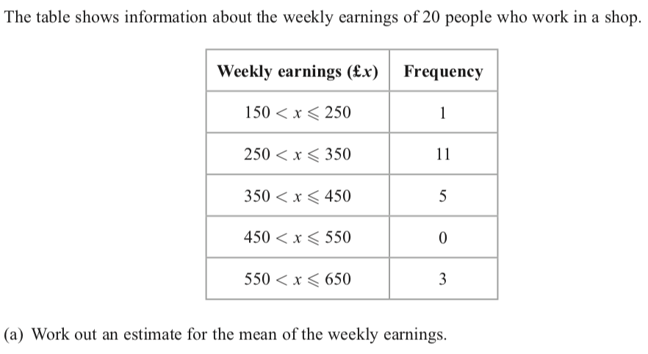
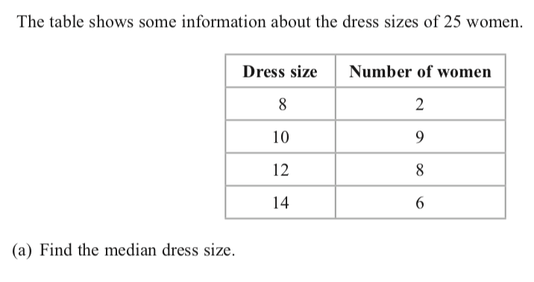
Averages
Back to Statistics
Home

Slide 3
Averages
Back to Statistics
Home

Slide 4
Box plots
Back to Statistics
Home

Slide 5
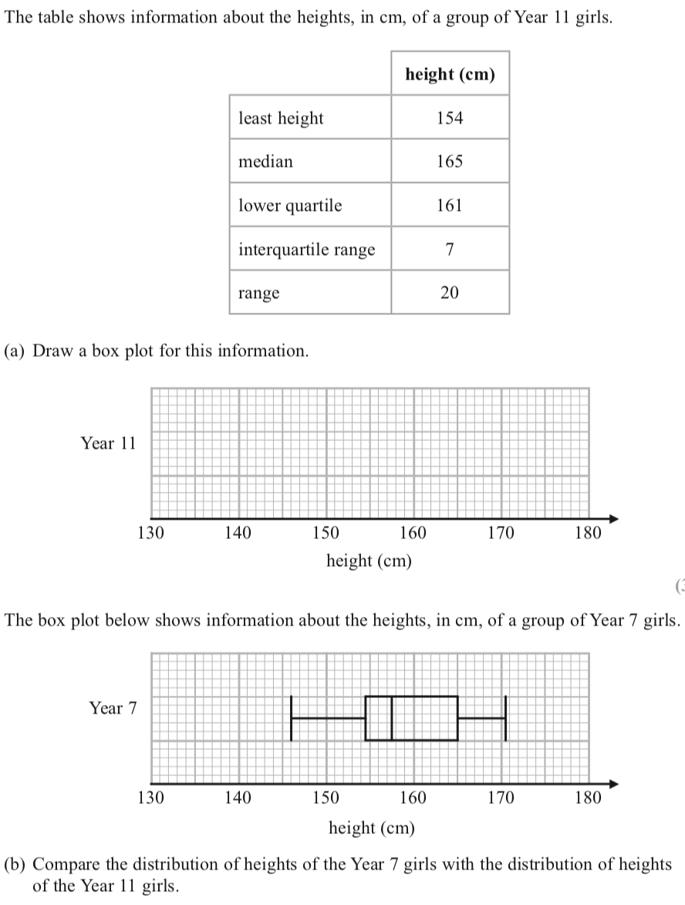
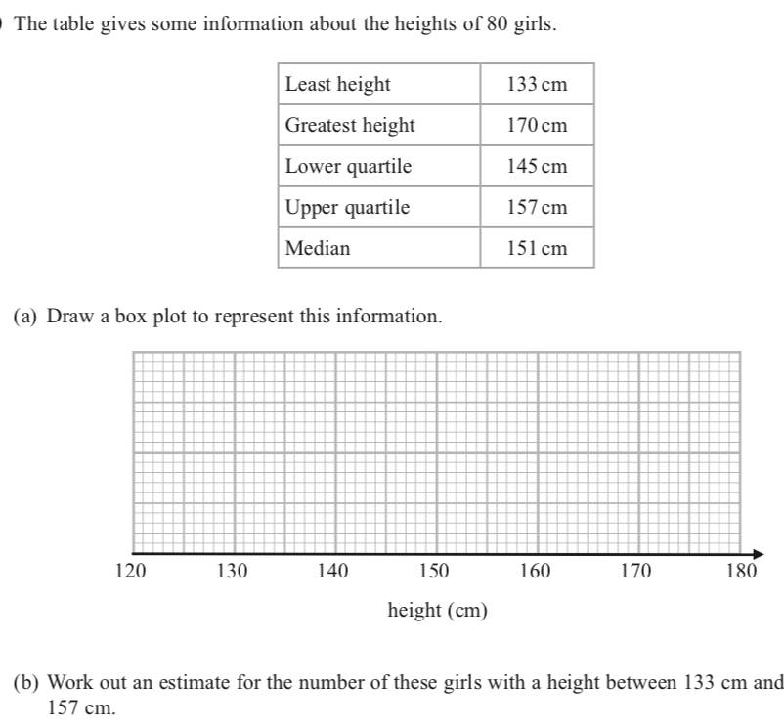
Box plots
Back to Statistics
Home

Slide 6
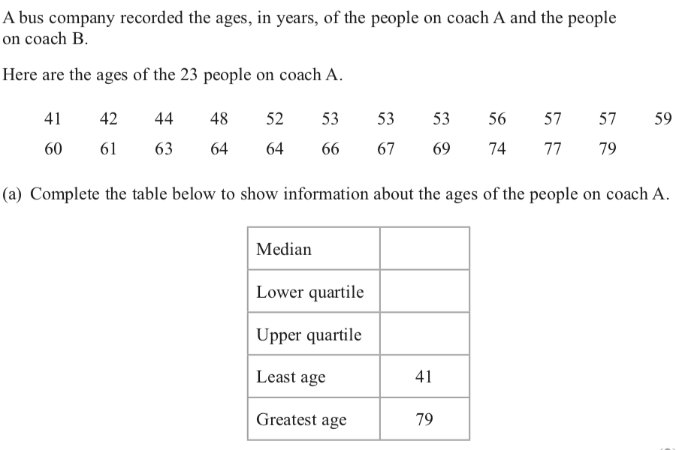
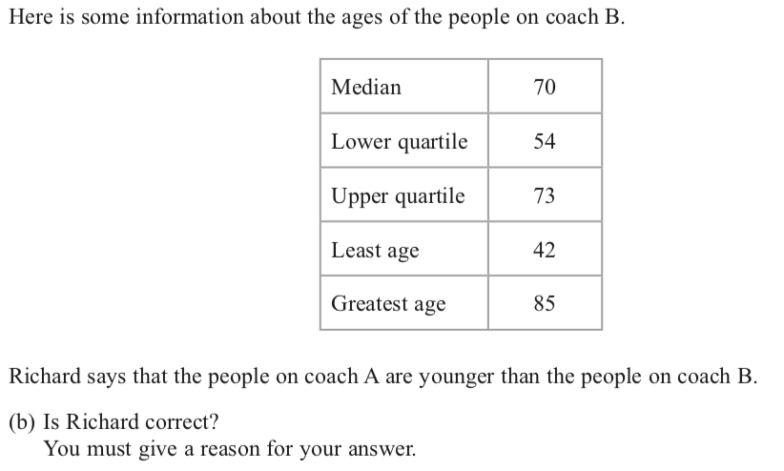
Box plots

Slide 7
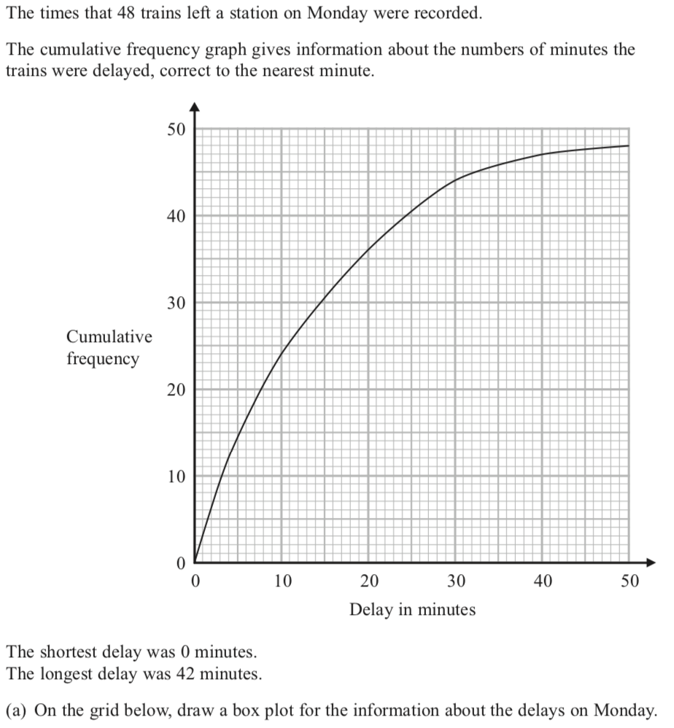
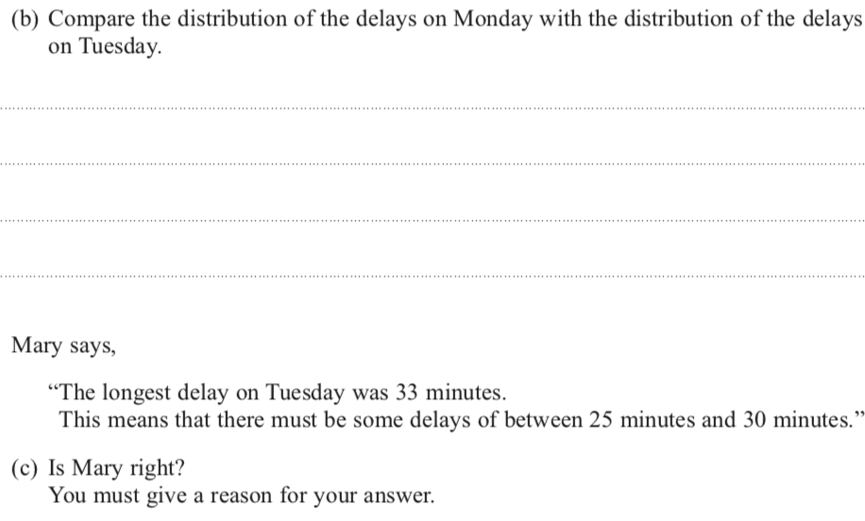
Box plots

Slide 8
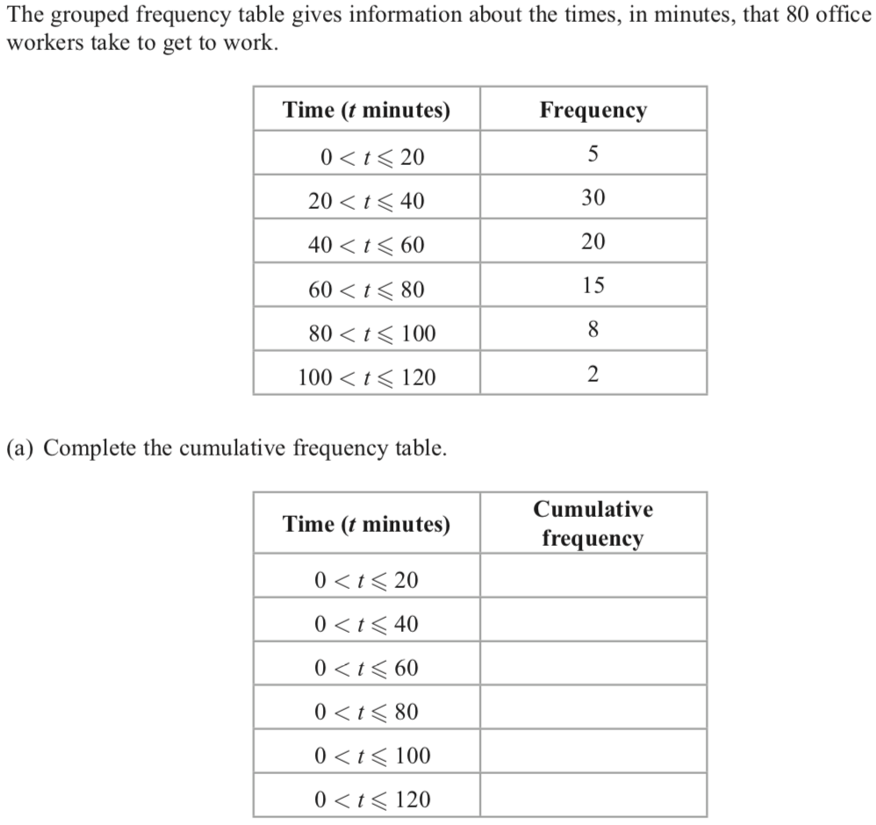
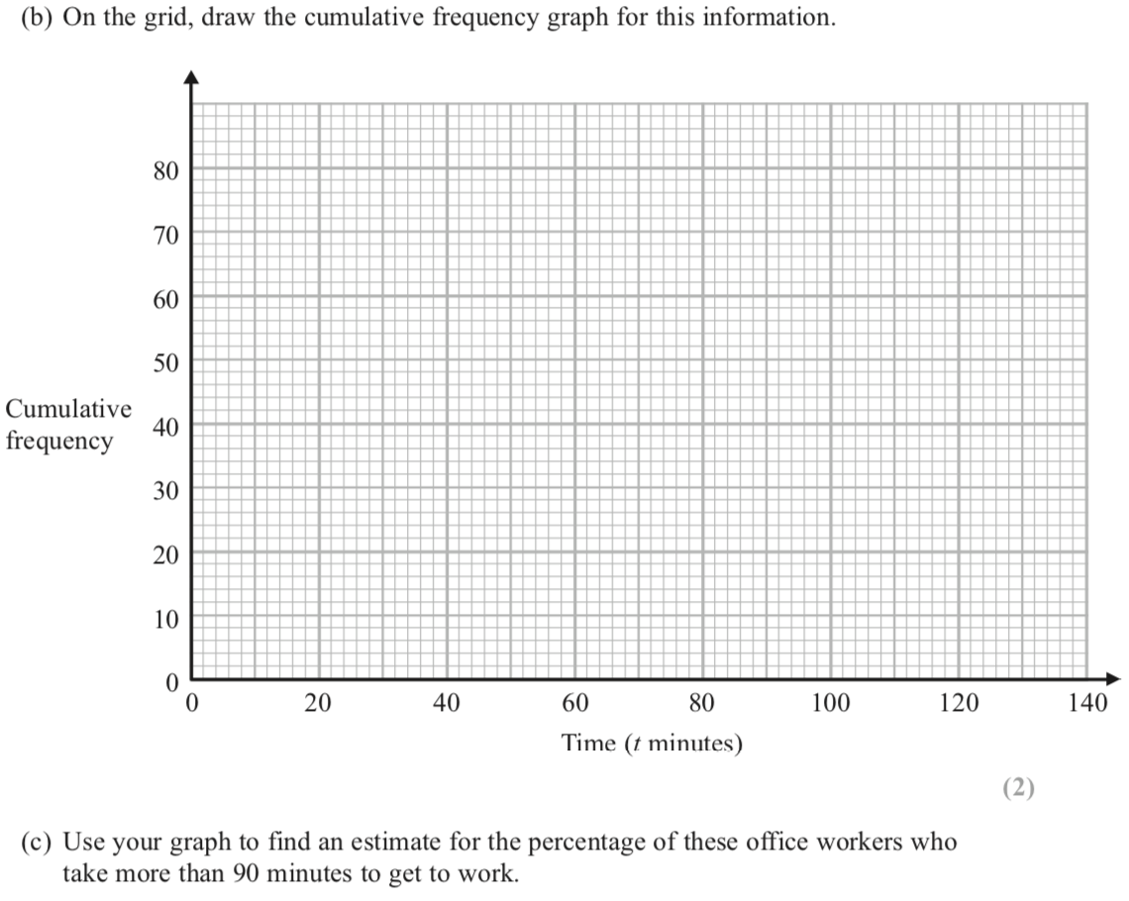
Cumulative frequency
Back to Statistics
Home

Slide 9
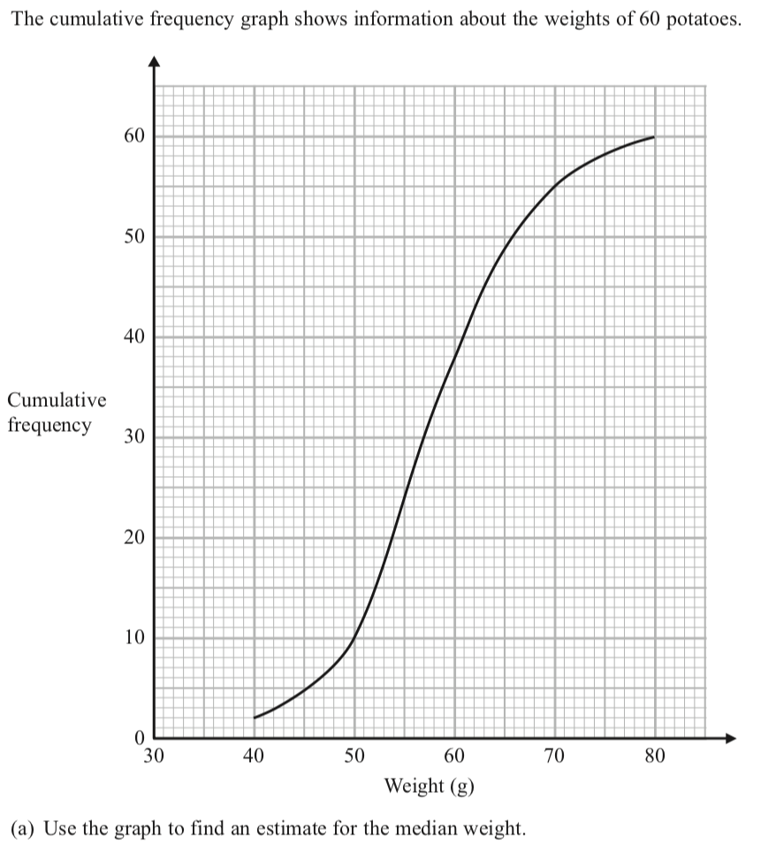
Cumulative frequency
Back to Statistics
Home

Slide 10
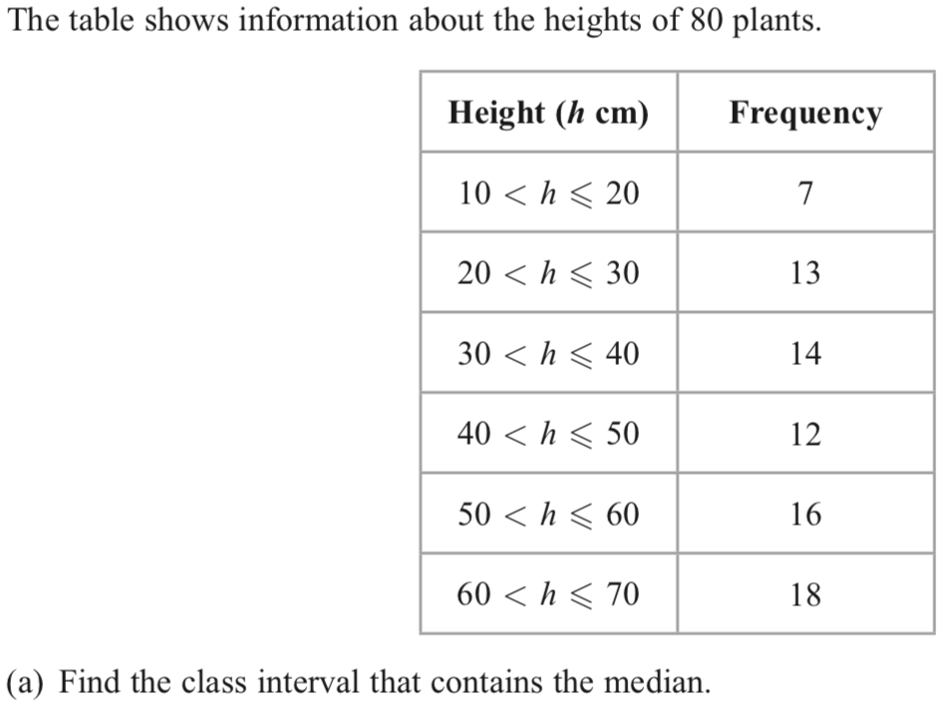
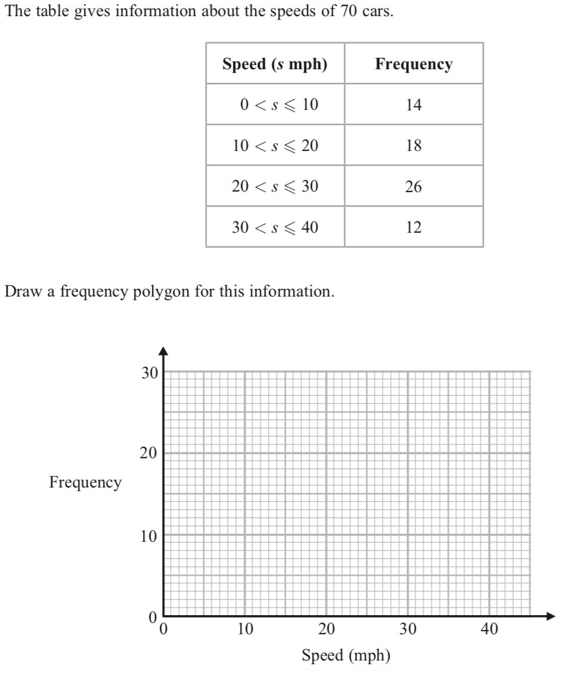
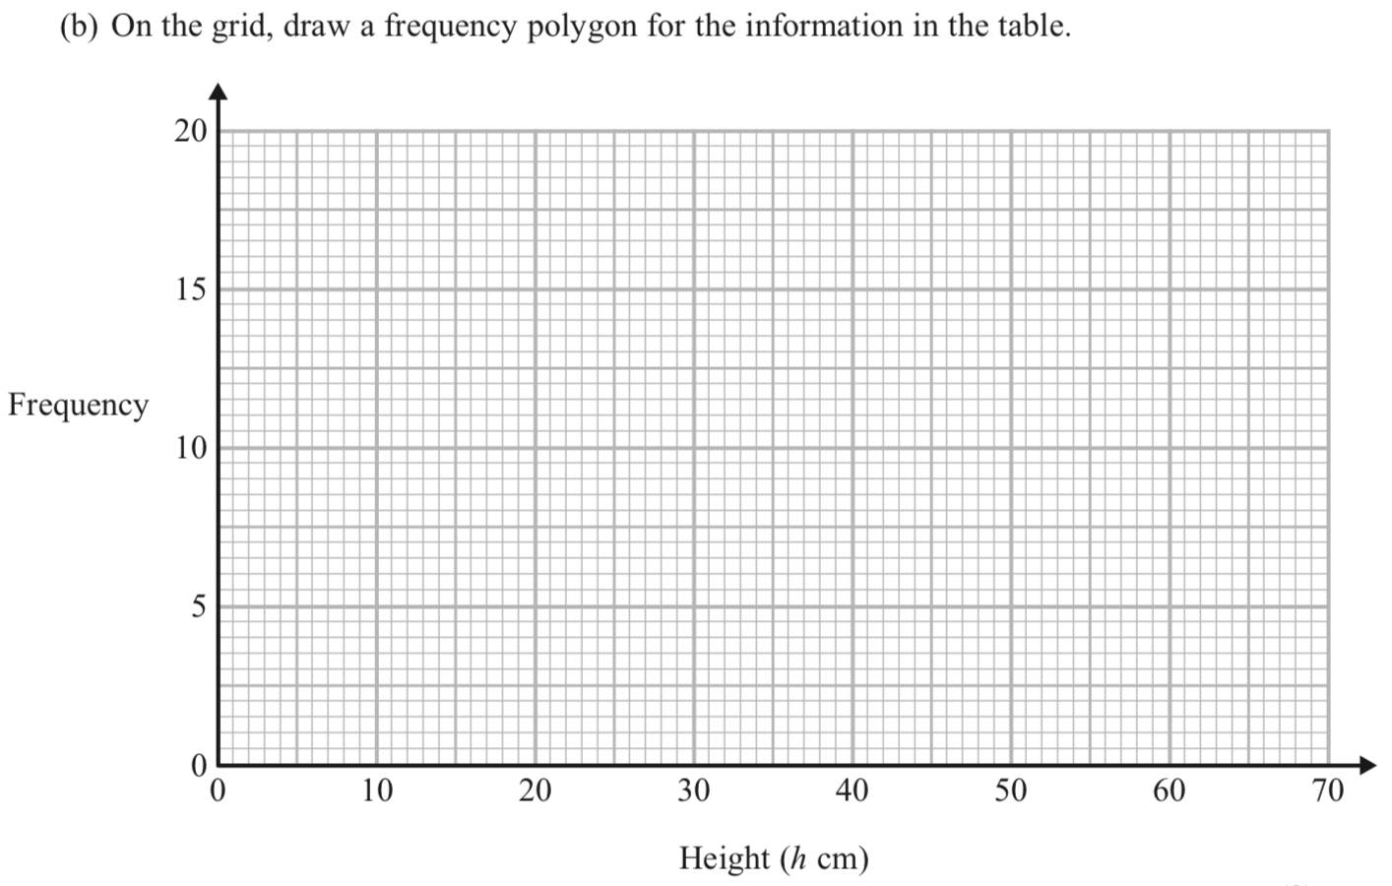
Frequency polygons
Back to Statistics
Home

Slide 11
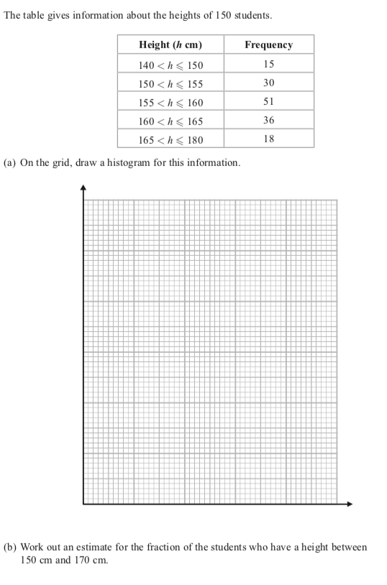
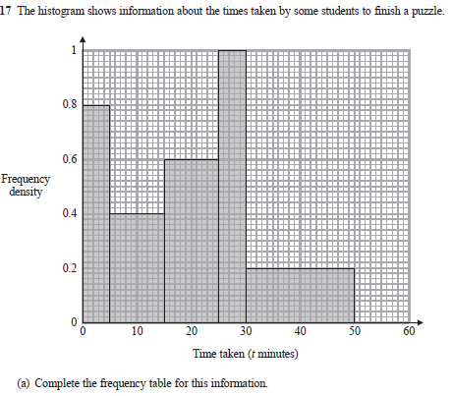
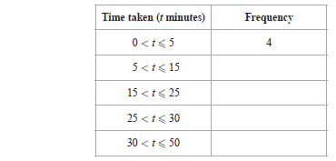
Histograms
Back to Statistics
Home

Slide 12
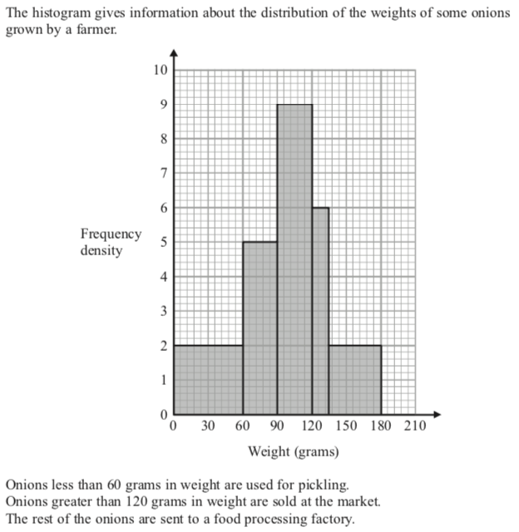
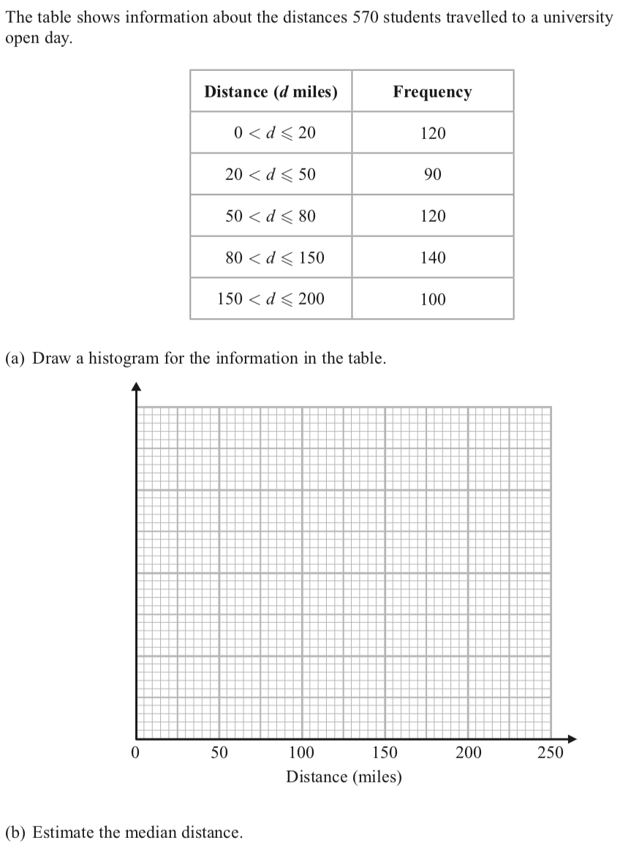
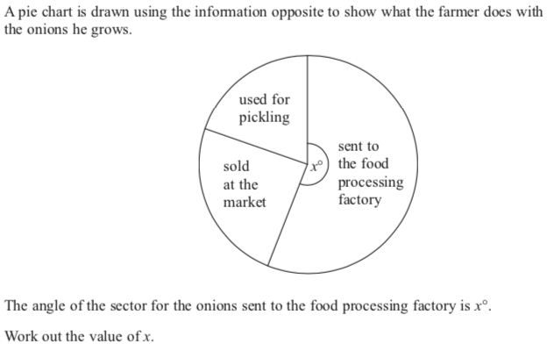
Histograms 2

Slide 13
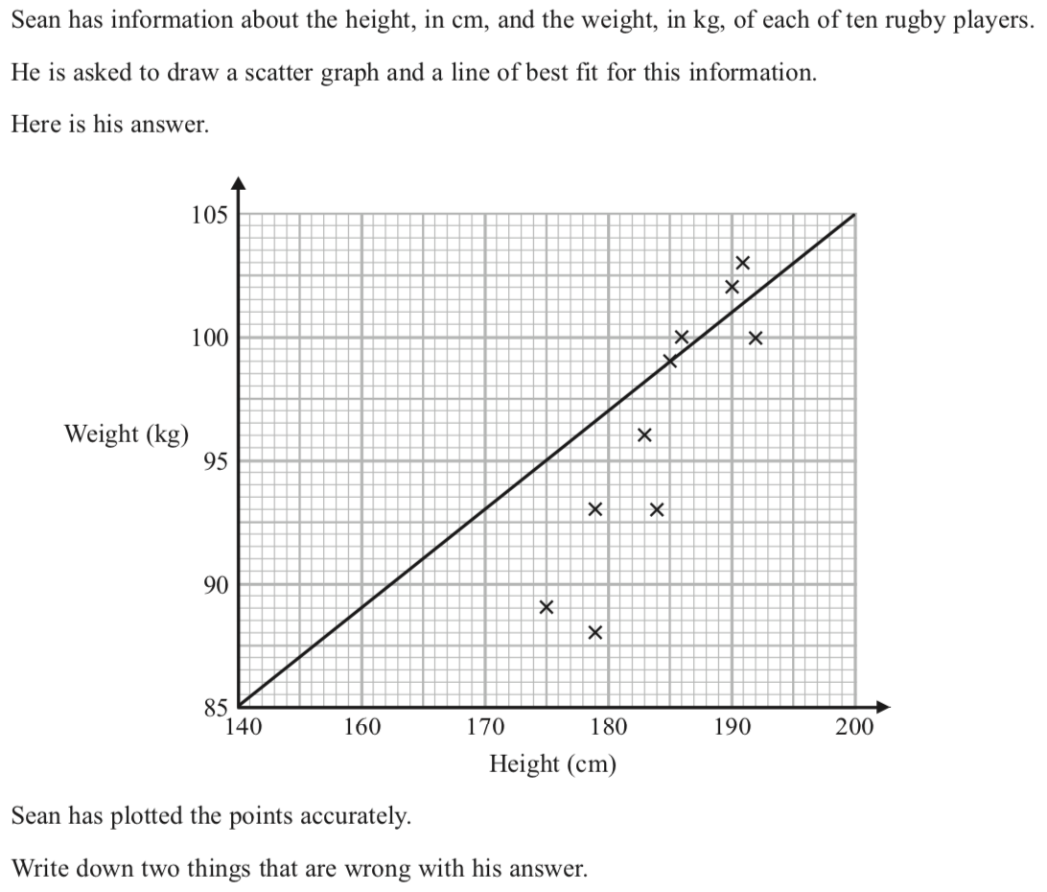
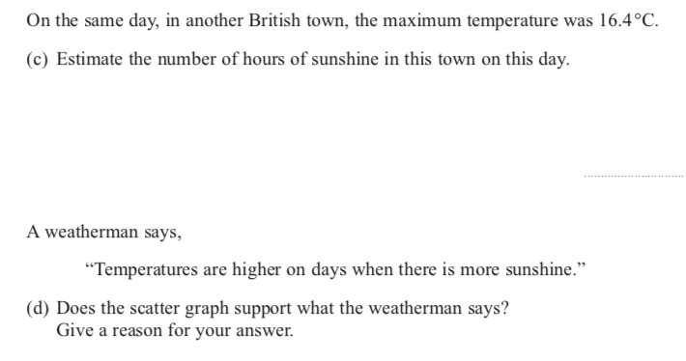
Scatter graphs
Back to Statistics
Home

Slide 14
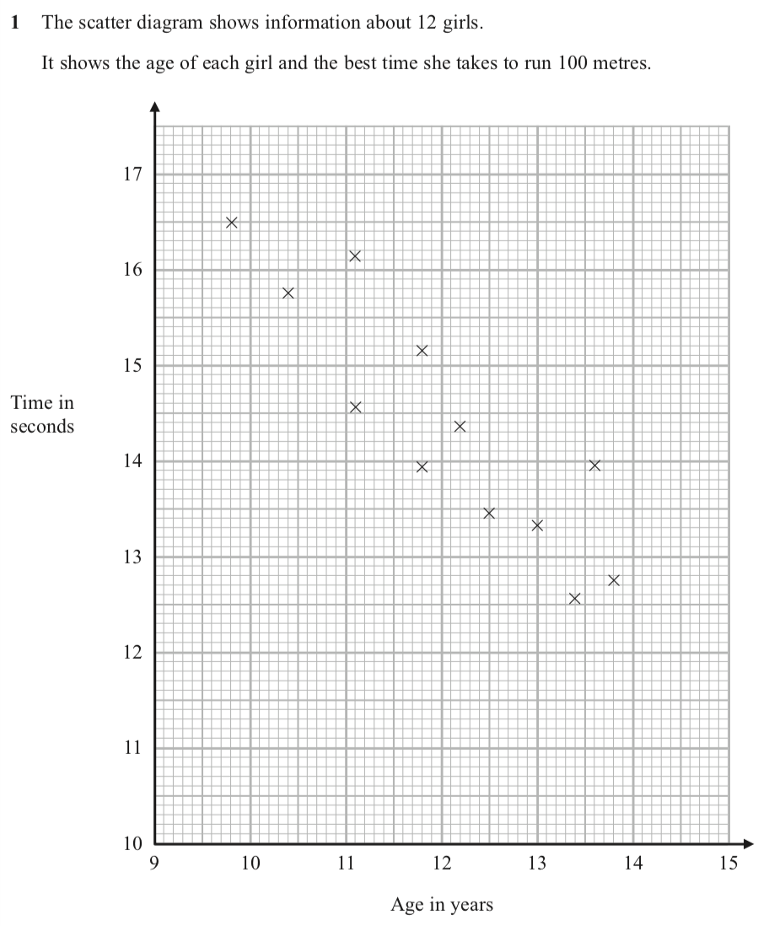
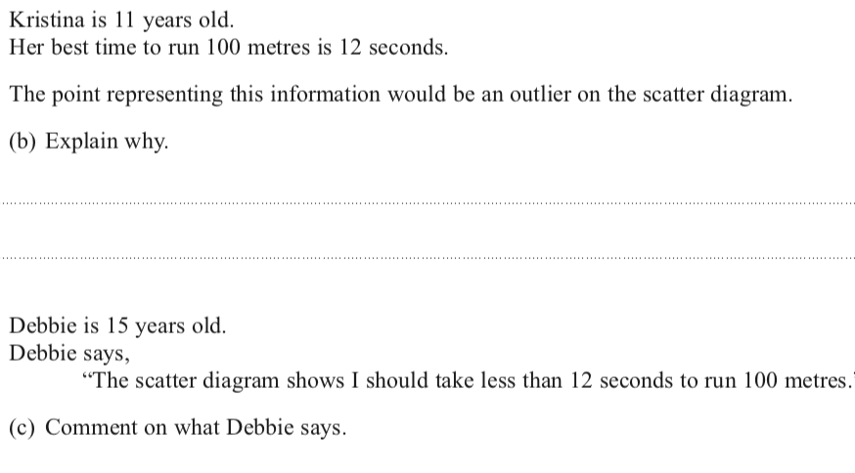
Scatter graphs
Back to Statistics
Home

Slide 15
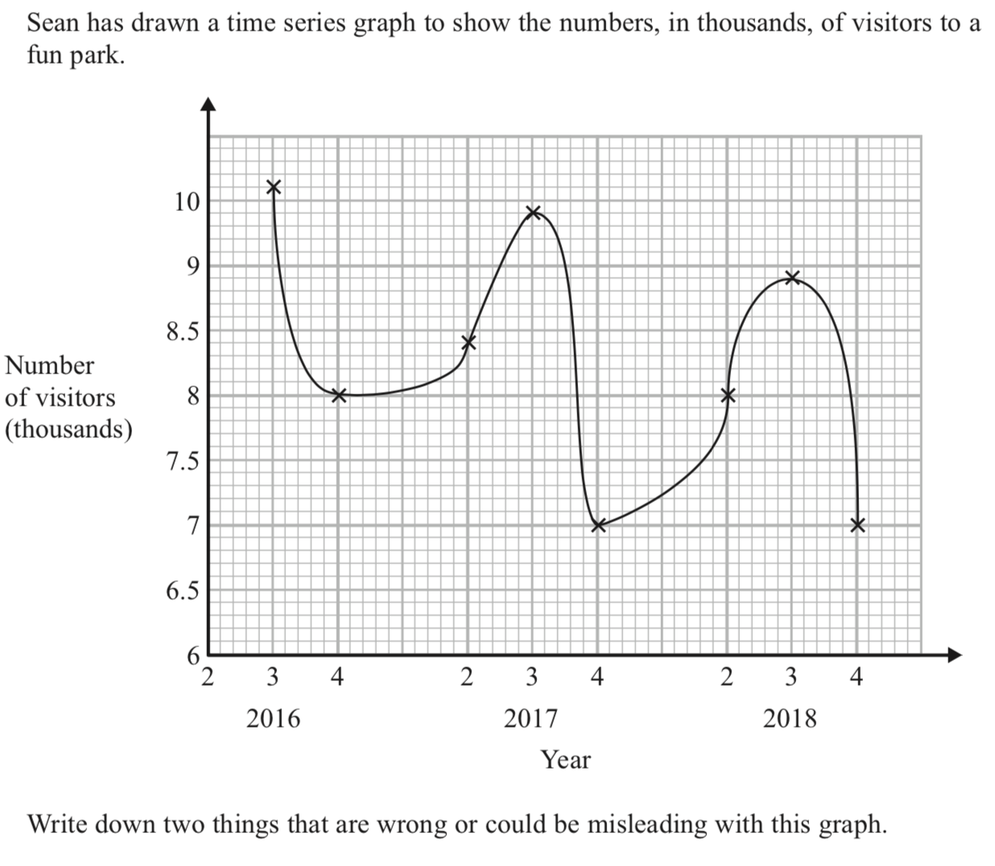
Time series

Slide 16
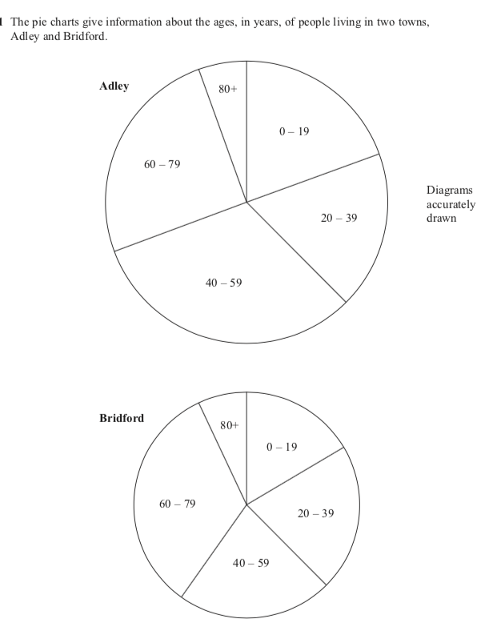
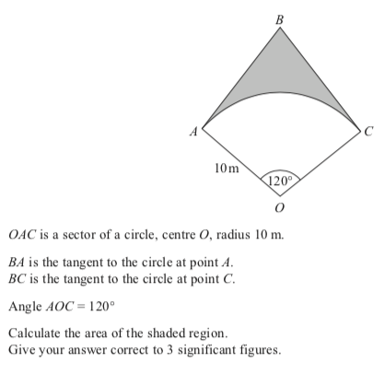
Combination
Back to Statistics
Home

Slide 17
Probability
Probability of dependent events
Probability of independent events
Venn diagrams
Sampling
Two way tables
Title page

Slide 18
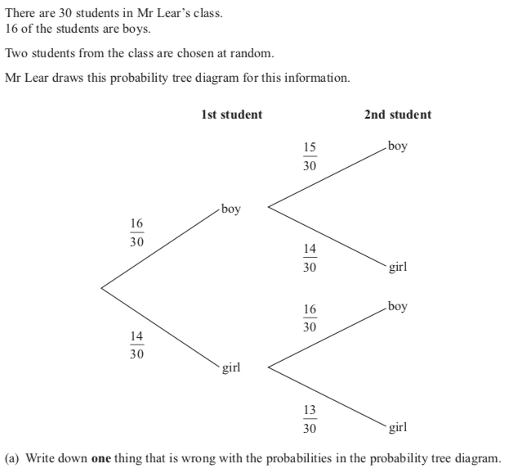
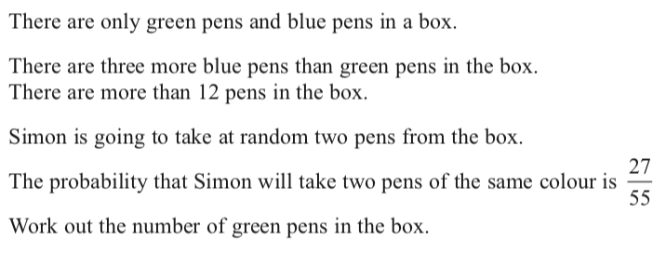
Probability of dependent events
Back to probability
Home

Slide 19
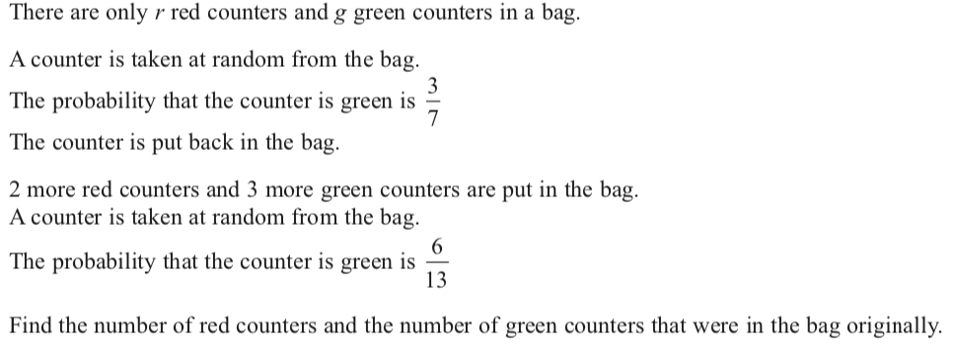
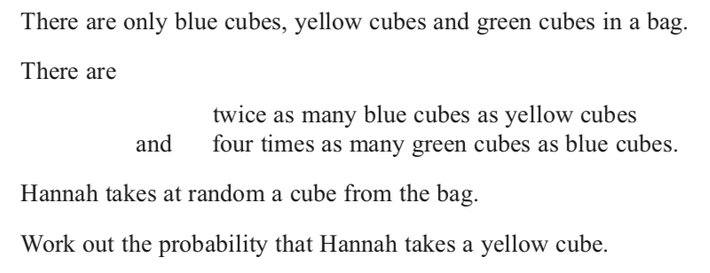
Probability of dependent events
Back to probability
Home

Slide 20
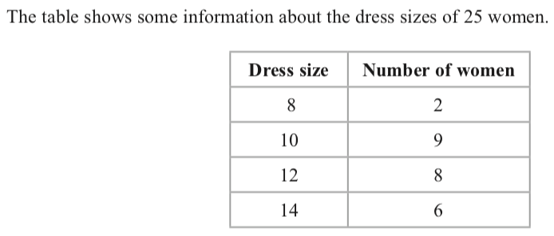
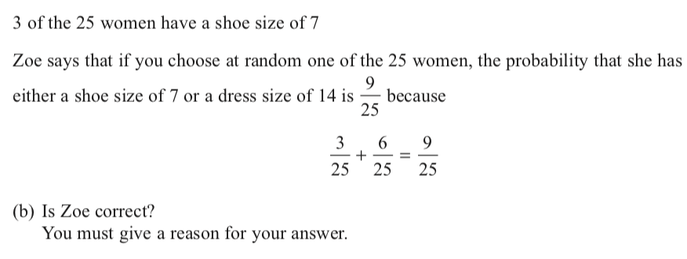
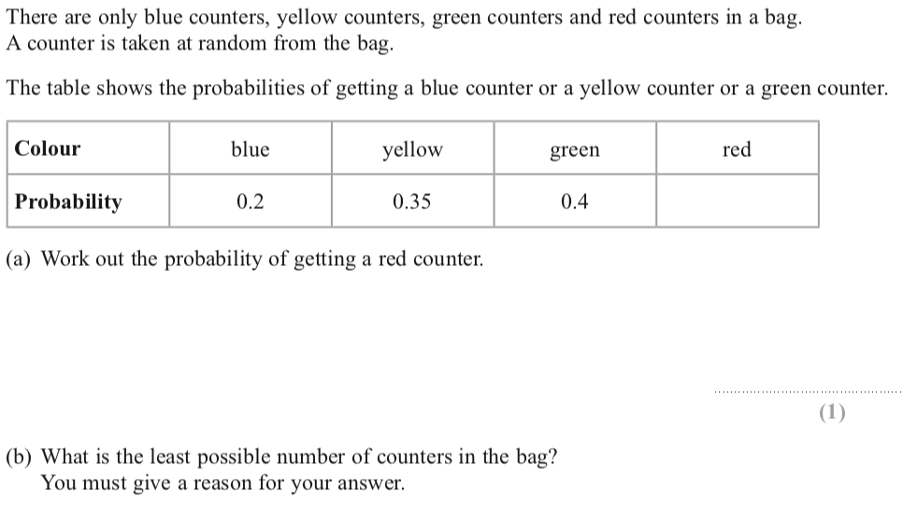
Probability of independent events 1
Back to probability
Home

Slide 21
Probability of independent events 1
Back to probability
Home

Slide 22
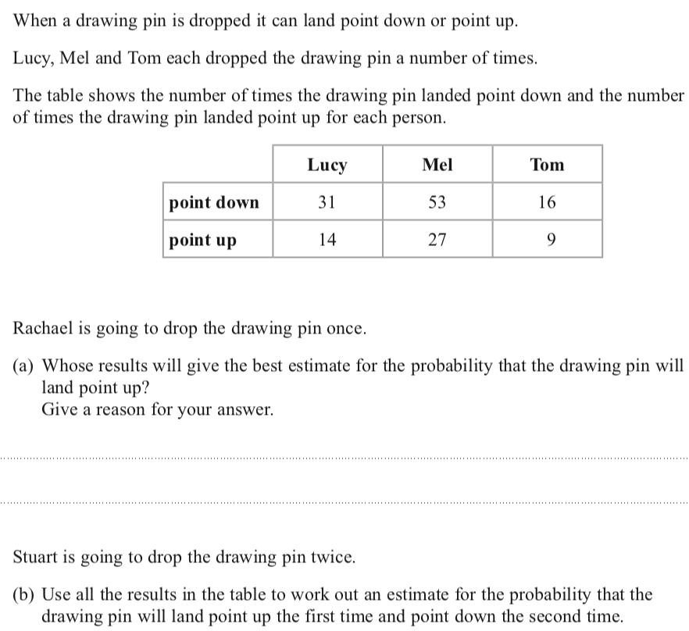
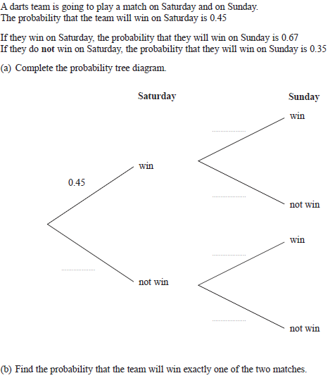
Probability of independent events 2
Back to probability
Home

Slide 23
Probability of independent events 2
Back to probability
Home

Slide 24
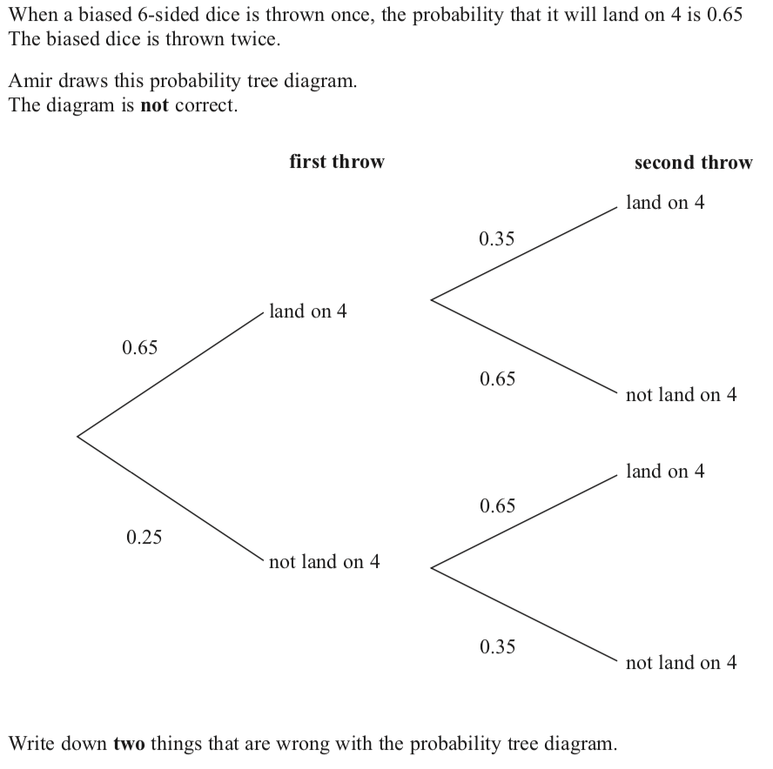
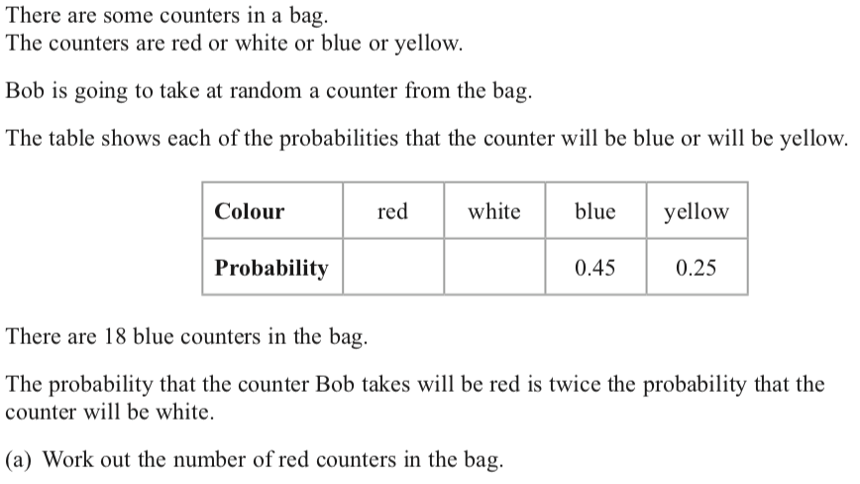
Probability of independent events 3
Back to probability
Home

Slide 25
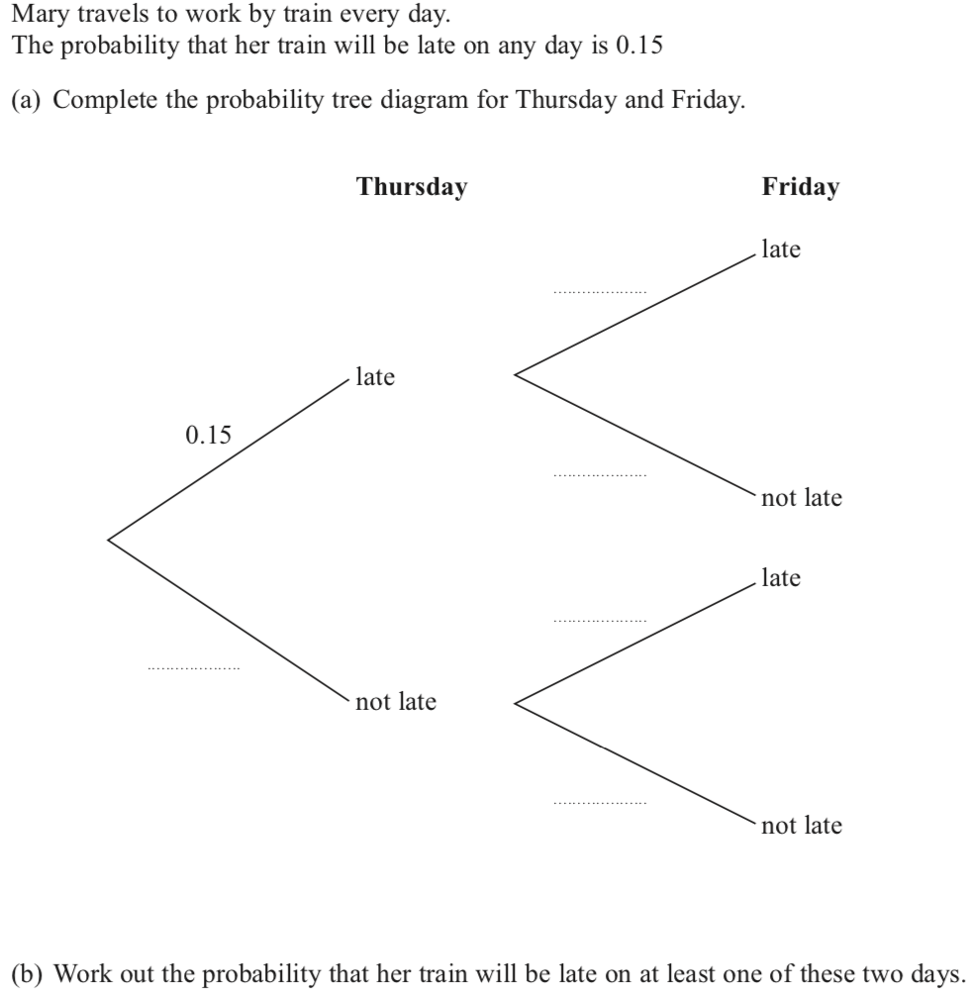
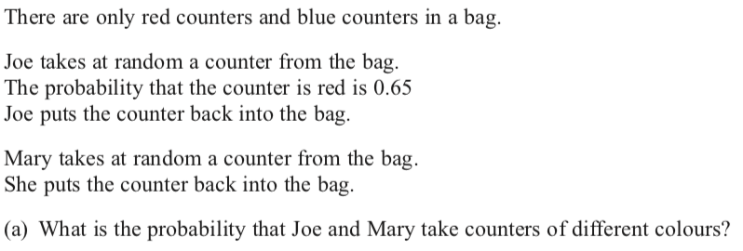
Probability of independent events 4
Back to probability
Home

Slide 26
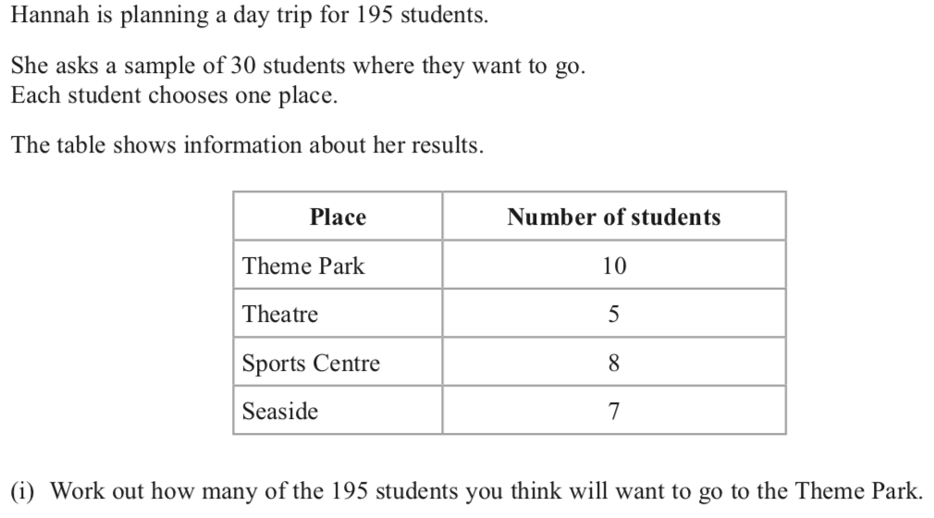
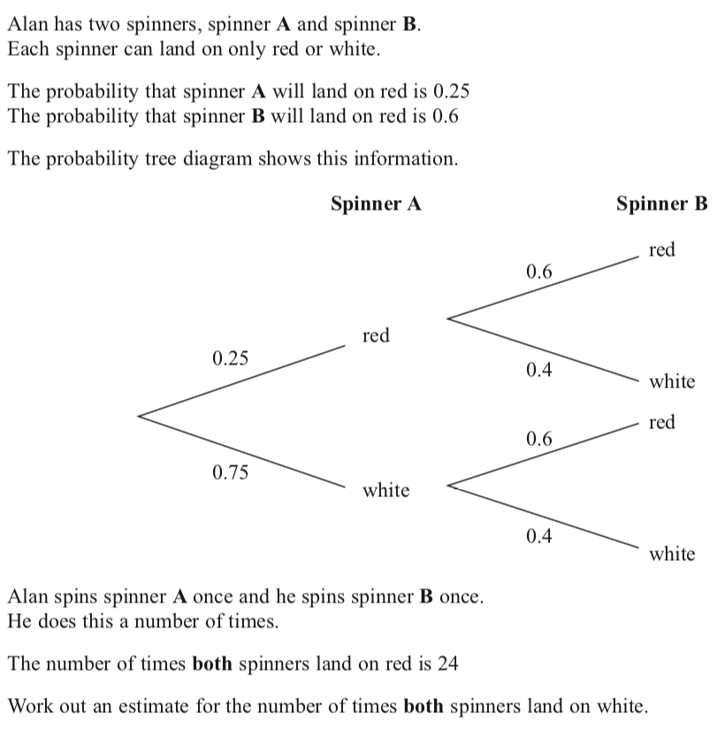
Sampling
Back to probability
Home

Slide 27
Sampling
Back to probability
Home

Slide 28
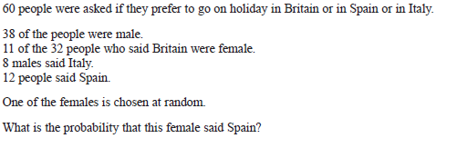
Two way tables
Back to probability
Home

Slide 29
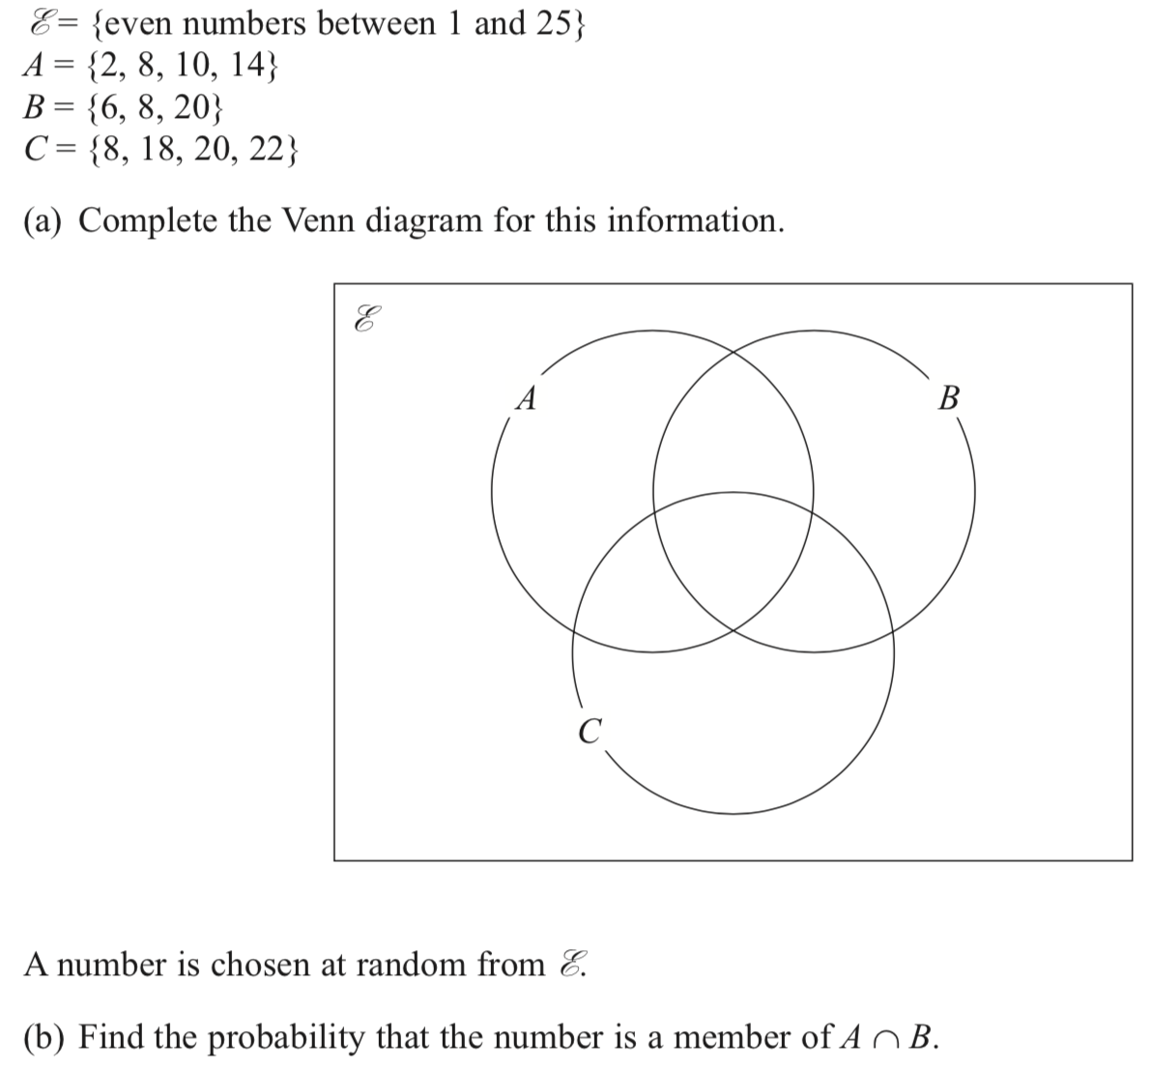
Venn diagrams
Back to probability
Home

Slide 30
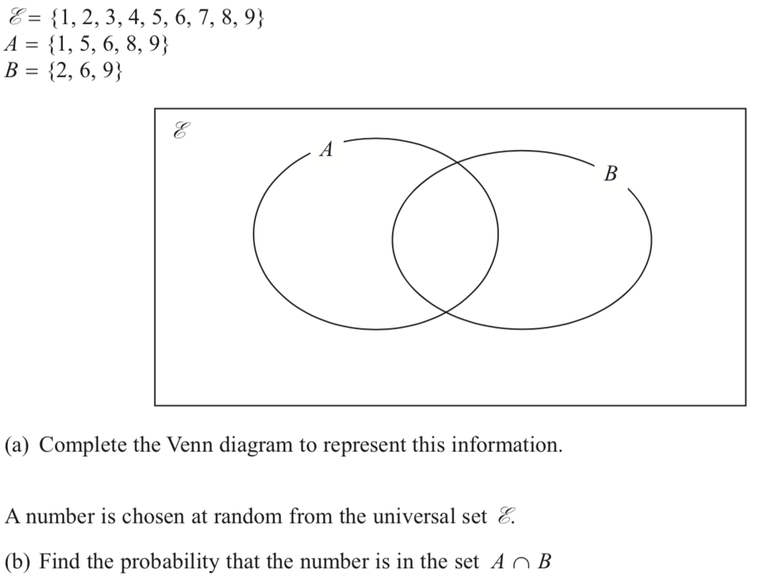
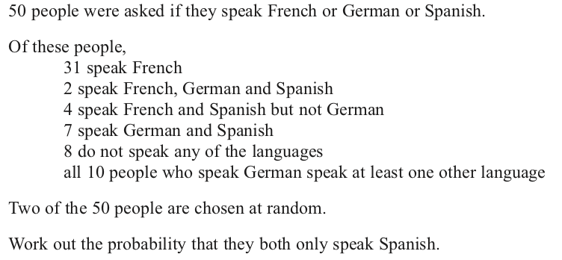
Venn diagrams
Back to probability
Home

