Slide 1
Keywords
Squares, roots and cubes 15/10/19
LO: Can I calculate squares and square roots?
2
2
Multiply by 6
Double it
Multiply by 10
Divide by 2
Divide by 10
Divide by 6
Answer is
Square it
Square it
Multiply by 11
Divide by 2
Half it
Divide by 22
Answer is
12
4
24
16
240
176
120
88
12
44
2
2

Slide 2
Keywords
What are square numbers?
1 x 1 = 1
4 x 4 = 16
2 x 2 = 4
5 x 5 = 25
3 x 3 = 9

Slide 3
Keywords
What are square numbers?
5²
= 5 x 5
8²
= 8 x 8

Slide 4
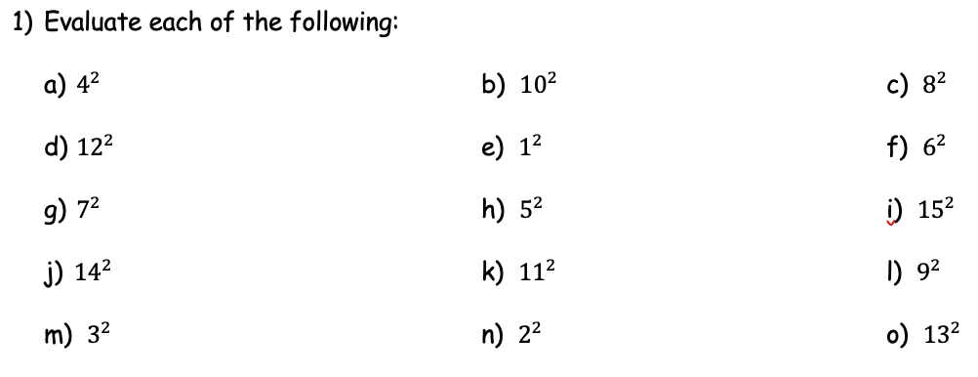
Keywords
Answer these questions in your book

Slide 5
Keywords
Square root
√
Square
3
9
Square Root

Slide 6
Keywords
√25
= 5
√9
= 3
√16
= 4

Slide 7
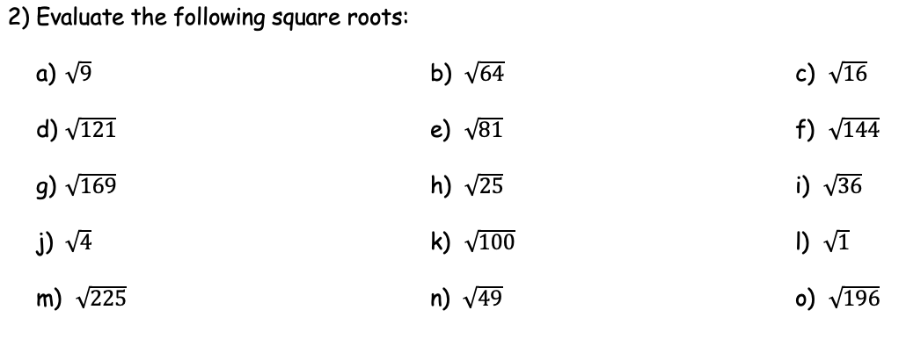
Keywords
Answer these questions in your book

Slide 8
Keywords
Cubes
$1³=1$ x 1 x 1
$4³=4$ x 4 x 4
$2³=2$ x 2 x 2
$5³=5$ x 5 x 5
$3³=3$ x 3 x 3

Slide 9
Keywords
Square root
√
Cube
3
27
Cube Root

Slide 10
Keywords
Cubes root
$$³√8$$
$$³√27$$
$$³√64$$

Slide 11
4² + 3²
5² + √4
5² x √4
√25
√36 x √49
√144 x √169
2³
2² + 3³
9³
7²
√81 + 4²
³√𝟖 x 12²
5² + 10²
10³
8² x ³√64
4² + 7²
10³ + 2³
9² x ³√1
9²
11²
2² x 5²
10²
4² x √25
5² x ³√64
8²

