Slide 1
2020 NFHS Baseball Rules Powerpoint
Robbie Lindeman
Florida High School Athletic Association
352-372-9551 ext 260
Notes:
Thank you for participating in this annual interpretation meeting. While the rules of baseball are in great shape, we continue to work toward improving the sport by recruiting and retaining more young people. We have to continue to strive to provide safe conditions and place them in situations that they are able to find success in some aspect of the sport. Ultimately, our goal is for them to be safe, have fun and gain some valuable life lessons from participation. New additions to our rules are indicated by underlining of the change. Deletions are noted by a strike-through of the deleted text.

Slide 2
FHSAA Baseball Administrator
Robbie Lindeman Director of Athletics
Responsibilities:
Girls Volleyball Administrator
Wrestling Administrator
Baseball Administrator
Ph: (352) 372-9551 x260 rlindeman@fhsaa.org

Slide 3
Eligibility & Compliance
Scott Jamison Director of Eligibility and Compliance
Responsibilities:
Governance elections
Non-traditional students
Foreign exchange/international student questions
Eligibility rulings and related issues
Eligibility and compliance intern coordinator
General eligibility and compliance questions
Ph: (352) 372-9551 x380 sjamison@fhsaa.org

Slide 4
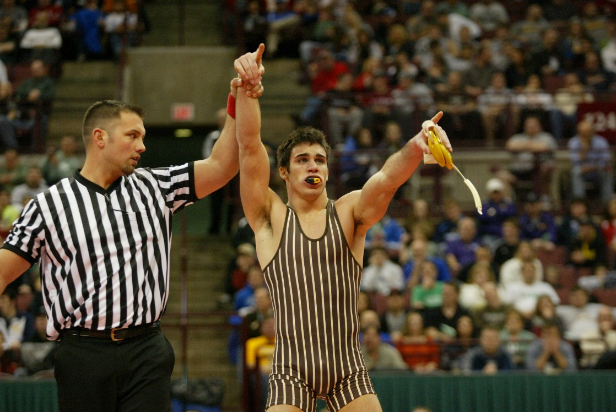
National Federation of State High School Associations
NFHS (located in Indianapolis, IN – Est. 1920):
National leadership organization for high school sports and fine arts activities;
National authority on interscholastic activity programs.
Conducts national meetings;
Sanctions interstate events;
Produces national publication for high school administrators;
National source for interscholastic coach training and national information center.
Notes:
The NFHS is the National authority on interscholastic sports and activities and has been in the educational athletics business since 1920.

Slide 5
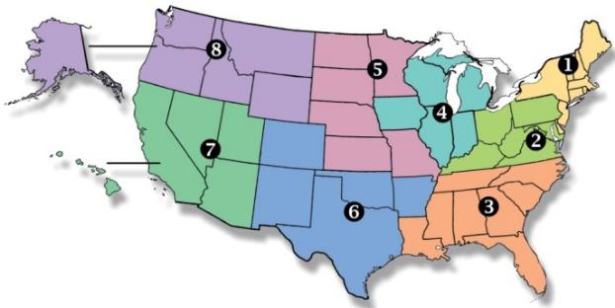
National Federation of State High School Associations
Membership = 50-member state associations and D.C.
NFHS reaches more than 19,000 high schools and 12 million participants in high school activity programs, including more than 7.8 million in high school sports.
Notes:
Services of the NFHS reach more than 19,000 high schools and 12 million participants throughout the 8 NFHS sections across the U.S.

Slide 6
NFHS Rules Review Committee
The NFHS Rules Review Committee is chaired by the chief operating officer and composed of all rules editors. After each committee concludes its deliberations and has adopted its recommended changes for the subsequent year, such revisions will be evaluated by the Rules Review Committee.
Davis Whitfield
Chief Operating Officer
Lindsey Atkinson
Girls Lacrosse and Volleyball
Bob Colgate
Football and Sports
Medicine
Sandy Searcy
Softball and Swimming & Diving
Elliot Hopkins
Baseball and Wrestling
Julie Cochran
Cross Country, Gymnastics, Field Hockey and
Track & Field
James Weaver
Boys and Spirit
Theresia Wynns
Basketball and Soccer
Dan Schuster
Ice Hockey
Notes:
All rules committee recommended rules changes are vetted through the NFHS Rules Review Committee before advancing to the NFHS Board of Directors for final action. The committee is comprised of all NFHS Director of Sports and chaired by the NFHS Chief Operating Officer.

Slide 7
National Federation of State High School Associations
The NFHS writes playing rules for 17 sports for boys and girls at the high school level.
Publishes 4 million pieces of materials annually.
Notes:
The NFHS writes playing rules for 17 sports, publishes High School Today (HST) along with several other key publications totaling over 4 million pieces annually.

Slide 8
NFHS Rules Book as e-Books
E-books features:
Searchable
Highlight areas of interest
Make notes
Easy navigation
Adjustable viewing size
Immediate availability
Notes:
The NFHS Rules and Case Book e-books are available for $6.99 each.

Slide 9
NEW NFHS Rules App
Rules App features:
Searchable
Highlight notes
Bookmarks
Quizzes for all sports
Easy navigation
Immediate availability
Free to paid members of the NFHS Coaches and Officials Associations
www.nfhs.org/erules for more information
Notes:
Rules Book Apps for all NFHS rules books and case books are available on iTunes and Google Play. Rules books and case books are cross-linked and enabled for searchable content.

Slide 10
2020 FHSAA/NFhs baseball rule changes

Slide 11
Designated hitter Rule 3-1-4
The DH may still be a 10th starter hitting for any one of the nine starting defensive players.
Notes:
The designated hitter has been a mainstay rule for decades. It has not changed. We have only added another option with the same concept.

Slide 12
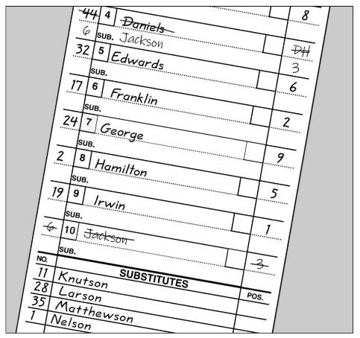
Designated hitter Rule 3-1-4a1
While there is no change from the previous DH rule.
When using a standard designated hitter, the role of the DH is still terminated for the remainder of the game when the defensive player for whom the DH batted, subsequently bats, pinch-hits or pinch-runs.

Slide 13
Designated hitter Rule 3-1-4a2
While there is no change from the previous DH rule.
The role of a standard DH is still terminated for the remainder of the game when the designated hitter or any previous designated hitter assumes a defensive position.

Slide 14
Designated hitter Rule 3-1-4b
The starting designated hitter (DH) may now be any one of the starting defensive players, including the pitcher.
A Player/DH then holds two positions: defensive player and designated hitter.

Slide 15
Designated hitter Rule 3-1-4b
In the case where one player is listed as a starting DH and a starting defensive player in the lineup, the role of the defensive player may be substituted for by any legal substitute.
The original player/DH may re-enter defensively one time.

Slide 16
Designated hitter Rule 3-1-4b-1
When using the P/DH, the role of the DH is terminated for the remainder of the game when any player substitutes offensively for the DH.

Slide 17
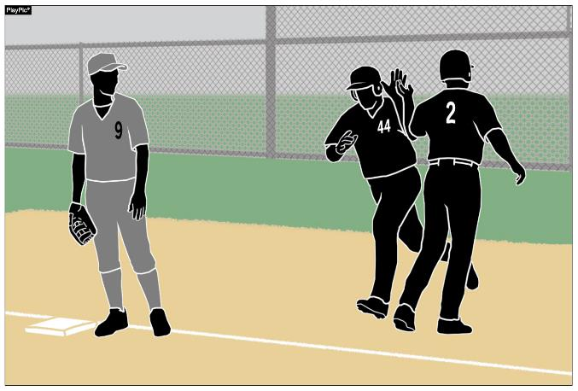
Designated hitter Rule 3-1-4b-2
As a reminder from the previous rule, the role of the DH is terminated for the remainder of the game when the starting defensive Player/DH is substituted for either as a hitter or a runner.

Slide 18
Designated Hitter (DH) Rule 3-1-4
ART. 4 . . . A hitter may be (not mandatory) designated for any one starting player (not just pitchers) and all subsequent substitutes for that player in the game. A starting defensive player cannot be listed as the designated hitter in the startup. A designated hitter for said player shall be selected prior to the start of the game, and his name shall be included on the lineup cards presented to the umpire-in-chief and to the official scorer.

Slide 19
Designated Hitter (DH) Rule 3-1-4
A team forfeits the use of a designated hitter if it fails to declare a designated hitter prior to the game. If a pinch hitter or pinch runner for the designated hitter is used, that player becomes the new designated hitter. The player who was the designated hitter may re-enter as the designated hitter under the re-entry rule. A designated hitter and the player for whom he is batting are locked into the batting order. No multiple substitutions may be made that will alter the batting rotation.
Notes:
If a pinch hitter or pinch runner for the DH is used, that player becomes the new DH under the first option (the standard DH).

Slide 20
Designated Hitter (DH) Rule 3-1-4
The role of the designated hitter is terminated for the remainder of the game when: A designated hitter may be used in one of the two scenarios:
a.The defensive player, or any previous defensive player for whom the designated hitter batted, subsequently bats, pinch-hits, or pinch-runs for the designated hitter; or
a. The designated hitter may be a tenth starter hitting for any one of the nine starting defensive players. If the designated hitter (DH) is used in this manner, the role of the DH is terminated for the remainder of the game when:

Slide 21
Designated Hitter (DH) Rule 3-1-4
1. The defensive player, or any previous defensive player for whom the designated hitter batted, subsequently bats, pinch-hits, or pinch-runs for the designated hitter; or
2. The designated hitter or any previous designated hitter assumes a defensive position.

Slide 22
Designated Hitter (DH) Rule 3-1-4
Rationale:
This rule change will provide coaches some options to strategize how to keep their better players in the game, to contribute to the offensive output of the team and give another player a chance to participate on defense. In addition, considering the pitch count rules, this change would help pitchers to keep their bat (because they are typically the best hitter) in the game, but can come out of the game to protect their arms from overuse.

Slide 23
FHSAA Rules Changes

Slide 24
IMPORTANT DATES
First practice date (Week 30) – Jan. 20
Game schedules due (Week 32) – Feb. 3
Preseason classic tournaments (Week 33) – Feb. 10-15
First regular season playing date (Week 34) – Feb. 17
Roster due on Home Campus (Week 34) – Feb. 17
Last date for a regular season contest for district tournament
ranking (Week 42) – April 18
Last regular season playing date (Week 43) – April 25

Slide 25
IMPORTANT DATES – State Series
District Tournament
Monday April 27- Friday May 1
Regional Tournament
Regional Quaterfinals May 7 and May 8
Regional Semifinals May 12 and May 13
Regional Finals May 16 and May 19
STATE CHAMPIONSHIPS
Wednesday May 20 – Saturday May 23
Monday May 25 – Wednesday 27

Slide 26
Points of emphasis

Slide 27
Designated hitter
There are now two options when using a designated hitter: the standard DH and the player/DH. Teams may also still choose to start the game without using a designated hitter (straight 9). All options must be declared prior to the start of the game.

Slide 28
Designated hitter
The courtesy runner (CR) can never have any function with a designated hitter (DH). When a DH comes to bat, he is a DH (regardless of either lineup option); when at bat, he can never assume a defensive position. As a result, a CR is never a legal substitute for a DH.

Slide 29
Designated hitter
If the DH is batting for another player, when he bats, he is a DH. As a result, if a runner comes in for him when he gets on base, it is a substitution, and that player is now the DH. If the DH is a Player/DH, he is batting as the DH. A substitution by an offensive player would eliminate the role of the DH.

Slide 30
Game-ending procedures
A state association may adopt game-ending procedures that determine how games are ended, including suspended games. However, if a state does not adopt game-ending procedures, by mutual agreement of the opposing coaches and the umpire-in-chief, any remaining play may be shortened or the game terminated. If a state association has adopted game-ending procedures, only those game-ending procedures may be used, unless the opposing coaches wish to terminate the game (4-2-4).

Slide 31
Game-ending procedures - FHSAA
4-2-2. The 10-run rule will be in effect after four-and-one-half or five complete innings.
4-2-2. The 15-run rule will be in effect after three and-one-half or four complete innings.
4-2-4. A game that has been called because of weather, mechanical failure or other conditions in which a winner cannot be determined will be treated as a suspended game. If the game is to be completed, it will be continued from the point of suspension, subject to the rules of the game. A game that has been called because of weather, mechanical failure or other conditions after four-and-one-half innings or five innings have been completed will be declared a completed game

Slide 32
Force-play slide rule
Runners are never required to slide, but if a runner elects to slide at any base, it must be legal. A legal slide can either be feet first or head first. If a runner slides feet first, at least one leg and buttock shall be on the ground.

Slide 33
Force-play slide rule
Runners may not pop-up into the fielder.

Slide 34
Force-play slide rule
Runners may not have a leg raised higher than the fielder’s knee.

Slide 35
Force-play slide rule
Except at home plate, runners may not slide through or beyond the base.

Slide 36
Force-play slide rule
Runners may not slide away from a base in the direction of the fielder. But a runner may slide in a direction away from a fielder to avoid making contact or altering the play of the fielder.

Slide 37
Force-play slide rule
The runner is out when he illegally slides. On a force play, the runner is also guilty of interference. The batter-runner is also declared out and all other runners must return to the base occupied at the time of the pitch.

Slide 38
COMPLIANT BASEBALL
The ball shall meet the current NOCSAE standard for baseball effective January 1, 2020. The NFHS authentication mark and the NOCSAE mark shall both be visible on the ball.

Slide 39
Baseballs Rule 1-3-1
Effective January 1, 2020 the SEI/NOCSAE mark is required on all baseballs that meet the NOCSAE standard that will be used in high school competition.
Baseballs shall have the SEI/NOCSAE mark along with the NFHS Authenticating Mark.
Rationale:
To maintain a consistent and uniform standard for high school competition. To ensure that every baseball manufactured meets the same level of quality and playability.

Slide 40
COMPLIANT BODY AND CHEST PROTECTOR
The catcher’s body/chest protector shall meet the NOCSAE standard effective Jan. 1, 2020.
Notes:
The compliant NOCSAE Body protector will have to be worn underneath the traditional chest protector.

Slide 41
Chest and body protector Rule 1-5-3
The catcher shall wear, in addition to a head protector, a mask with a throat protector, body/chest protector that meets the NOCSAE standard at the time of manufacture (Effective January 1, 2020), protective cup (male only), and baseball protective shin guards. The SEI/NOCSAE mark is required on all body/chest protectors that meets the NOCSAE standard at the time of manufacture that will be used in high school competition.

Slide 42
Chest and body protector Rule 1-5-3
Rationale:
A SEI/NOCSAE standard has been developed to protect the heart and the cardiac silhouette from commotio cordis. The NOCSAE standard could be included in a product that is either a separate device/apparel or a device constructed into a traditional chest protector. This proposal is recommended and endorsed by the NFHS Sports Medicine Advisory Committee (SMAC) to minimize risk. The catcher has to wear either a chest protector that meets the NOCSAE standard or a body protector that meets the NOCSAE standard underneath a traditional chest protector. It is the responsibility of the coach to verify that his/her players are properly equipped and in uniform.

Slide 43
COMPLIANCE OF PLAYER EQUIPMENT
A face mask/guard specifically designed for a particular helmet model may be attached after manufacture, provided that procedure is approved by the manufacturer and meets the SEI/NOCSAE standard at the time of manufacture.
Notes:
Cheek and jaw protectors are allowed to be used on batting helmets.

Slide 44
PROPER PITCHING POSITIONS
The windup is one of two legal pitching positions. For the windup, the pitcher’s non-pivot foot shall be in any position on or behind a line extending through the front edge of the pitcher’s plate.

Slide 45
PROPER PITCHING POSITIONS
The set is one of two legal pitching positions. For the set position, a pitcher shall stand with his entire non-pivot foot in front of a line extending through the front edge of the pitcher’s plate and with his pivot foot in contact with or directly in front of and parallel to the pitcher’s plate.

Slide 46
PROPER PITCHING POSITIONS
Pitchers are no longer required to have their entire pivot foot in contact with the pitcher’s plate. This recognizes that many mounds are such that it is problematic for the pitcher to have his entire pivot foot in contact with the pitcher’s plate.

Slide 47
PROPER PITCHING POSITIONS
The so-called hybrid stance is illegal as it does not meet the requirements of either the windup or set positions.

Slide 48
ENFORCEMENT OF nfhs JEWELRY RULE
Jewelry, including necklaces, bracelets and earrings, shall not be worn except for religious or medical medals. A religious medal must be taped and worn under the uniform. A medical alert must be taped and may be visible.

Slide 49
NFHS OFFICIALS and coaches Education

Slide 50
SPORTS-SPECIFIC Officiating COURSES www.nfhslearn.com
Introduction to mechanics and techniques used in each sport
Ideal for new officials or those in first few years of officiating
30-45 minutes to complete
Topics vary based on the needs of the officials in the sport
NFHS Officials Association members cost is $10
Non-members - course is $20
API available to state associations to collect results
Notes:
SPORTS-SPECIFIC OFFICIATING COURSES
Introduction to mechanics and techniques used in each sport
Ideal for new officials or those in first few years of officiating
30-45 minutes to complete
Topics vary based on the needs of the officials in the sport
Course is FREE to any NFHS Officials Association member
Non-members course is $20
Contact NFHS Officials Department for details (317.972.6900)

Slide 51
NFHS OFFICIALS EDUCATION SPORT-SPECIFIC COURSES
Courses Available
Officiating Football
Soccer – Fouls and Misconduct
Swimming and Diving
Officiating Wrestling
Officiating Basketball
Umpiring Softball
Officiating Volleyball – Ball Handling
Future Courses
Officiating Baseball
Basketball – Three-Person Mechanics
Field Hockey
Track and Field
Volleyball – Overlapping
Softball – Mechanics
Communication Among Officials and Coaches
Soccer - Offside
Notes:
NFHS OFFICIAL EDUCATION
Courses Available
Officiating Football
Soccer – Fouls and Misconduct
Swimming and Diving
Officiating Wrestling
Officiating Basketball
Umpiring Softball
Officiating Volleyball – Ball Handling
Future Courses
Officiating Baseball
Basketball – Three-Person Mechanics
Field Hockey
Track and Field
Volleyball – Overlapping
Softball – Mechanics
Communication Among Officials and Coaches
Soccer - Offside

Slide 52
Interscholastic Officiating www.nfhslearn.com
Introduction to skills and concepts used as an official
Ideal for new officials or those in first few years of officiating
30-45 minutes to complete
Topics include: basics of becoming and staying an official, science of officiating, art of officiating, how to combine these skills for successful officiating
Course is FREE to any NFHS Officials Association member
Non-members course is $20
API available to state associations to collect results
Notes:
The Interscholastic Officiating Course contains the following information:
Introduction to skills and concepts used as an official
Ideal for new officials or those in first few years of officiating
30-45 minutes to complete
Topics include: basics of becoming and staying an official, science of officiating, art of officiating, how to combine these skills for successful officiating
Course is FREE to any NFHS Officials Association member
Non-members course is $20
API available to state associations to collect results

Slide 53
Nfhs learning center www.nfhslearn.com
Professional Development For ALL
Coaches
Officials
Administrators
Parents
Students
Performing Arts
Notes:
Digital platform for online professional development courses are available on www.nfhslearn.com.

Slide 54
NFHS Officials Association Central Hub
https://nfhs-baseball.arbitersports.com/front/105406/Site
Contains:
Sport information
Rules information
Rules library
Searchable rules book
Video content on officiating sport, competition situations and interpretations
Notes:
State associations with 100% membership in the NFHS Officials Association and any individual member has access to the Central Hub for officials.

Slide 55
Notes:
VIDEO FOR TEACHING AND LEARNING
The new video library is located at www.nfhslearn.com
A variety of video in many sports is provided.

Slide 56
Thank you and have a great Baseball season!
www

