Slide 1
July 2nd General Meeting
July 2nd, 2019

Slide 2
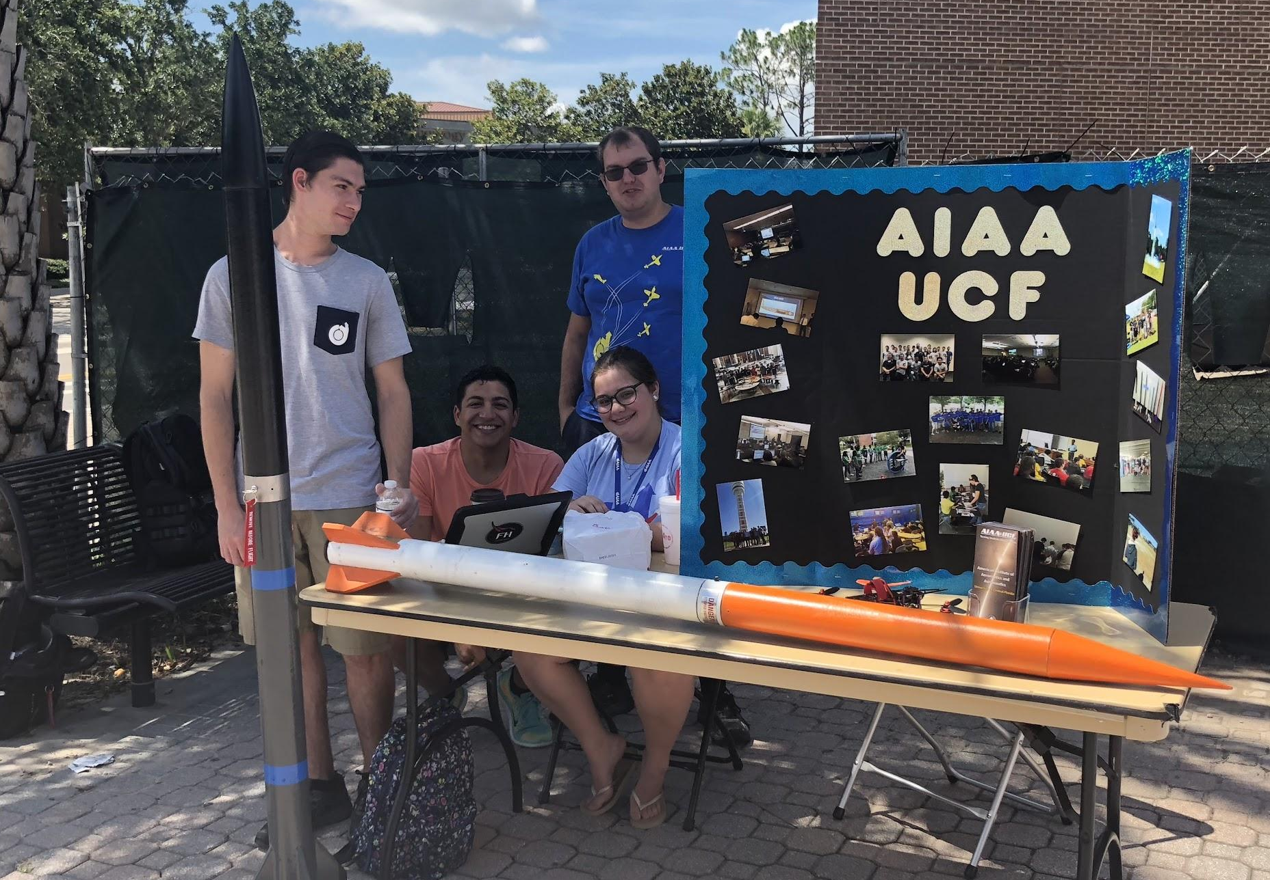
Who Are We?
University of Central Florida Section of AIAA
Largest Engineering Club at UCF
Largest AIAA Student Chapter in the Country
Design Projects and Events
Notes:
Copy this slide to add slides to the presentation.

Slide 3
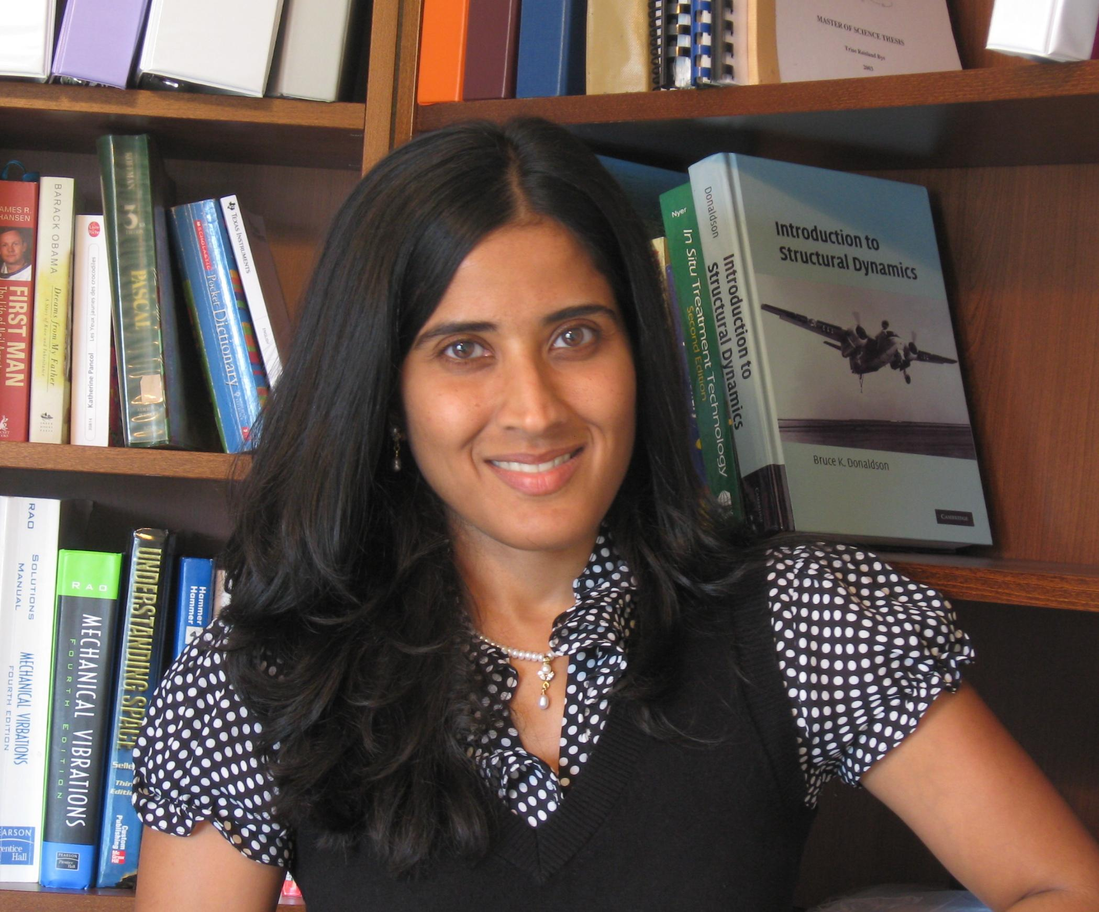
Advisor - Dr. Seetha Raghavan
MAE Associate Professor
Ph.D. (Aeronautics and Astronautics), Purdue University, West Lafayette, IN, 2008
M.S. (Aeronautical Eng.), École Nationale Supérieure de L’Aéronautique et de L’Espace, Toulouse, France, 1997
B.E. (Mechanical Eng.), Nanyang Technological University, Singapore, 1995
Notes:
Copy this slide to add slides to the presentation.

Slide 4
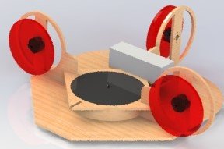
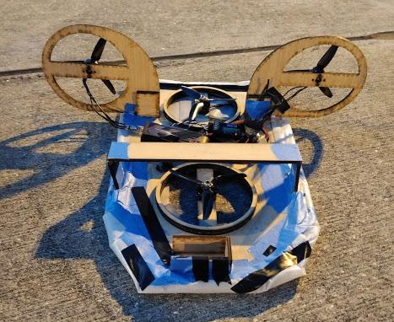
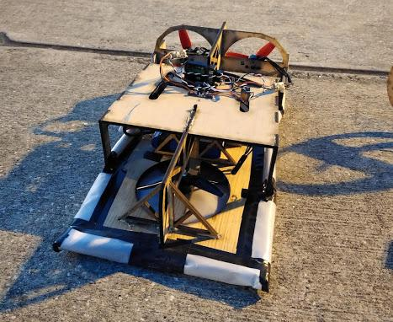
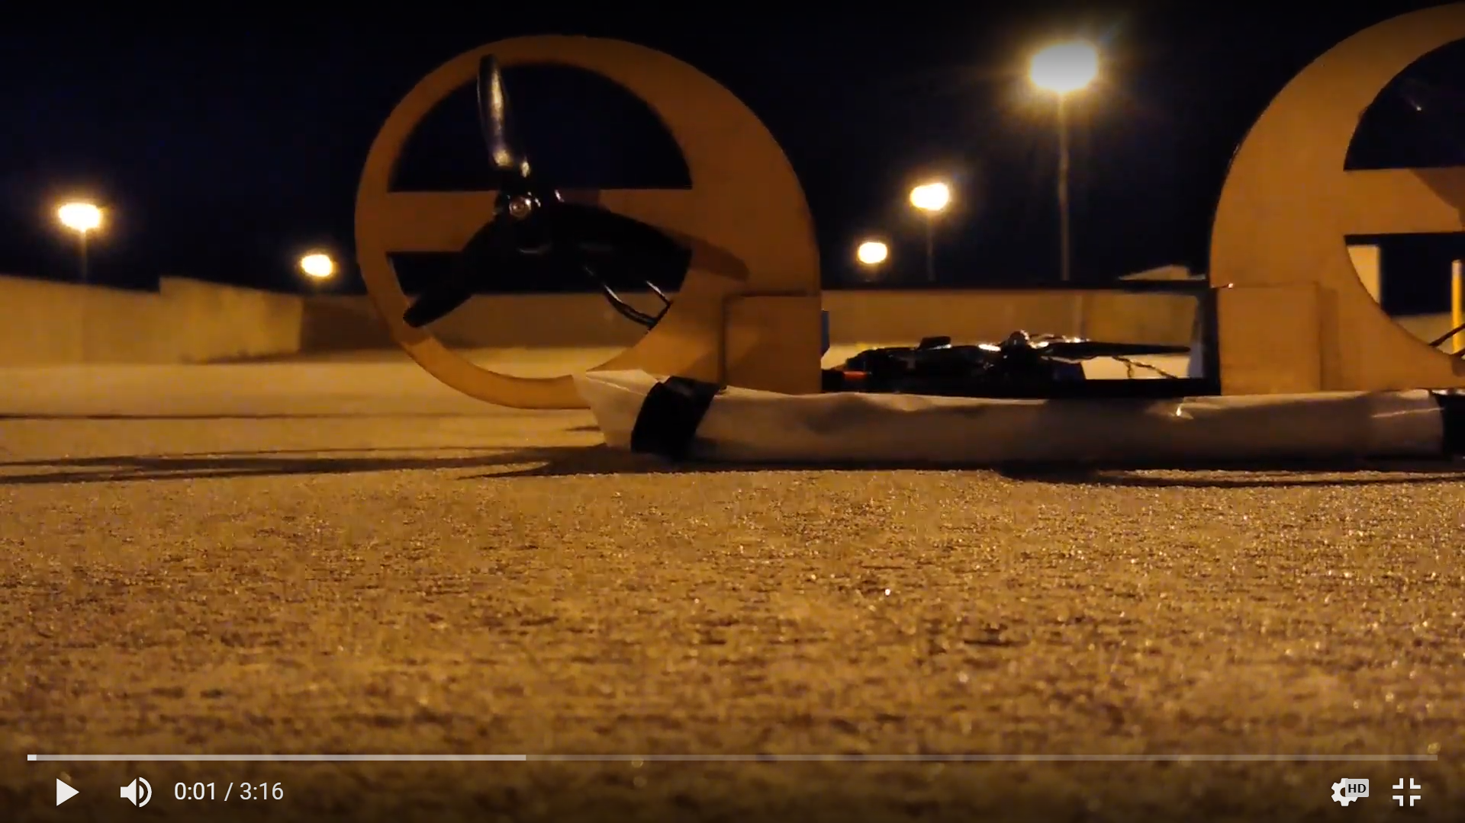
Hovercraft Design Competition
Limited Capacity (5 Teams max)
Small Teams (1 - 3 Per Team)
Hands on CAD Learning
Summer: Concise - Modular Designs
Drag-Racing
Fall/Spring: Free & Modular Design
Jousting
SoccAir
Meetings:
Mondays 6:00-7:50PM & Tuesdays 5:00-6:50PM
Location: ENG1 Rm. 383
Sign-up Link: https://forms.gle/Pg2TUYzA7WEscG5k7

Slide 5
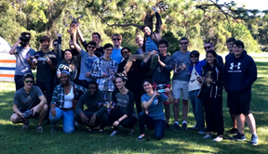
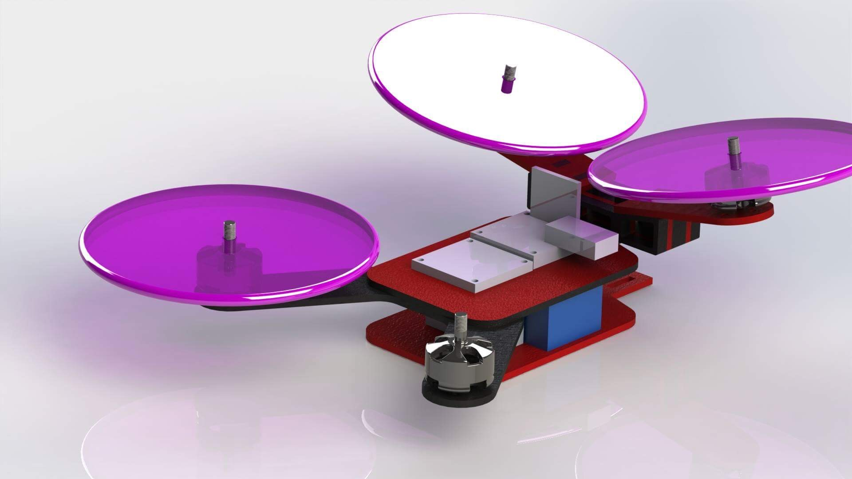
Quadcopter Design Competition
Quadcopter Design Competition
Design and Build Quadcopters in teams to race against each other at the end of the semester.
No experience necessary!
Learn to CAD, laser cut, and
fly!
Meetings:
Wednesdays 6-7:20 PM HEC 103
Sign-Up Link: http://bit.ly/2XdlbQD
(That’s a lowercase L, not a capital i)

Slide 6
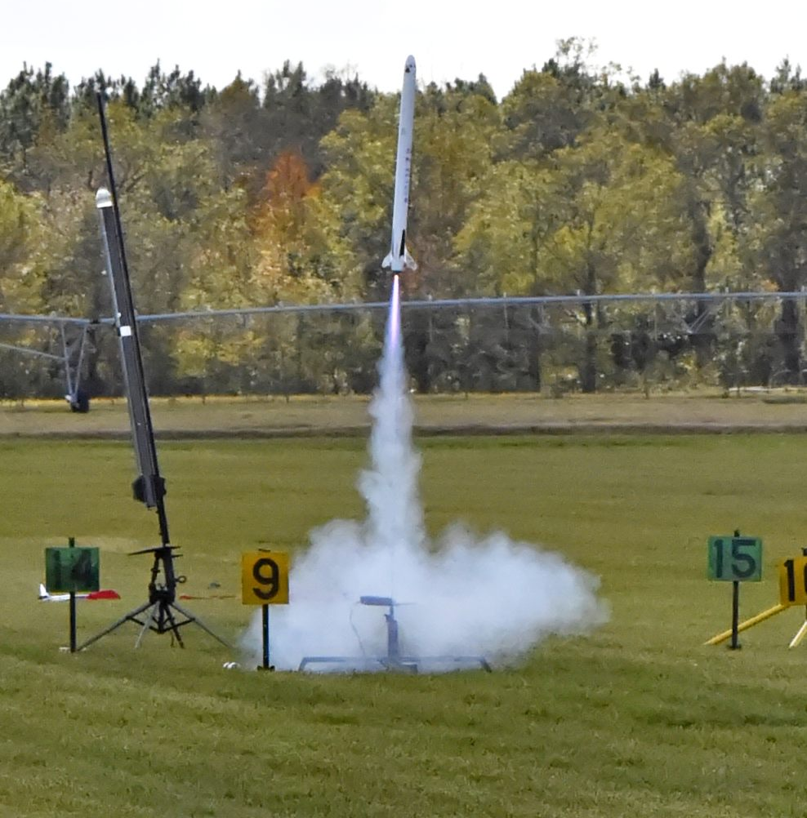
Rocket League
Design, build and launch rockets in a competitive environment:
Landing Challenge
Design Challenge
Altitude Challenge
Design Custom Parts
No Experience Required
Launch
August 17th Palm Bay,FL
Meetings:
ENG1 327 Tues/Thurs 6:00pm-7:20pm
Sign-up link: https://forms.gle/i3bHAHQaCxY6bPUf7
Notes:
Copy this slide to add slides to the presentation.

Slide 7
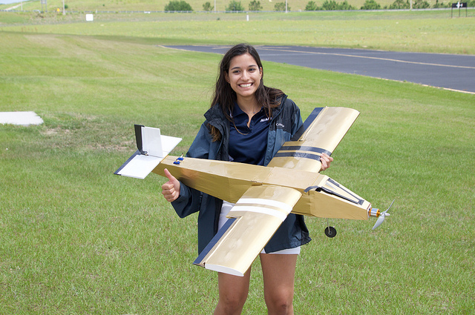
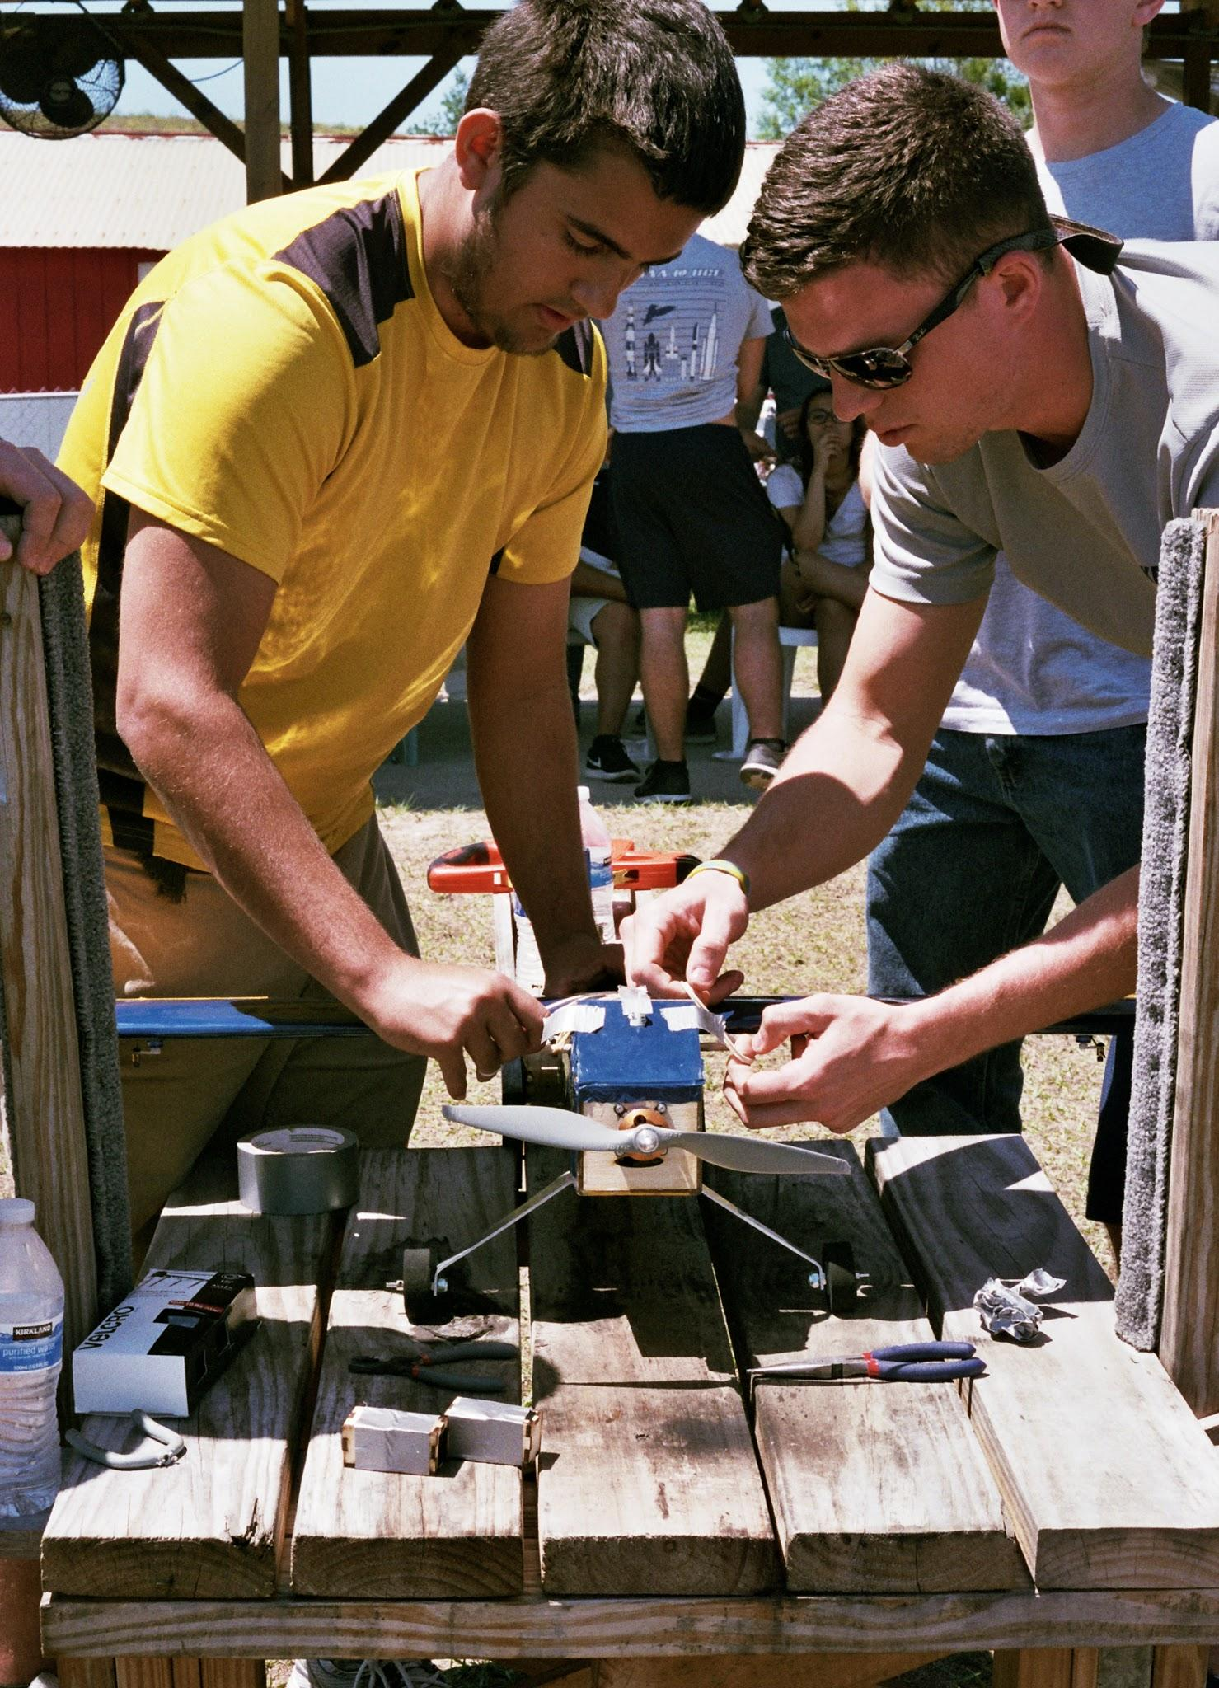
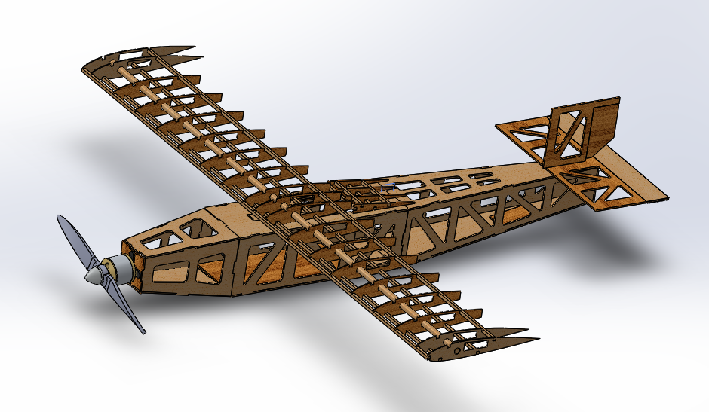
Aviation Design Competition
Design, build and fly an RC airplane
Learn and apply fundamentals of aerodynamics
No prior experience is necessary
Insight to future coursework
Meetings and Competition Dates: TBA
This project doesn’t start until the fall, so stay tuned
Notes:
New Photos

Slide 8
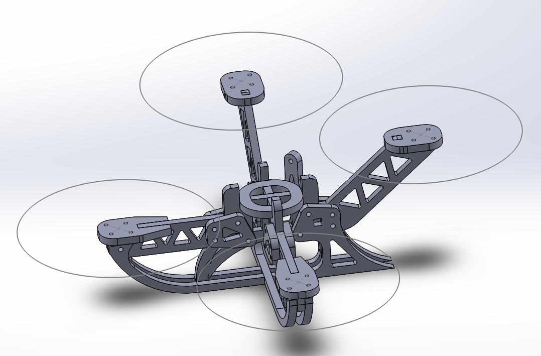
Solidworks Workshops
A general outlook at the capabilities of Solidworks
Relevant to Hovercraft, Quadcopter, and even the Great Navel Orange Race
Weekly labs that progressively cover sketching, modeling, and assembling your parts
Meetings: Thursdays 7pm
Office Hours: ENG 2 Room 205
Notes:
Copy this slide to add slides to the presentation.

Slide 9
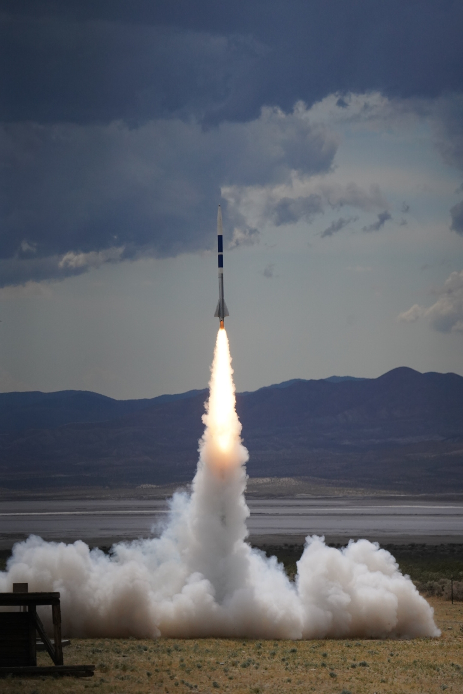
UCF’s Most Powerful Rocket
AIAA UCF won 2nd place at the FAR-1030 national rocket competition!
The High Power Rocketry team launched a student-built experimental rocket to 21,348 feet.
Stay tuned for information on next year’s project, starting in Fall.
Notes:
Copy this slide to add slides to the presentation.

Slide 10
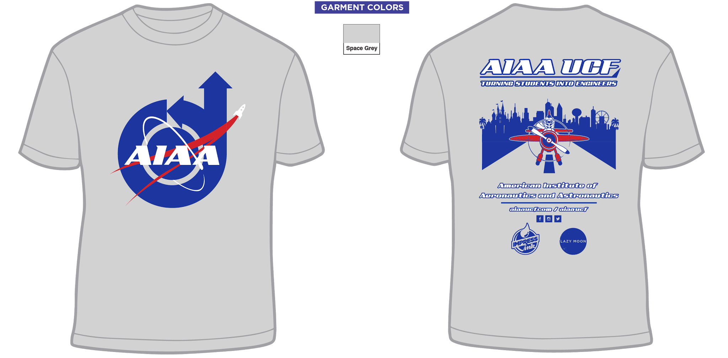
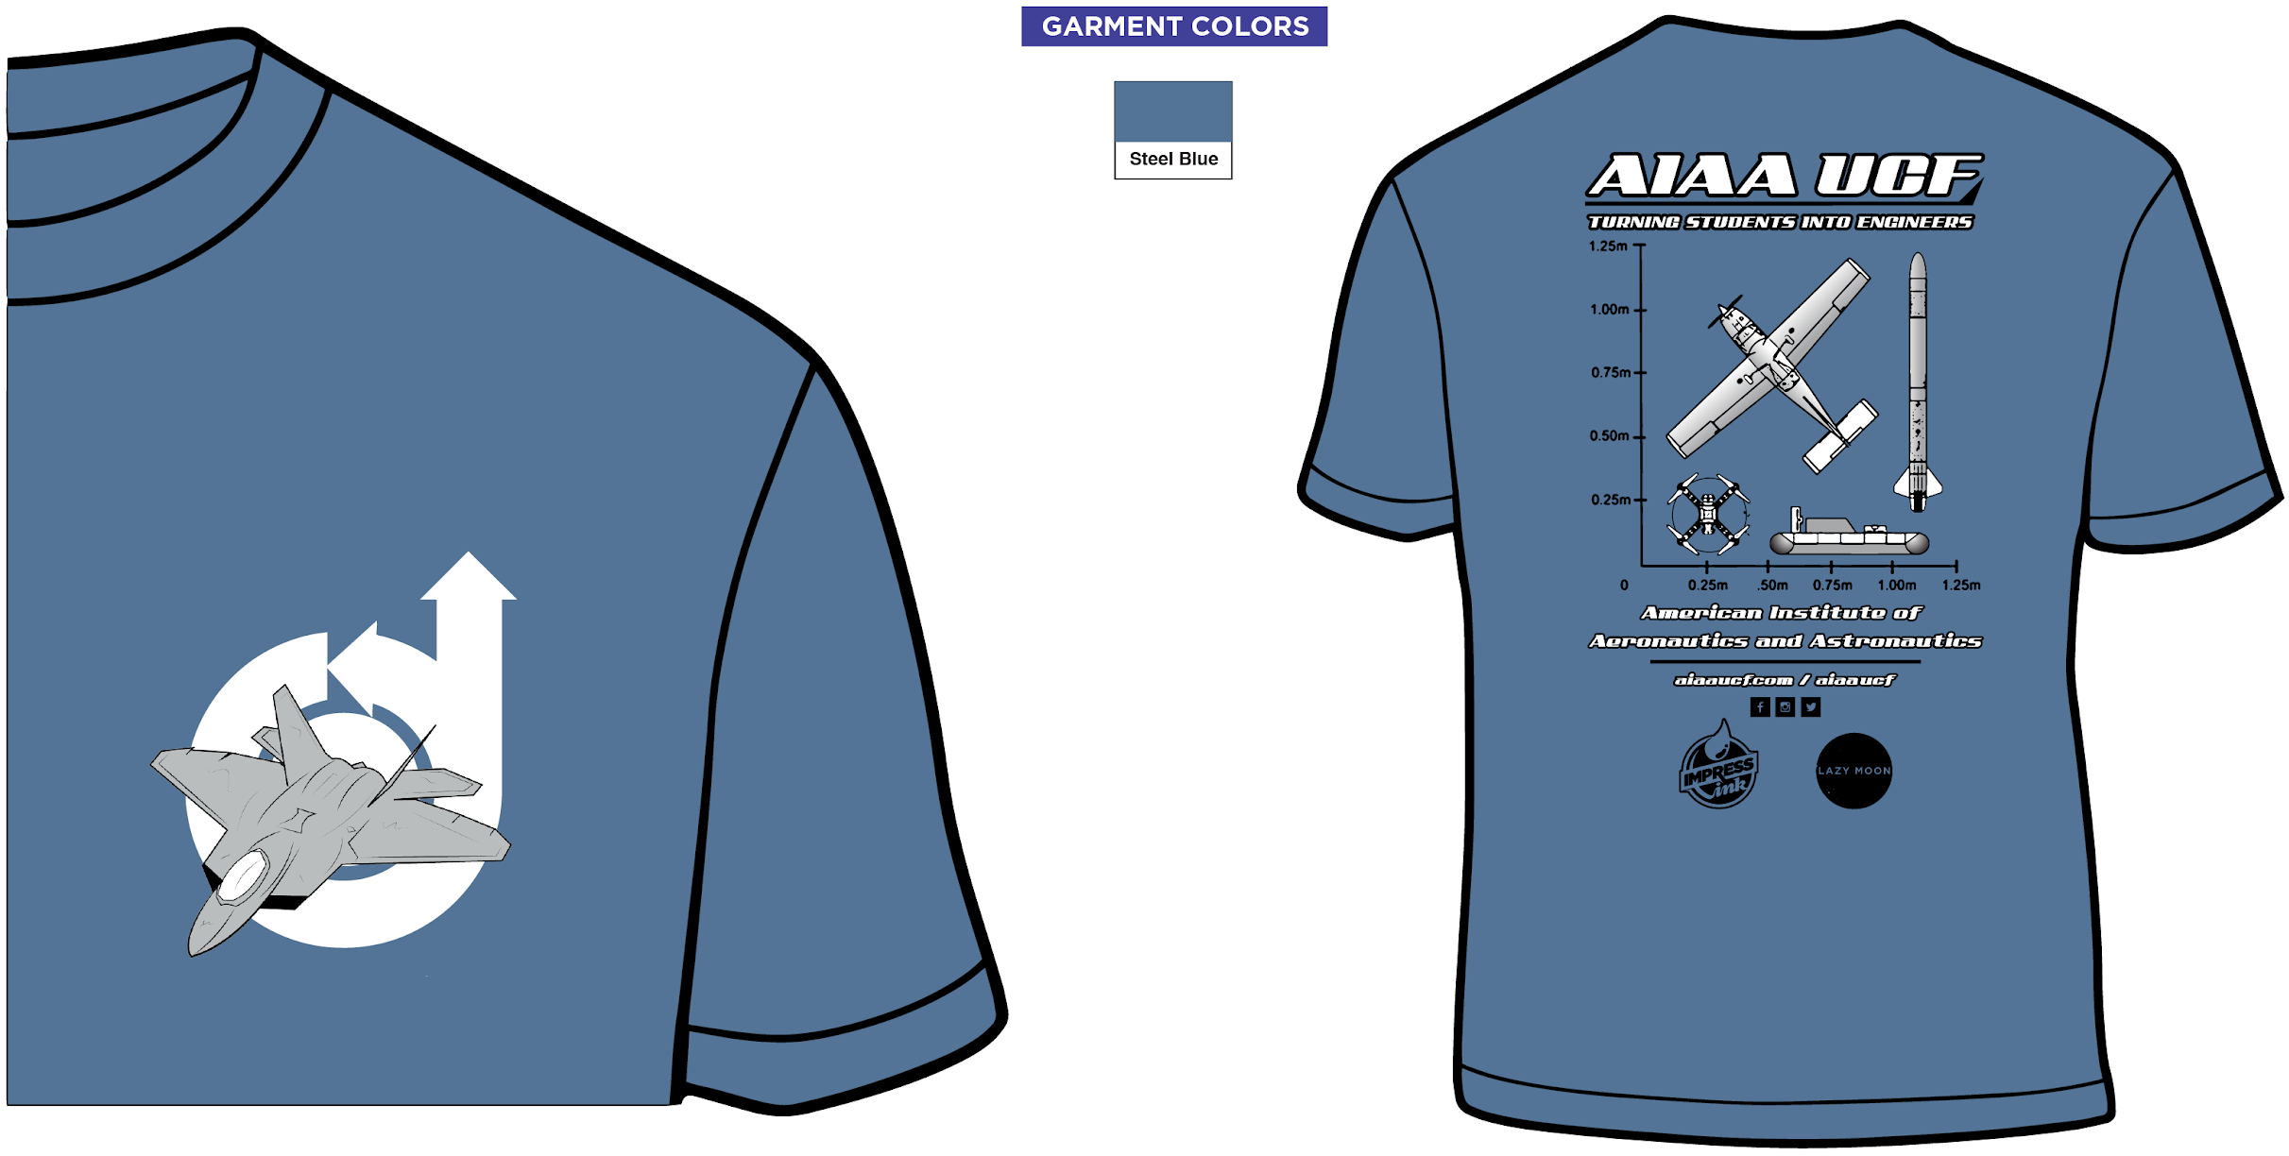
Membership
Membership Dues
Yearly Dues with a shirt: $35
Dues without a shirt: $25
Shirt Sales *while supplies last*
$5
$3
Notes:
Copy this slide to add slides to the presentation.

Slide 11
2019-2020 Officer Applications
https://forms.gle/fhwCVubq2PPASXft8
Or message us for a direct link
Notes:
Copy this slide to add slides to the presentation.

Slide 12
Social Media
AIAA - UCF CHAPTER
@aiaaucf
@AIAAUCF
Follow us on Facebook,
Instagram, and Twitter for the
latest updates, pictures, and
reminders.
DISCORD:
https://discord.gg/k9u43Cn
Join our discord server for project discussion, announcements, information, and updates. (Membership required)
Notes:
Copy this slide to add slides to the presentation.

Slide 13
Notes:
This final slide must at the end of the presentation

Slide 14
Abdiel Santos Galindo
NASA Exploration Ground System’s
Technology Infusion and Innovation Engineer

